Slide 1
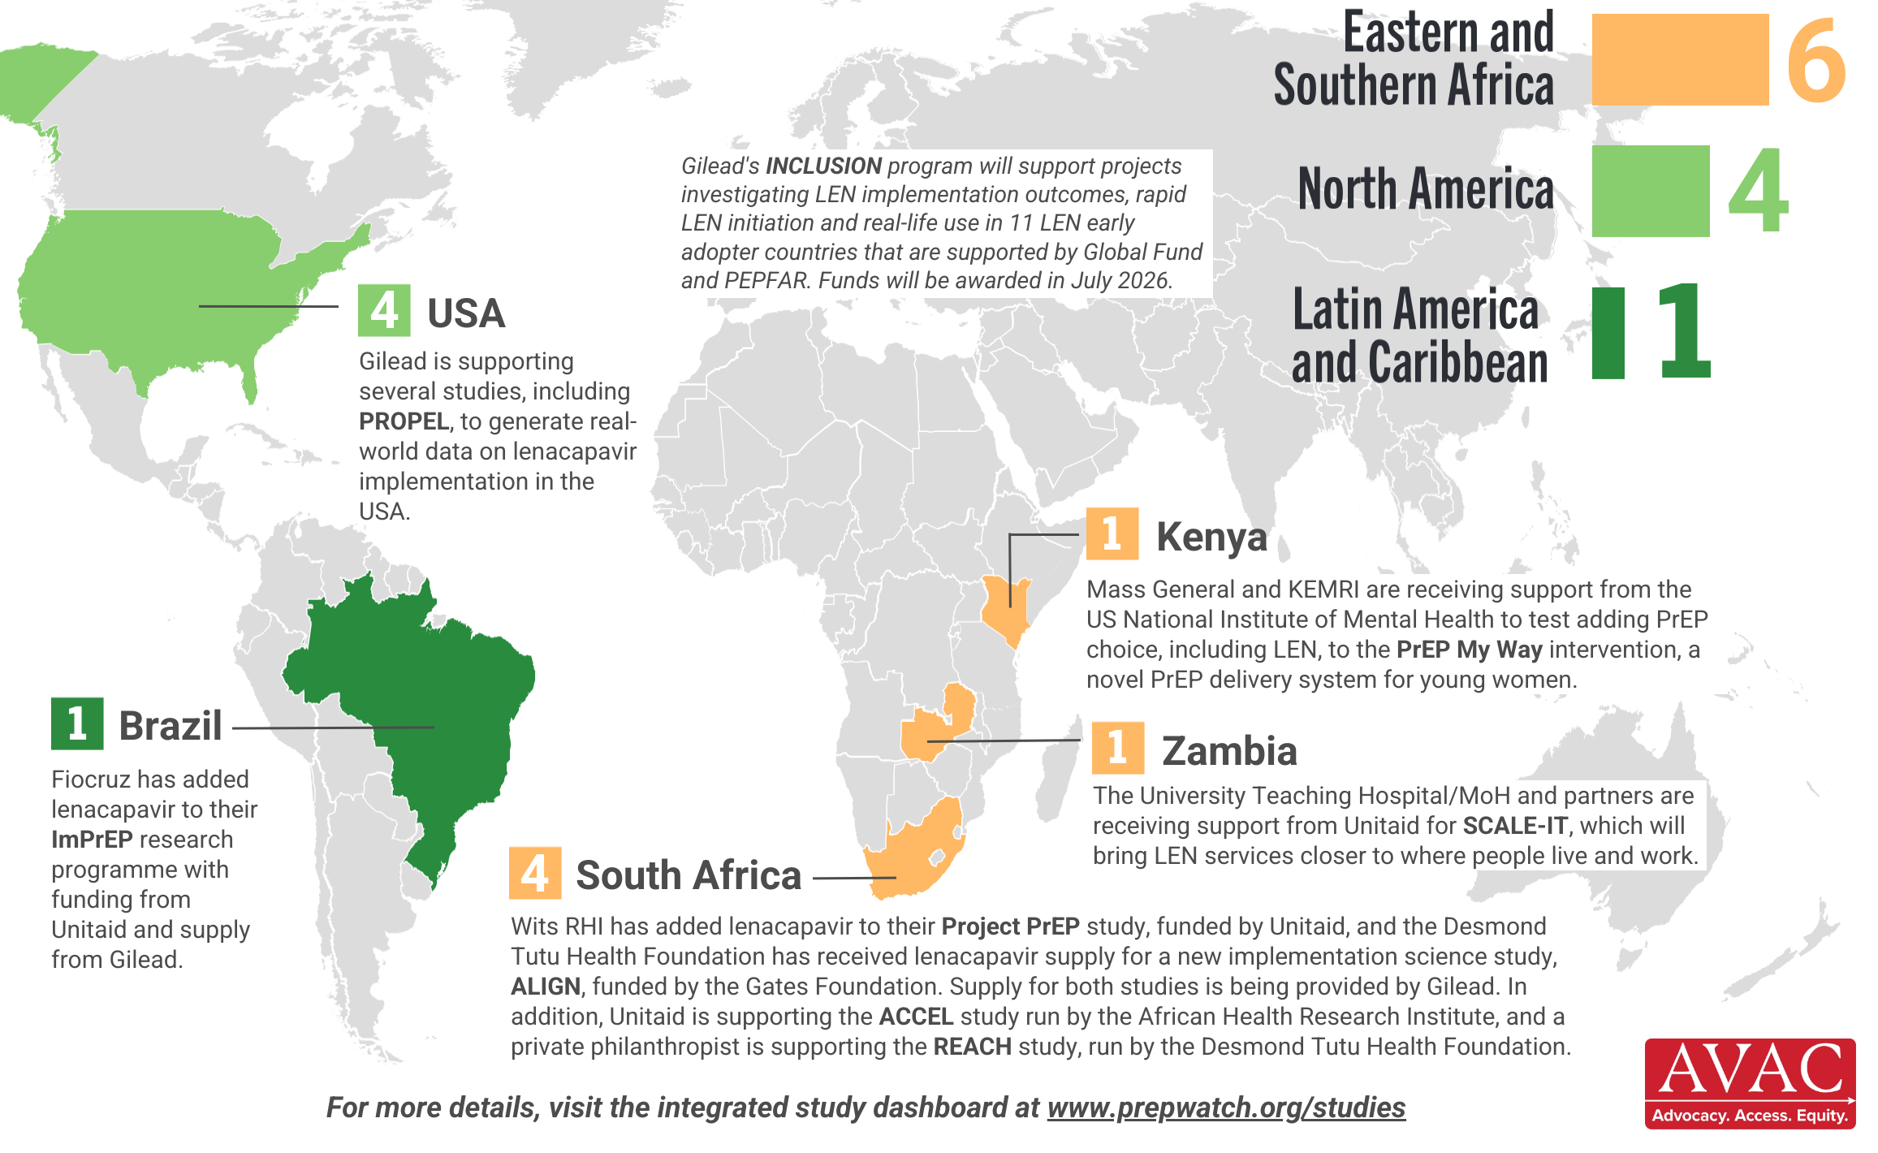
Lenacapavir Implementation Studies
11 studies ongoing for LEN in 5 countries as of April 2026

