Slide 1
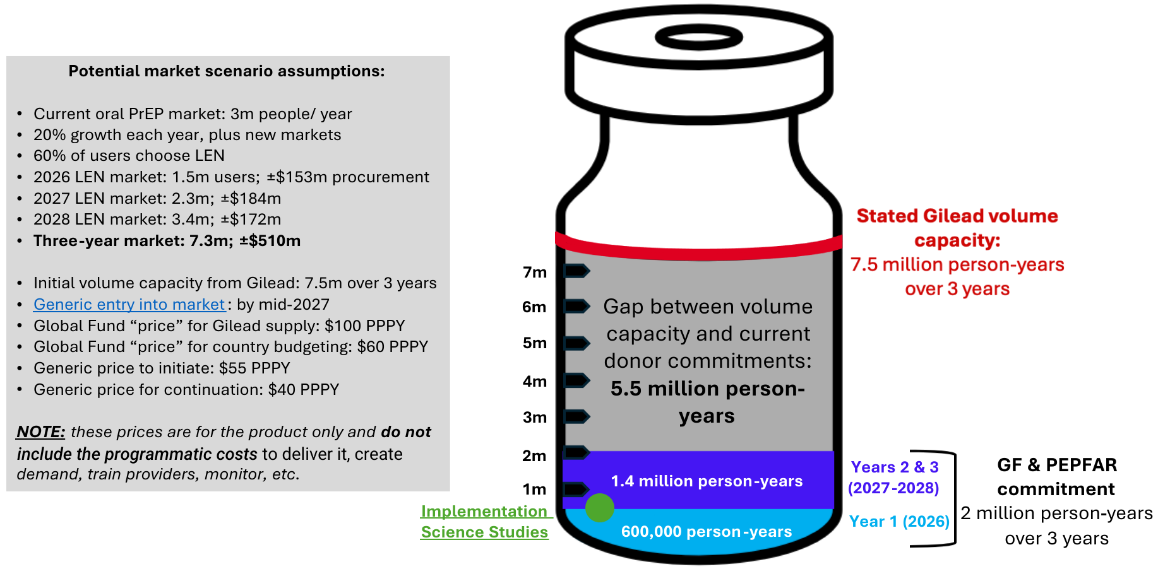
Potential Lenacapavir (LEN) Supply, 2026-28

