Slide 1
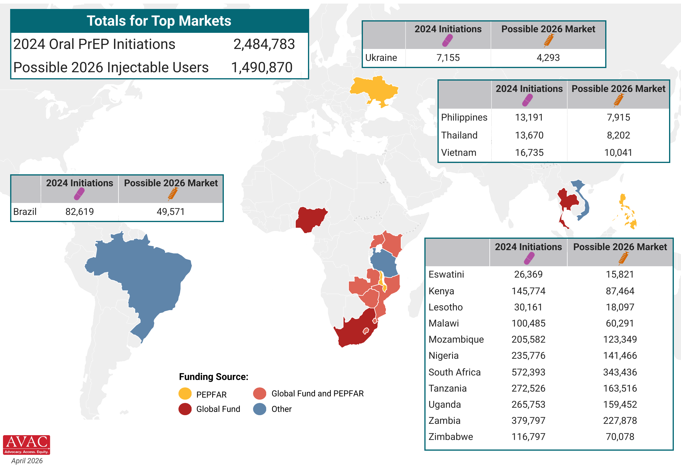
Potential Market of LEN for PrEP
The top 16 PrEP markets, based on 2024 oral PrEP initiations and the possible 2026 injectable market, assuming 60% of new PrEP users choose an injectable, as seen in implementation studies

