Slide 1
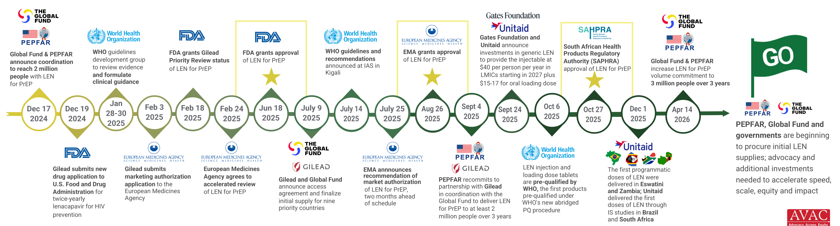
Where We Are Now with LEN for PrEP
Updated July 2026

