Slide 1
AVAC Infographics
HIV Vaccine Awareness Day, 2026

Slide 2
Table of Contents
Preventive Vaccines
  HIV Vaccine Clinical Trials Pipeline
  Preventive Vaccines: People’s Research Agenda
bNAbs
  Broadly Neutralizing Antibodies and HIV
  Broadly Neutralizing Antibody (bNAb) Combinations
HIV Prevention Pipeline
  Years Ahead in HIV Prevention Research: Time to Market
  ARV-Based and MPT R&D Pipeline
  HIV Prevention Pipeline: Products to Watch
  People’s Research Agenda Summary Table
Impact of US Funding Cuts on Research and Programs
  HIV Prevention Pipeline: Impact of USAID & NIH Cuts
  The Cost of Cutting HIV Research
  NIH: Cuts to Clinical Trials

Slide 3
Preventive Vaccines

Slide 4
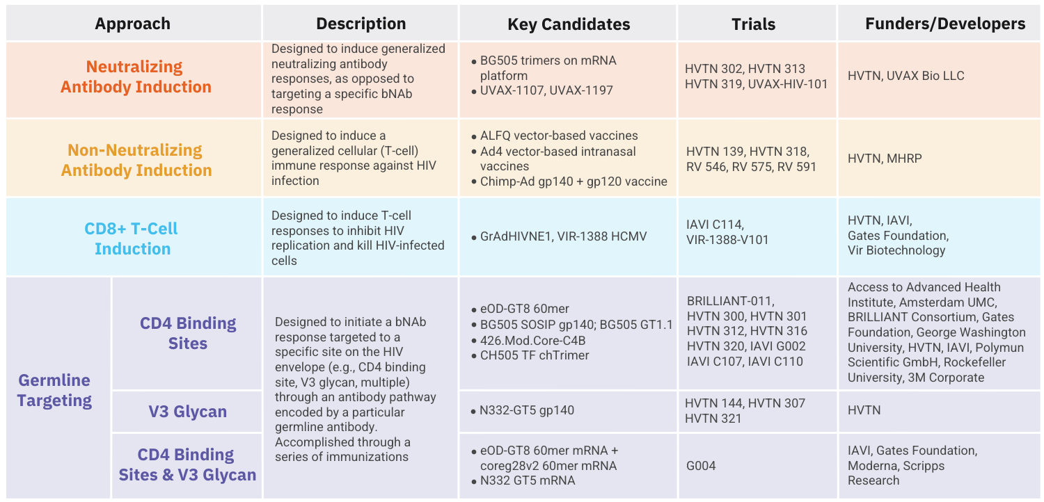
HIV Vaccine Clinical Trials Pipeline
All vaccine candidates shown above are currently in Phase I trials. More details can be found in AVAC's Pipeline Tracker.

Slide 5
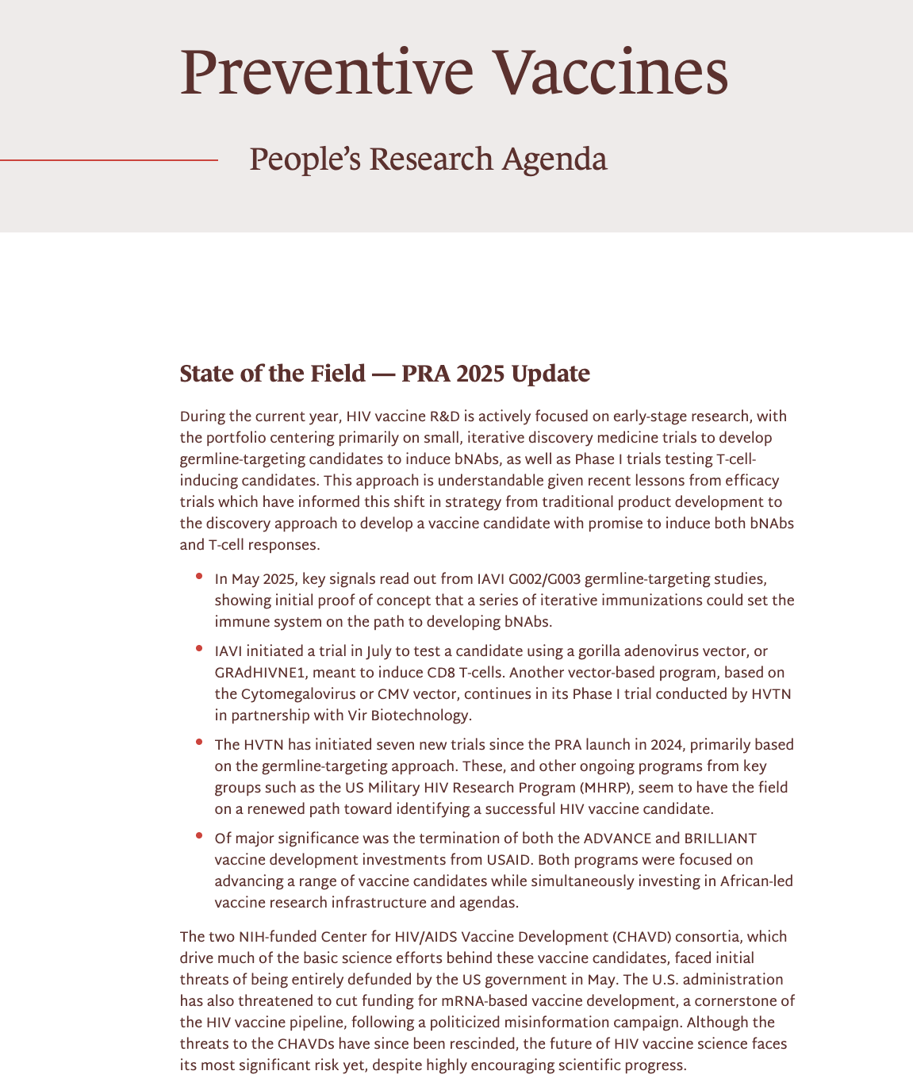
Preventive Vaccines: People’s Research Agenda
Visit https://avac.org/pra2025-preventive-vaccines/

Slide 6
bNAbs

Slide 7
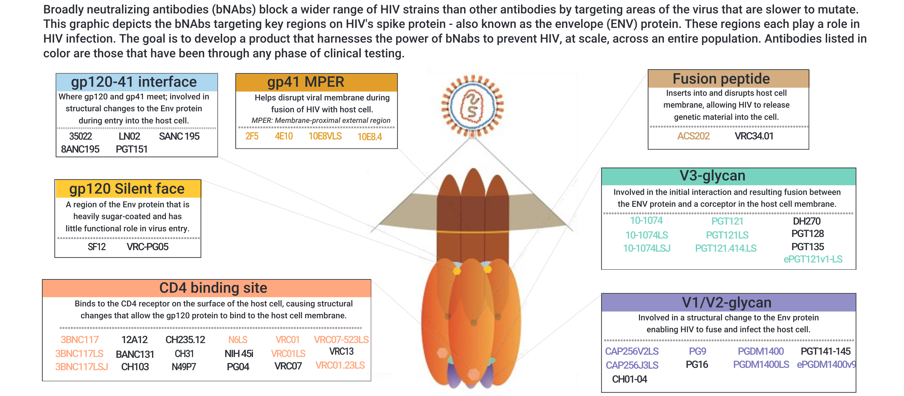
Broadly Neutralizing Antibodies and HIV

Slide 8
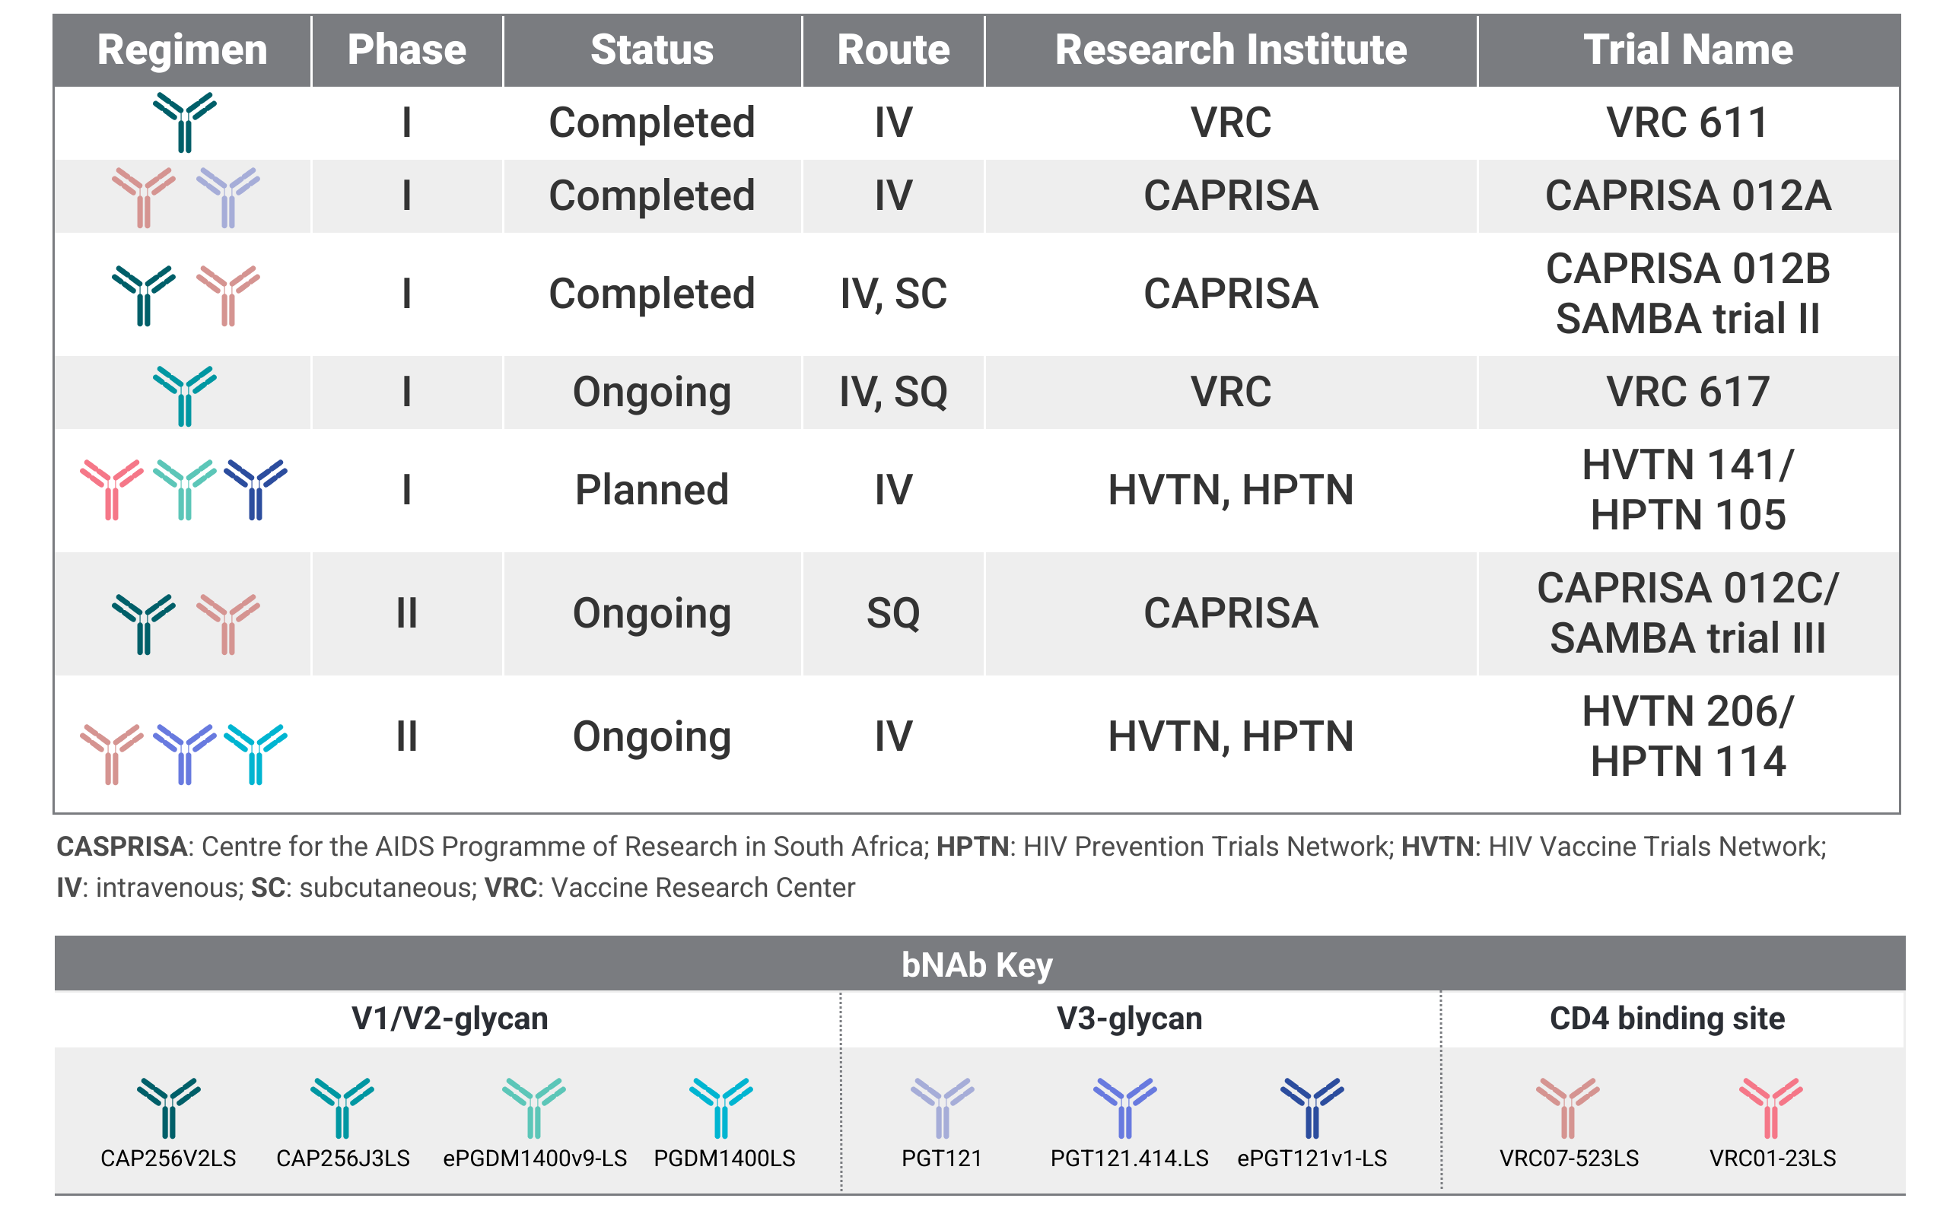
Broadly Neutralizing Antibody (bNAb) Combinations

Slide 9
HIV Prevention Pipeline

Slide 10
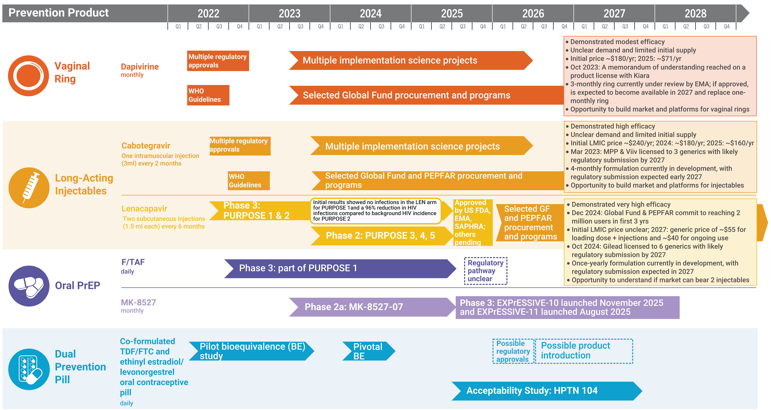
Years Ahead in HIV Prevention Research:
Time to Market

Slide 11
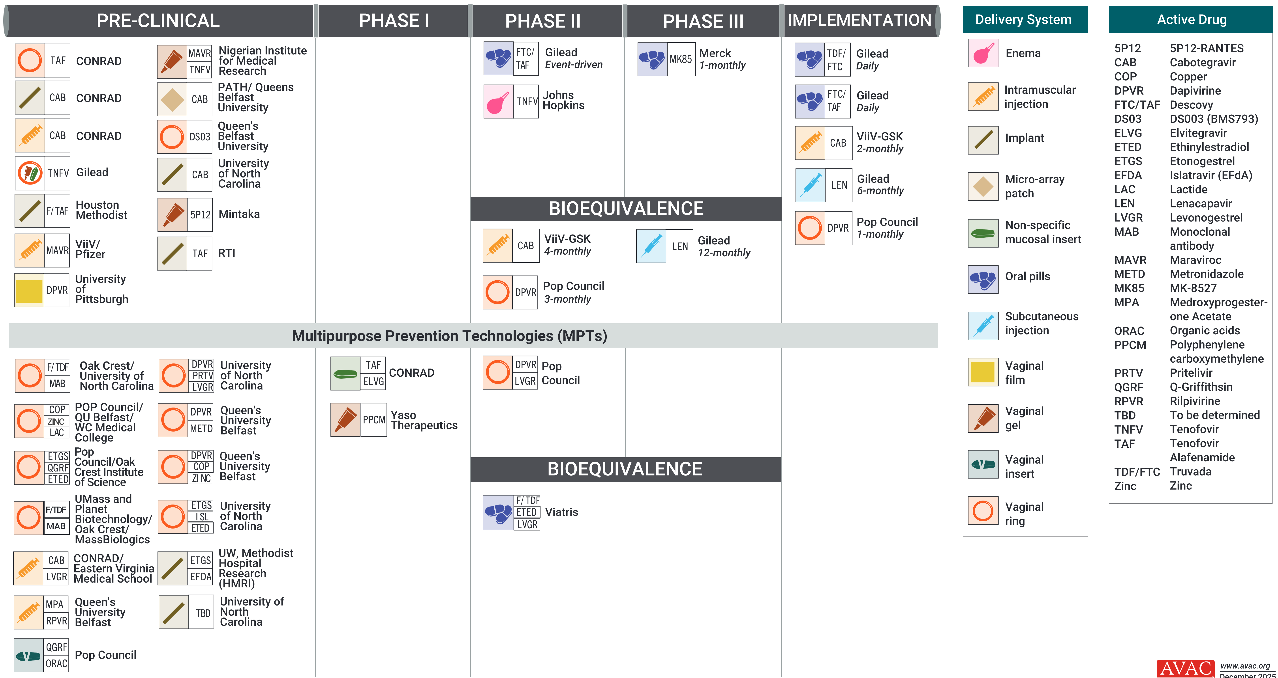
ARV-Based and MPT R&D Pipeline

Slide 12
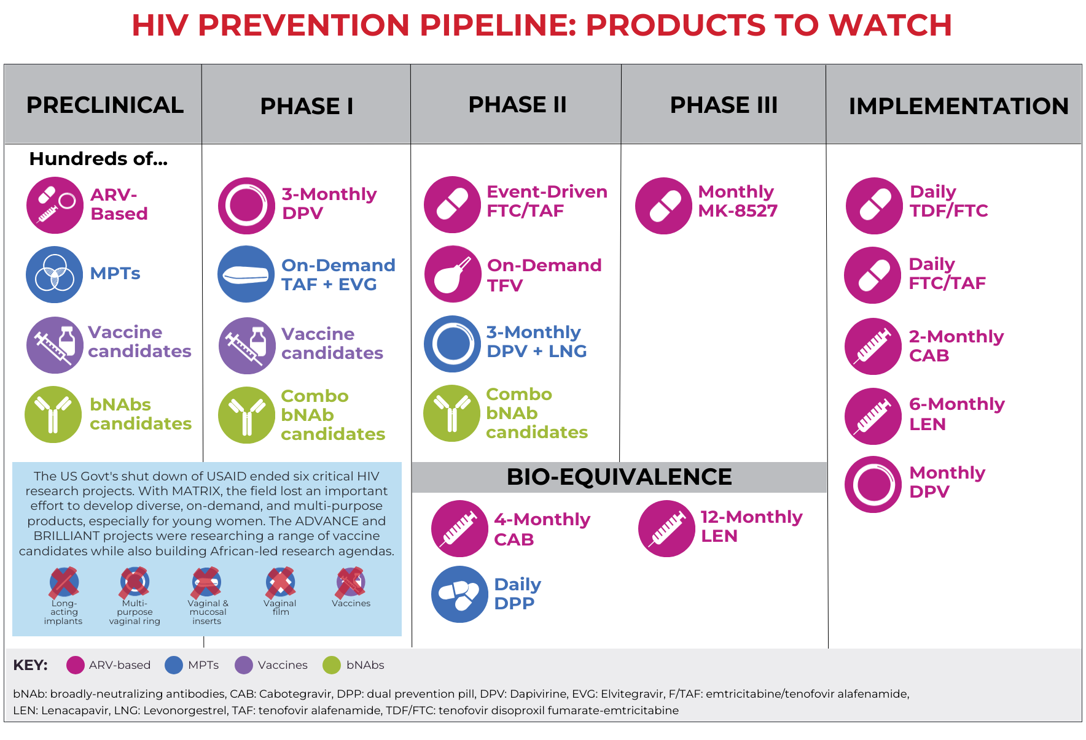
HIV Prevention Pipeline: Products to Watch

Slide 13
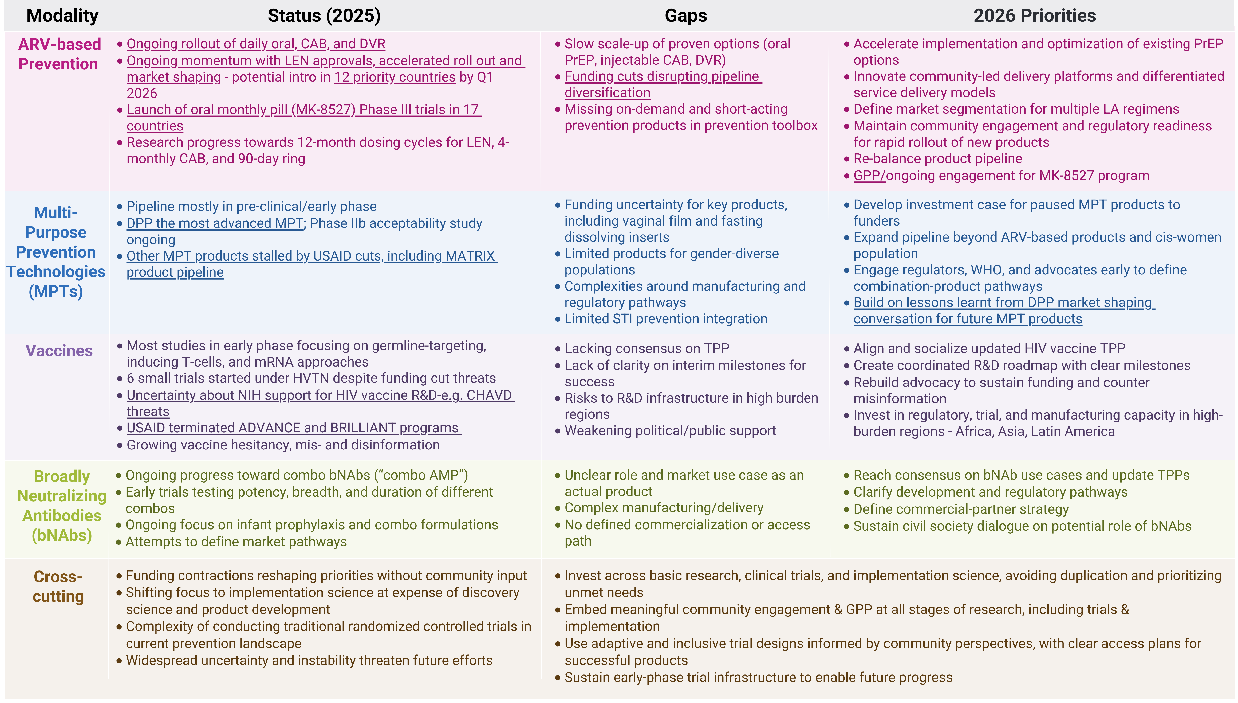
People’s Research Agenda Summary Table

Slide 14
Impact of US Funding Cuts on Research and Programs

Slide 15
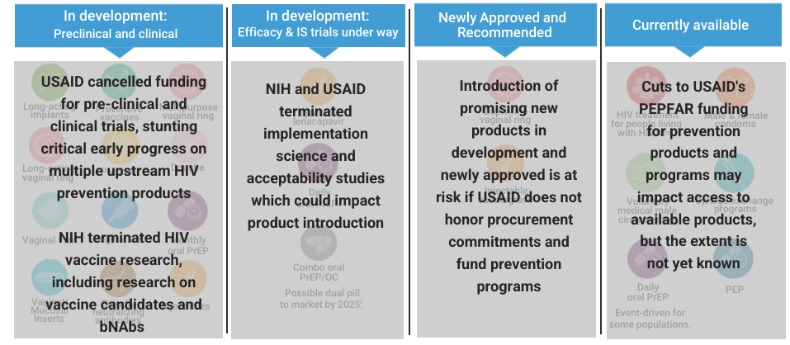
HIV Prevention Pipeline: Impact of USAID & NIH Cuts

Slide 16
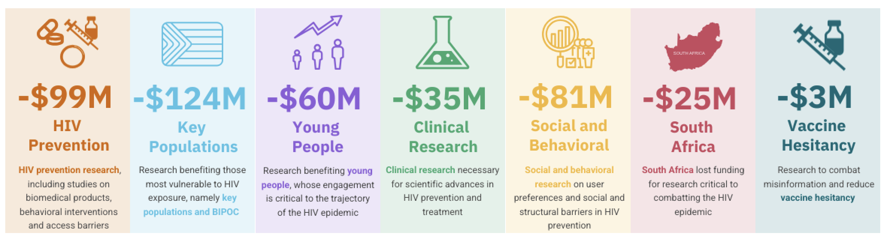
The Cost of Cutting HIV Research
NIH terminated 191 HIV-specific grants in 2025, slashing over $200 million from key HIV prevention research grants¹
¹Grants may cover more than one research area, so total across categories shown here exceeds $200 million in total funding lost

Slide 17
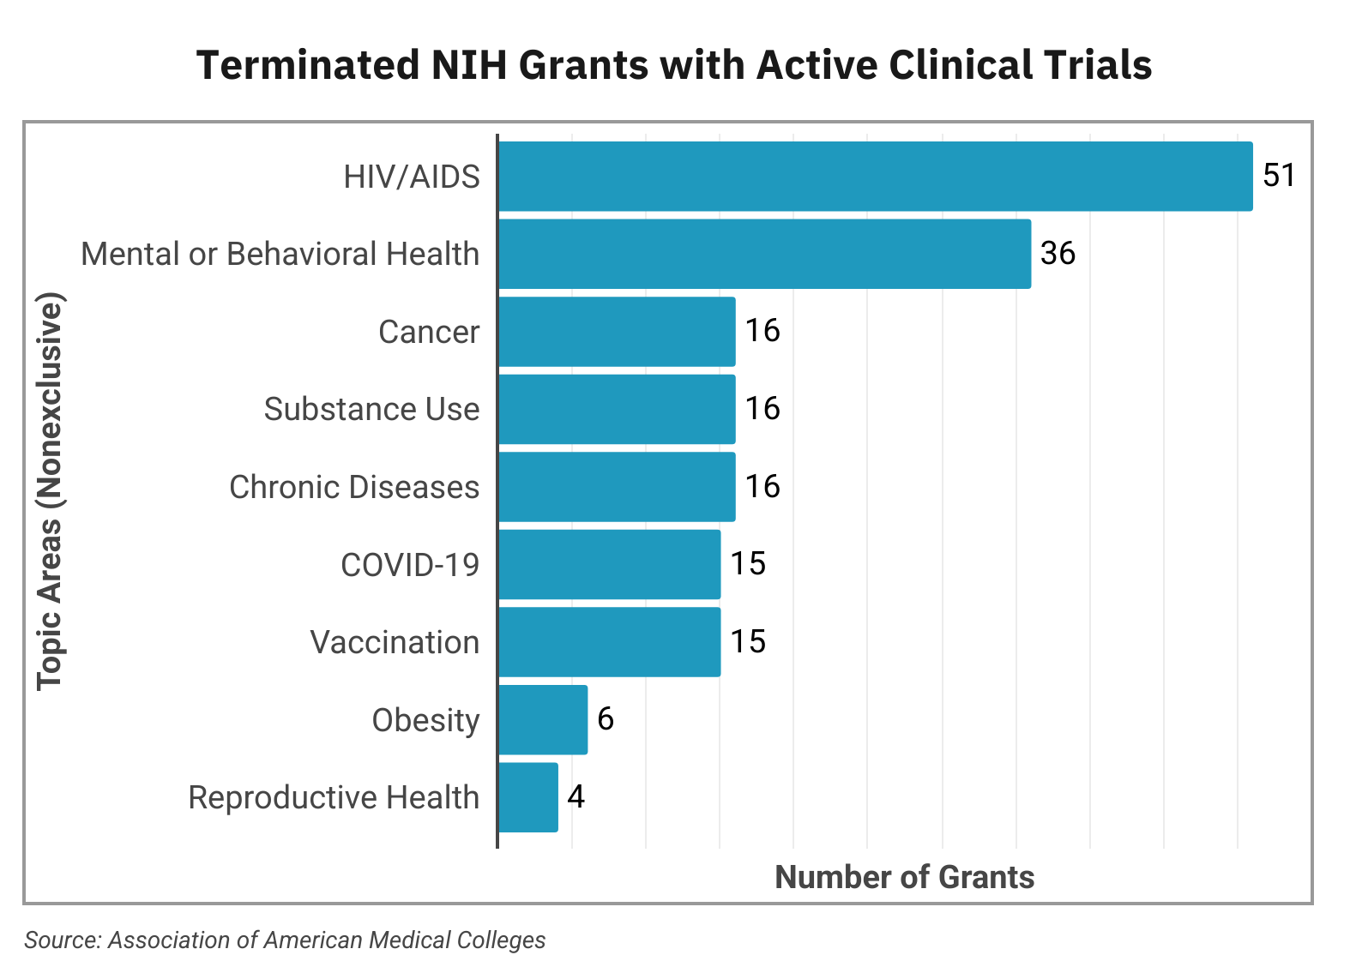
NIH: Cuts to Clinical Trials
Total NIH termination of grants—unprecedented in history of agency
  $19B lost funding = 777 terminated grants
  $643M = 113 active clinical trials terminated
  56% ($~360M) of terminated clinical trials related to HIV

