Slide 1
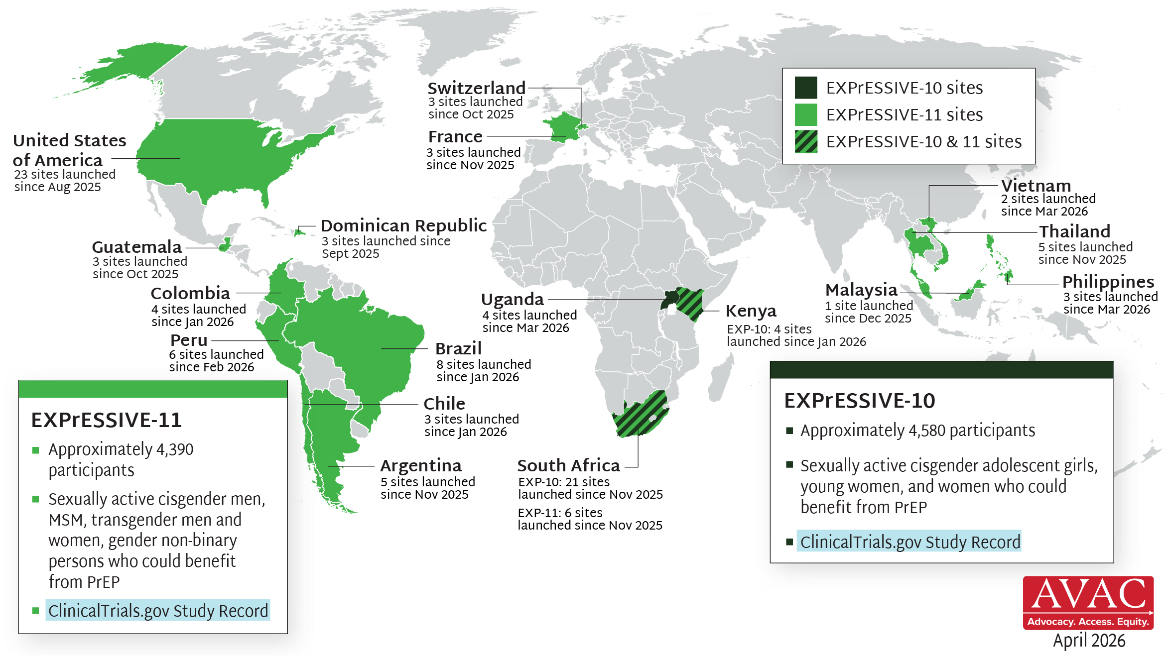
EXPrESSIVE Phase III Program Countries of AMI
17 countries hosting sites for Phase III program of monthly PrEP pill, Alimatravir (AMI); EXPrESSIVE-11 launched Aug 2025; EXPrESSIVE-10 launched Nov 2025

