Slide 1
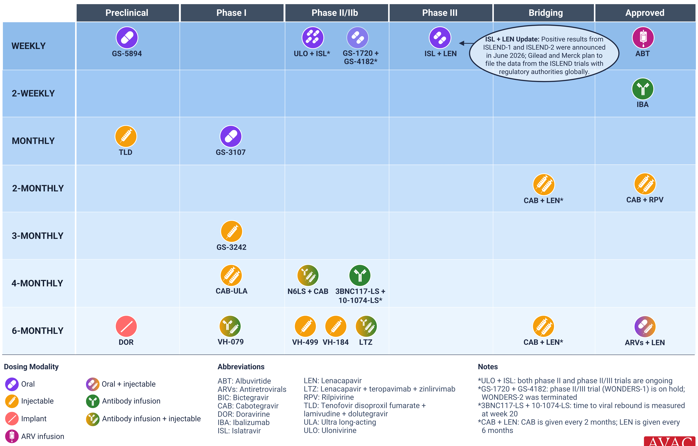
Long-Acting Treatment Pipeline

