Slide 1
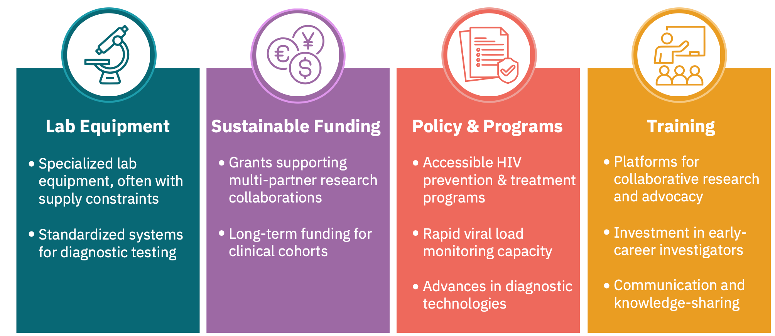
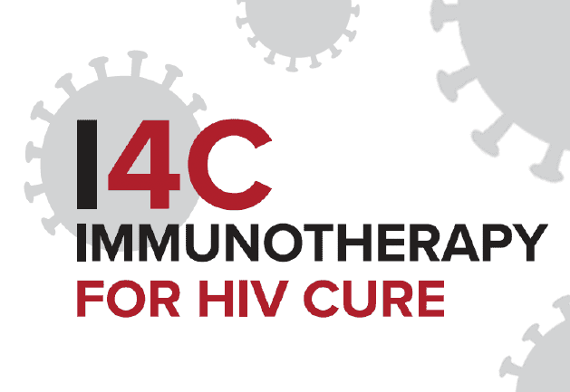
What Does it Take to Conduct HIV Cure Research?
Progress depends on strengthening four critical systems
This graphic was developed using grant funding provided by the National Institutes of Health, grant number UM1AI164556

