Slide 1
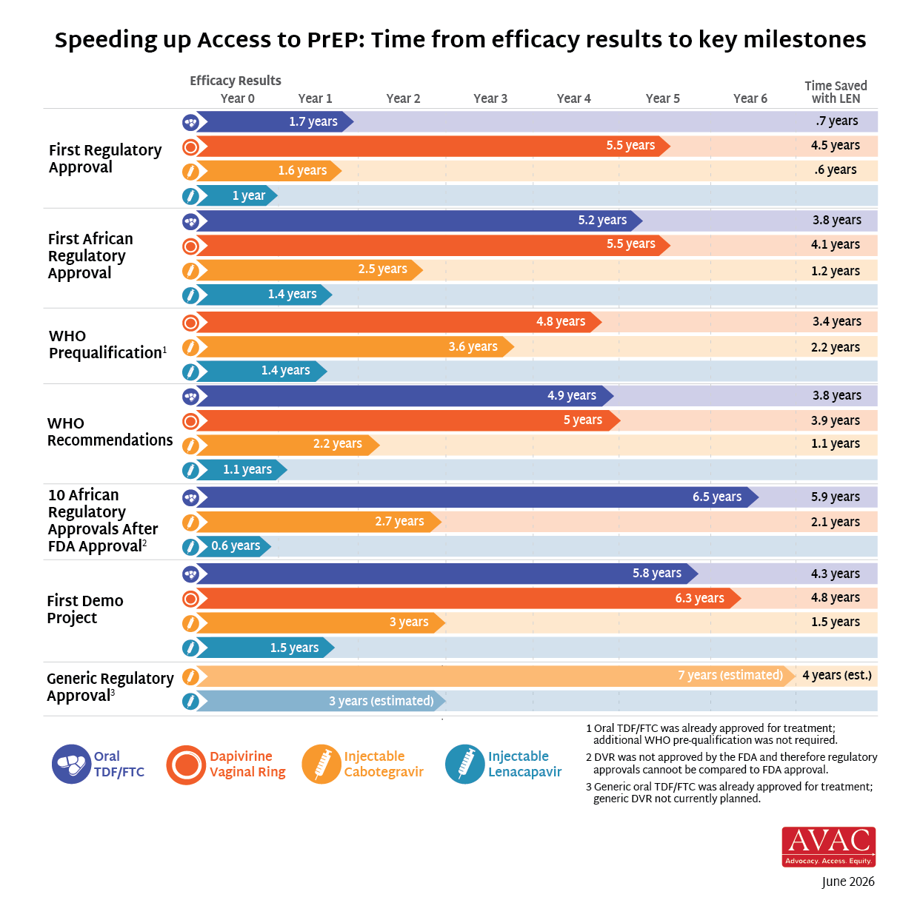
Reducing Time to Impact with LEN

