Slide 1
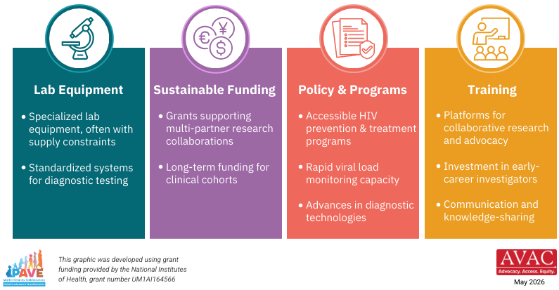
What Does it Take to Conduct HIV Cure Research?
Progress depends on strengthening four critical systems

