Slide 1
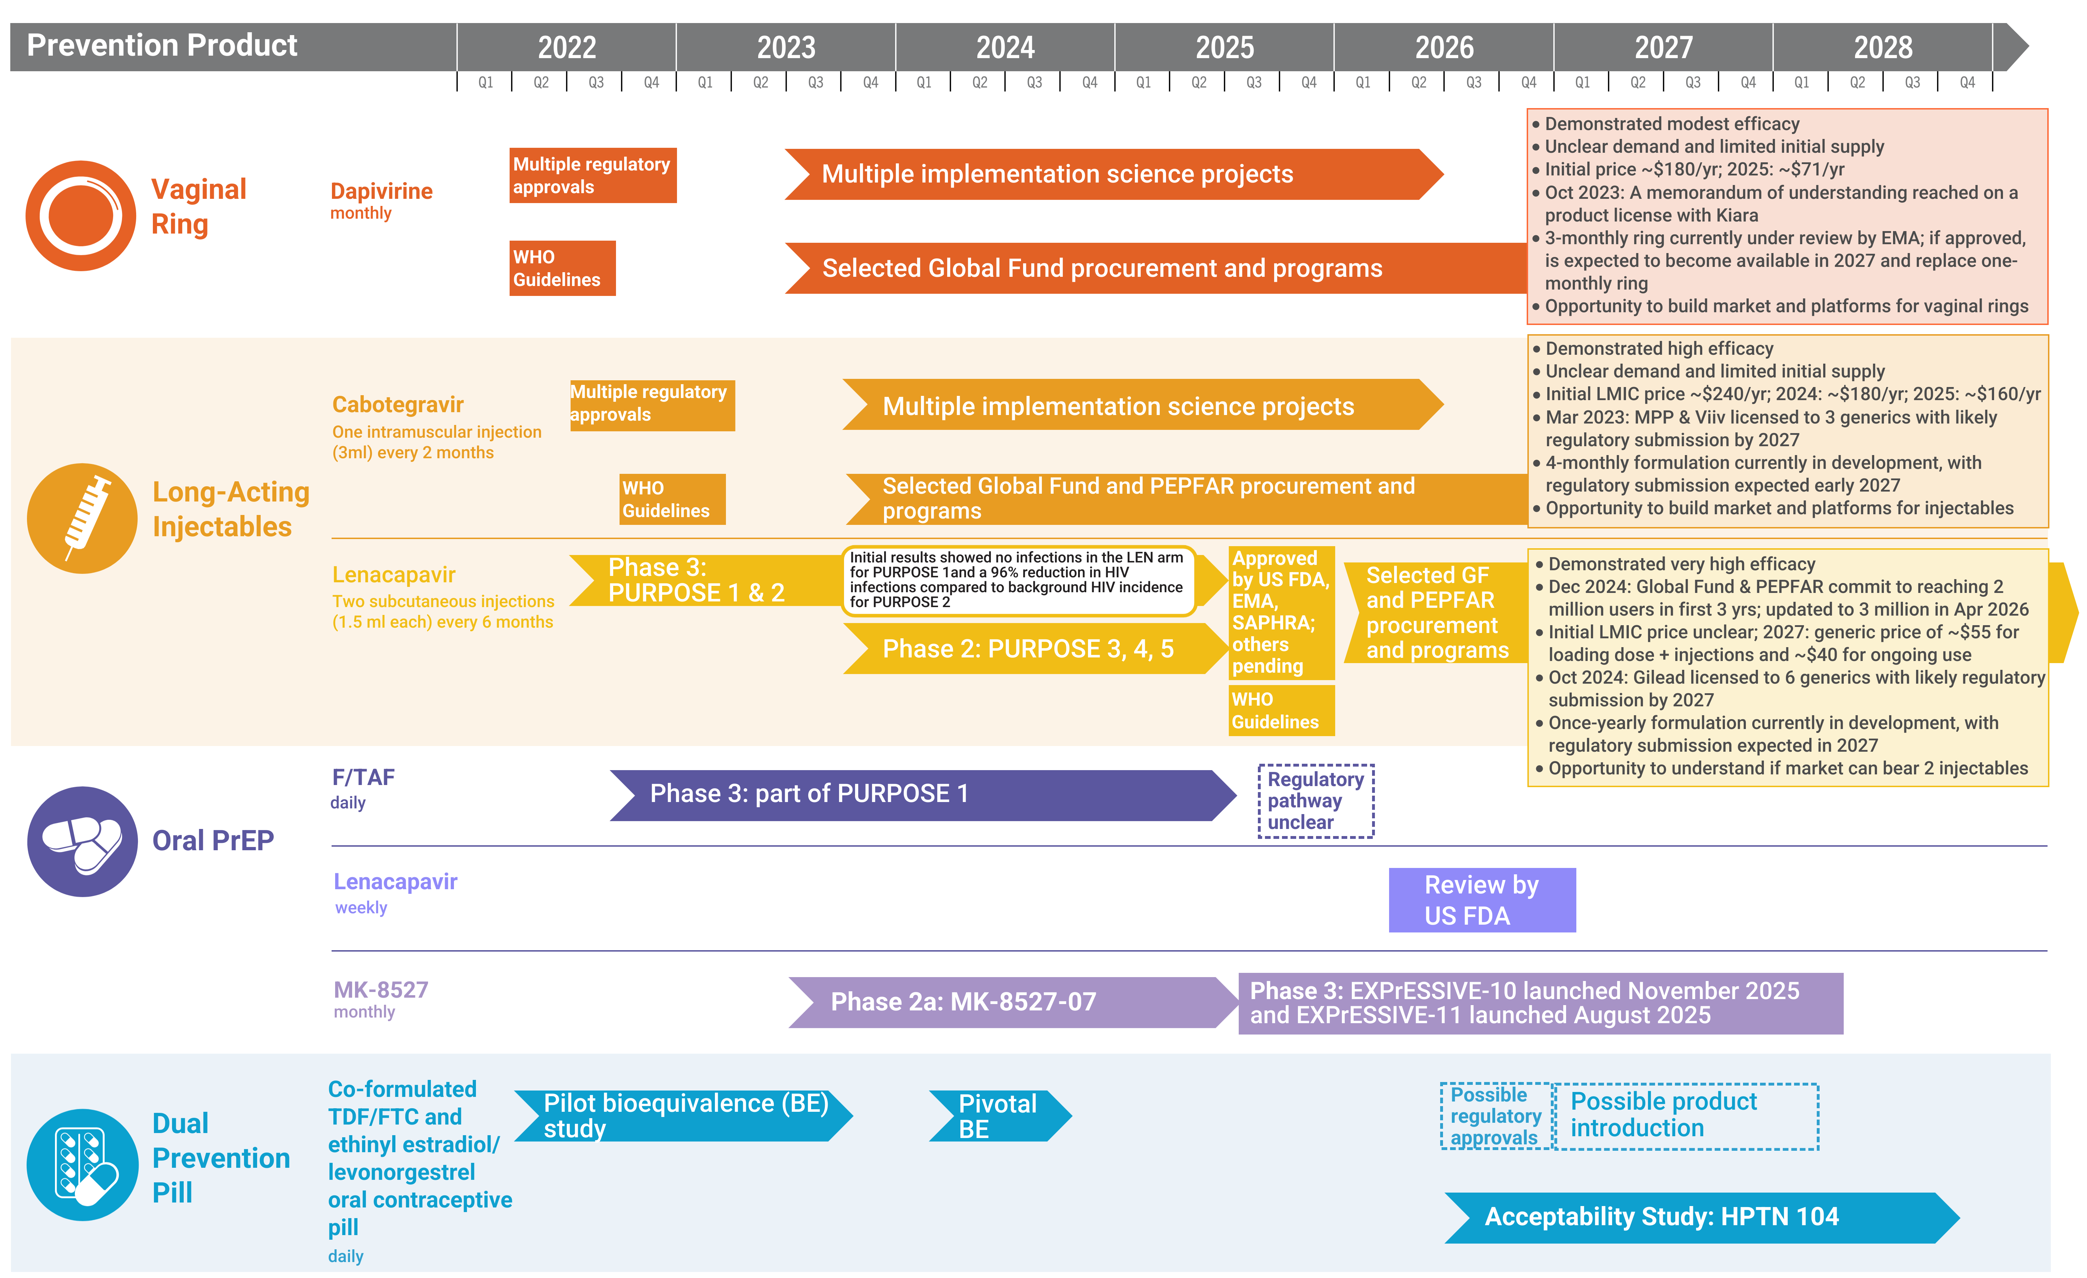
Years Ahead in HIV Prevention Research:
Time to Market

