Slide 1

AVAC’s up-to-date infographics on the research and development pipeline, prevention options, and the impact of US funding cuts—available for use in conference presentations

Slide 2
Table of Contents
HIV Prevention Pipeline
  Years Ahead in HIV Prevention Research: Time to Market
  The HIV Prevention Pipeline
  ARV-Based and MPT R&D Pipeline
  HIV Prevention Pipeline: Products to Watch
  People’s Research Agenda Summary Table
  EXPrESSIVE Phase III Program Countries of MK-8527
PrEP
  Innovation Pile-Up in Next-Generation PrEP
  Speeding Up Access to PrEP
  Learn Lessons, Accelerate Access, Reduce Time to Impact
  PrEP Prices for LMICs
  Where We Are Now with LEN for PrEP
  Lenacapavir Regulatory Approval
  Potential Market of LEN for PrEP
  Potential Lenacapavir (LEN) Supply, 2026-28
  Lenacapavir Implementation Studies
  Lenacapavir for PrEP Rollout
  Cabotegravir Implementation
  Overview of Lenacapavir Trials

Slide 3
Table of Contents (cont.)
MPTs & STIs
  MPT R&D Pipeline
  Spotlight on MPTs Addressing STIs
  Current Status of STI Vaccine Development
Preventive Vaccines
  HIV Vaccine Clinical Trials Pipeline
  HIV Vaccine & Efficacy Trials to Date
  Discovery Medicine for HIV Vaccines
bNAbs
  Broadly Neutralizing Antibodies and HIV
  Broadly Neutralizing Antibody (bNAb) Combinations
HIV Treatment
  Long-Acting HIV Treatment Pipeline
HIV Cure
  What Does it Take to Conduct HIV Cure Research?
  HIV Cure Research Cohorts (link TK)
PEPFAR Data Release - April 2026
  Decline in PEPFAR Supported PrEP Initiations
Impact of US Funding Cuts on Research and Programs
  HIV Prevention Pipeline: Impact of USAID & NIH Cuts
  The Cost of Cutting HIV Research
  NIH: Cuts to Clinical Trials
  PrEP Delivery Imperiled
  Impact of US Funding on Services for Key Populations
  Change in PrEP Initiations

Slide 4
HIV Prevention Pipeline

Slide 5
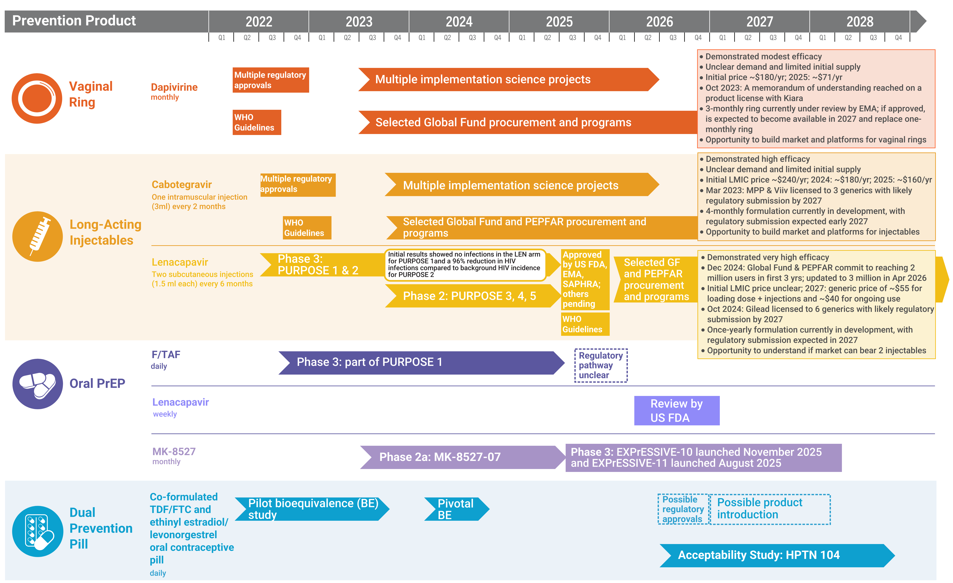
Years Ahead in HIV Prevention Research:
Time to Market

Slide 6
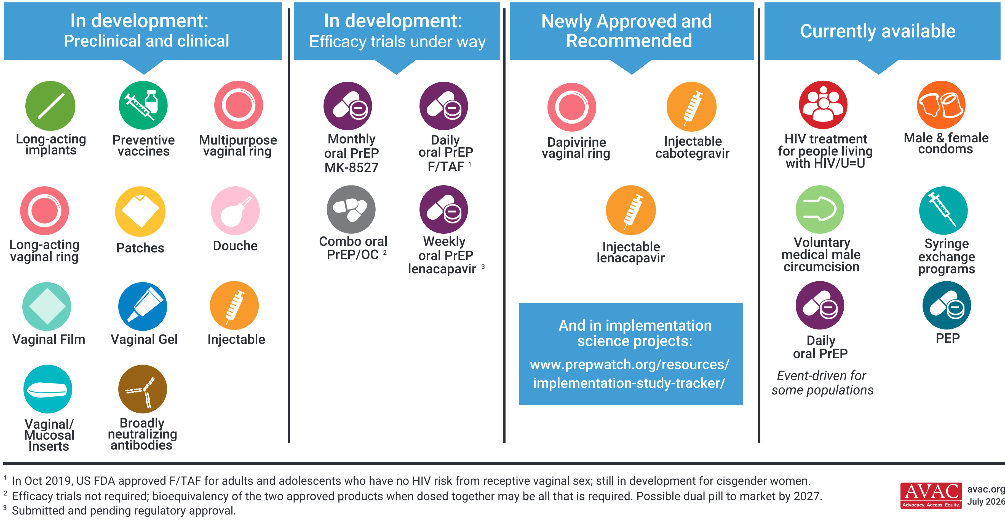
The HIV Prevention Pipeline

Slide 7
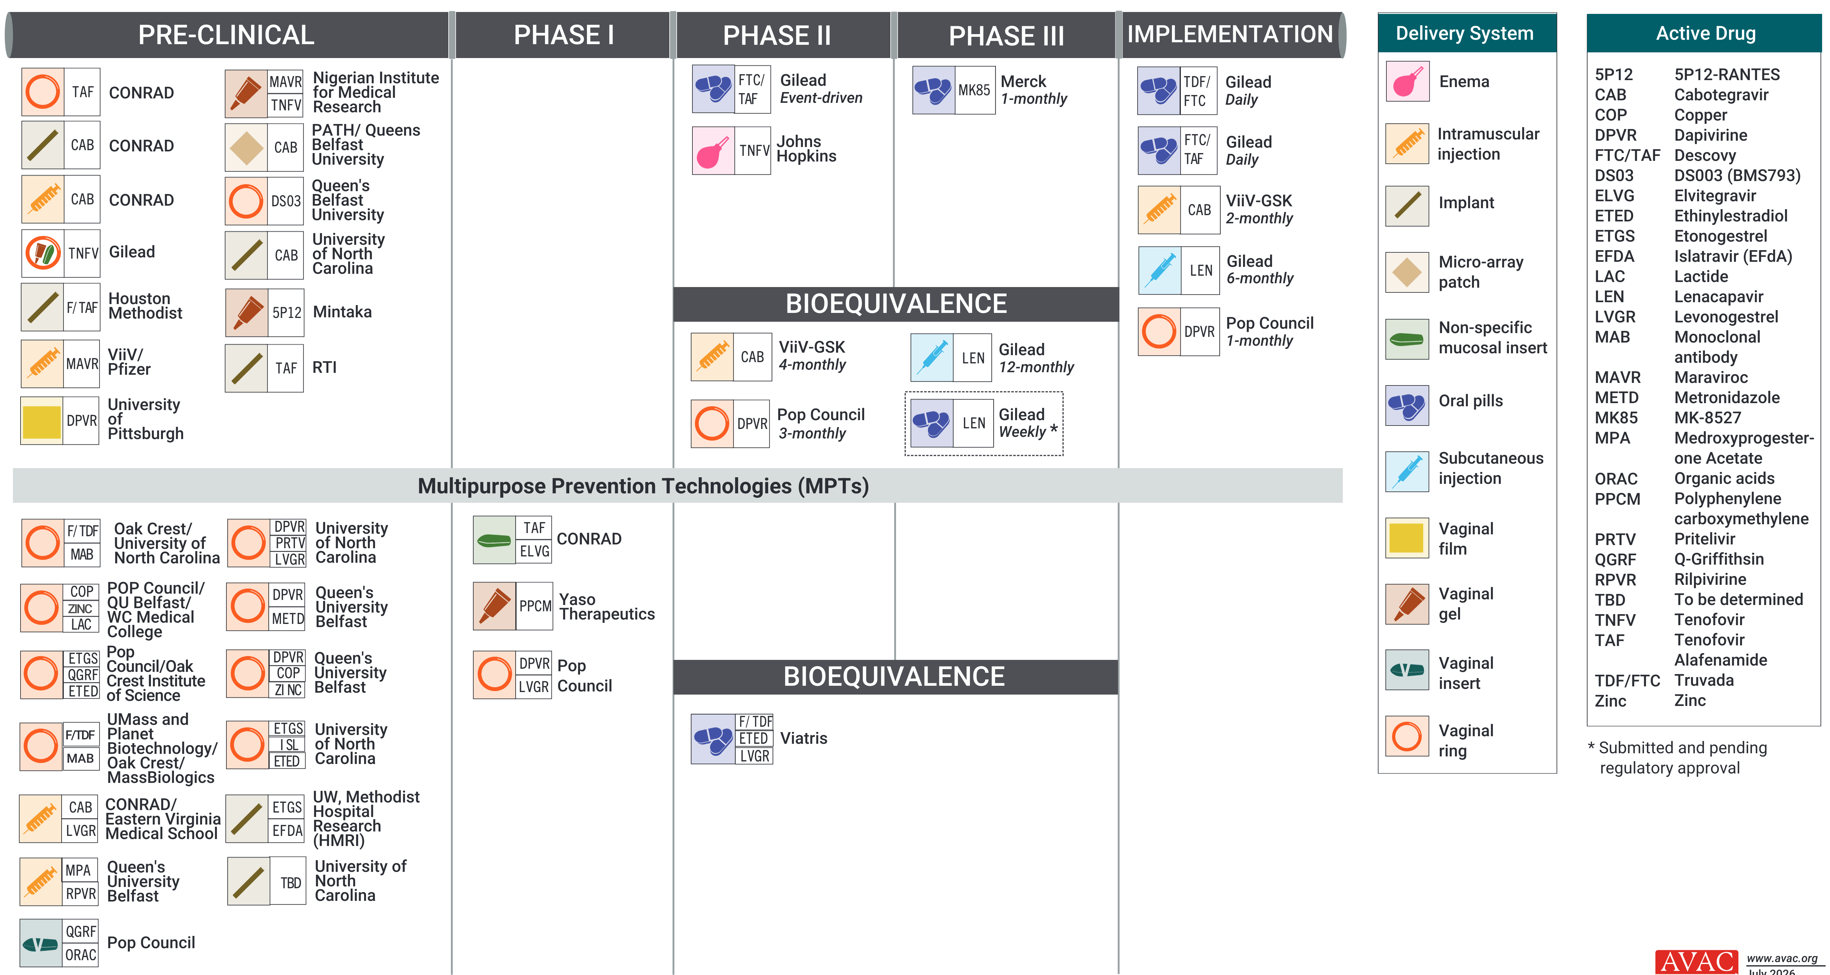
ARV-Based and MPT R&D Pipeline

Slide 8
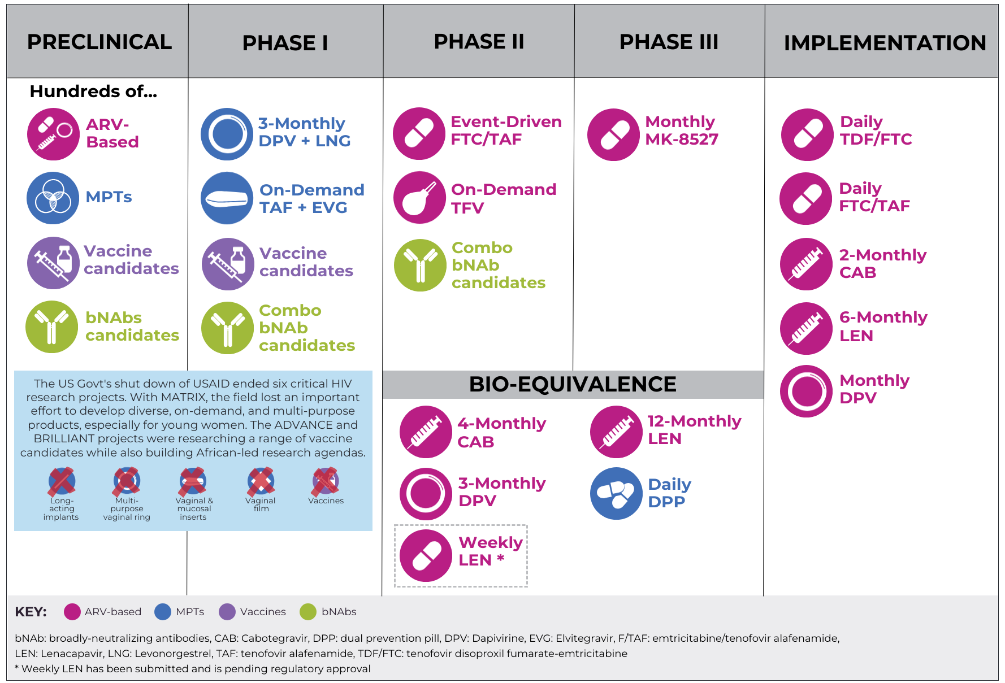
HIV Prevention Pipeline: Products to Watch

Slide 9
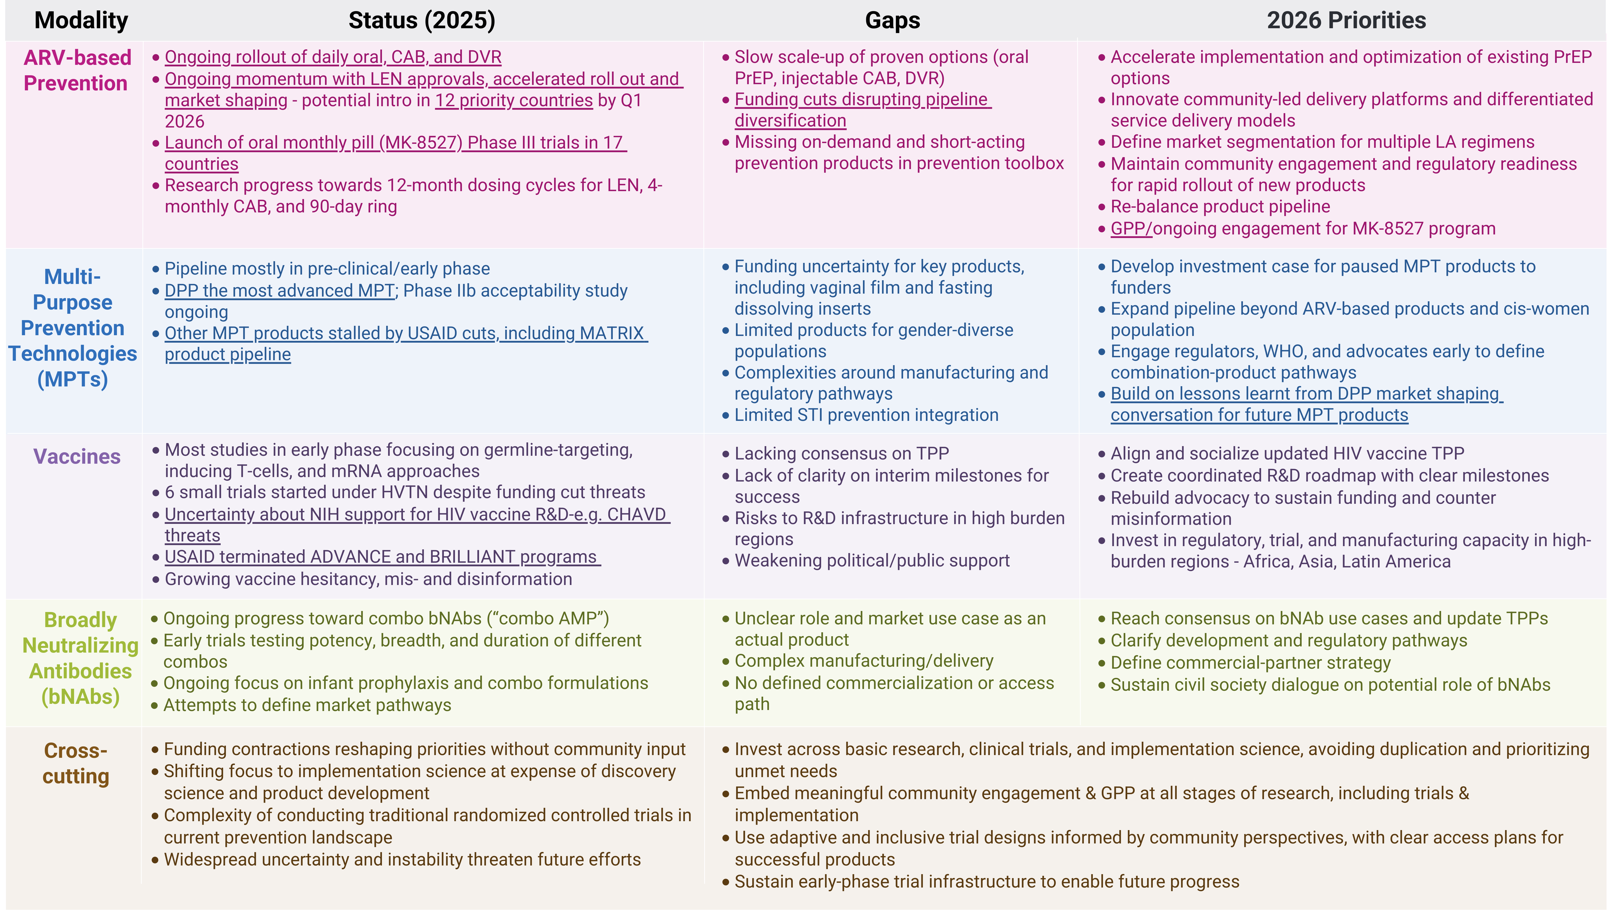
People’s Research Agenda Summary Table

Slide 10
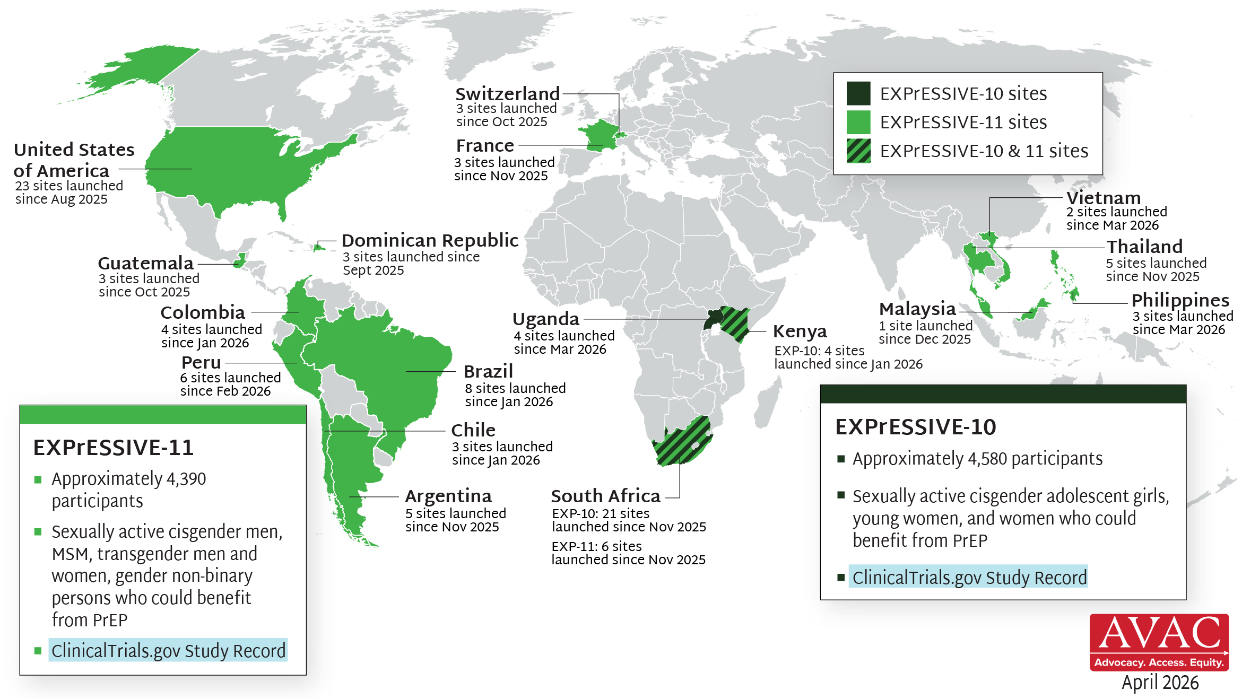
EXPrESSIVE Phase III Program Countries of MK-8527
17 countries hosting sites for Phase III program of monthly PrEP pill, MK-8527; EXPrESSIVE-11 launched Aug 2025; EXPrESSIVE-10 launched Nov 2025

Slide 11
PrEP

Slide 12
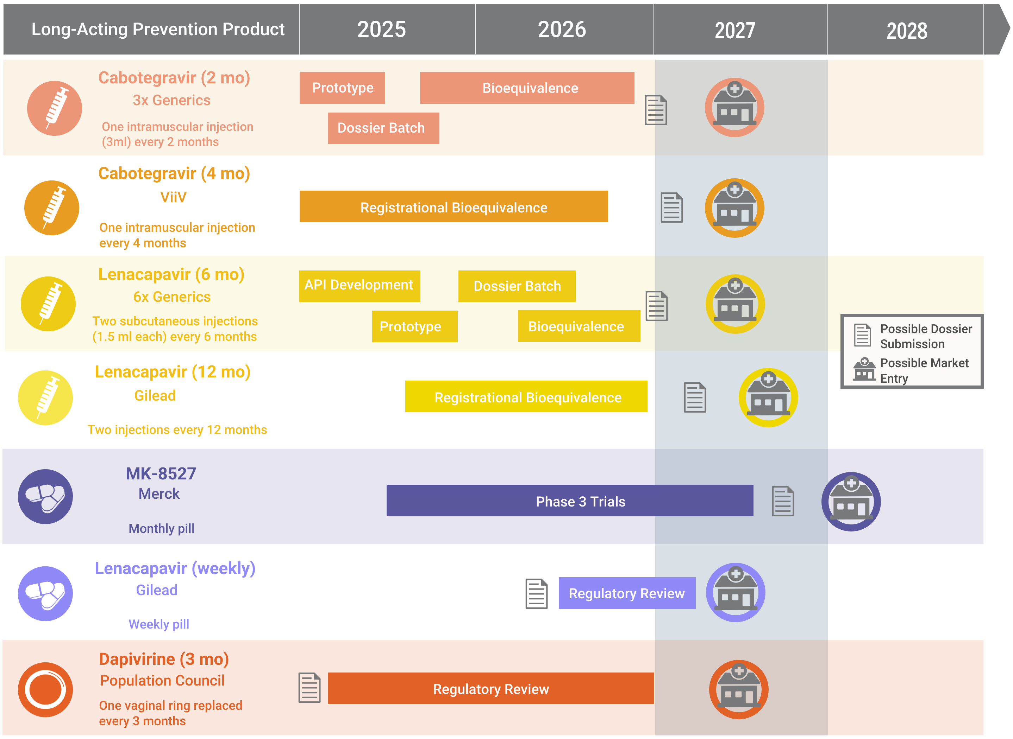
Innovation Pile-Up in Next-Generation PrEP

Slide 13
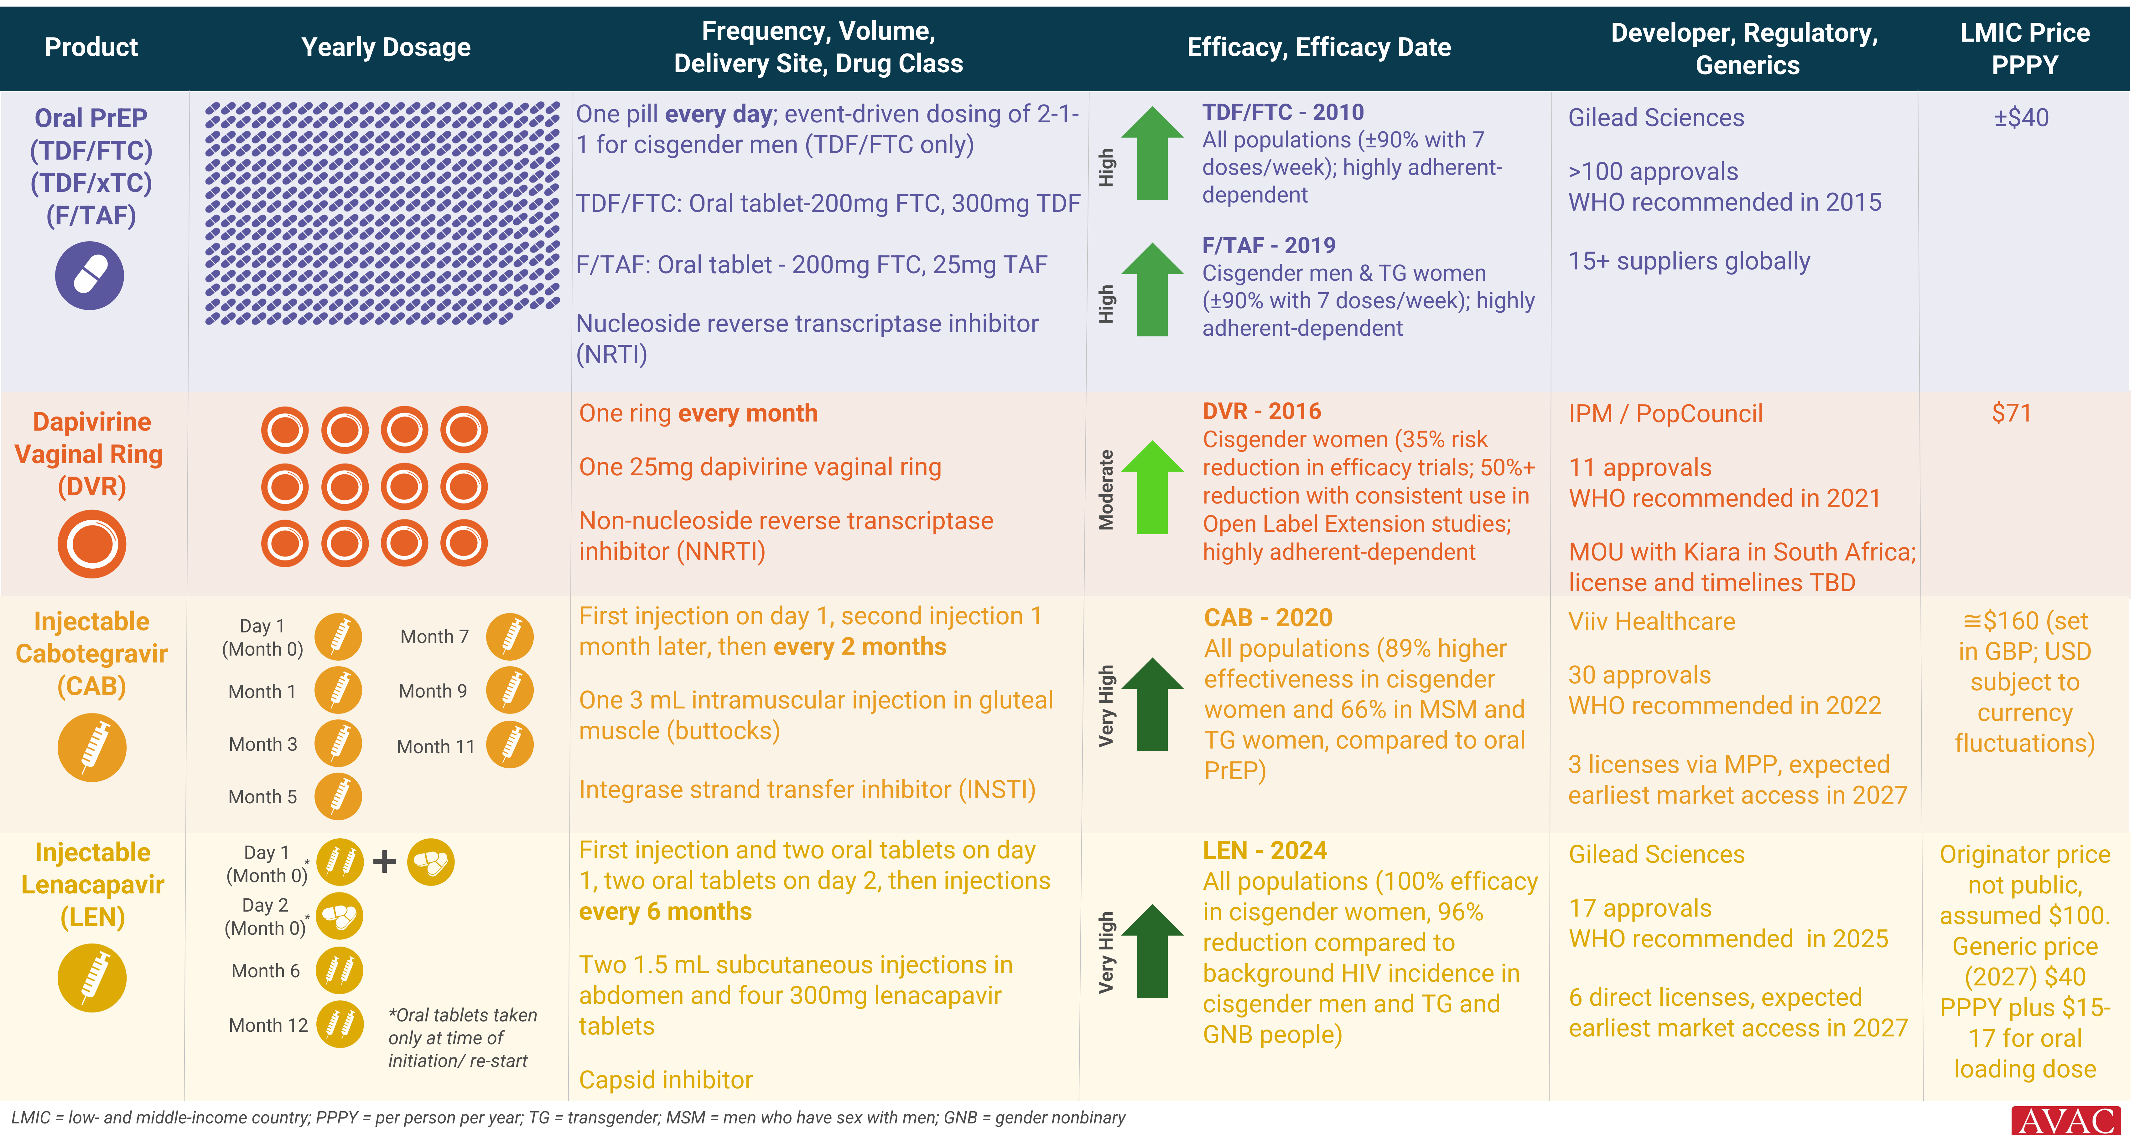
HIV Prevention Product Overview

Slide 14
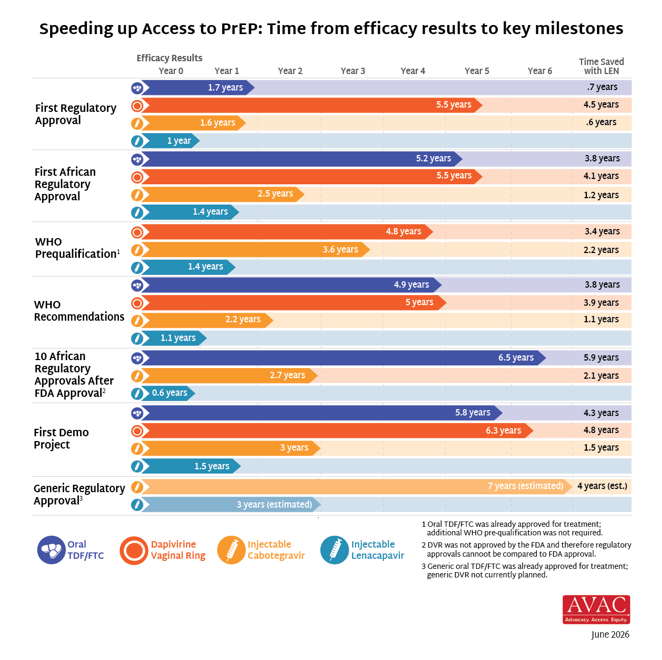
Reducing Time to Impact with LEN

Slide 15
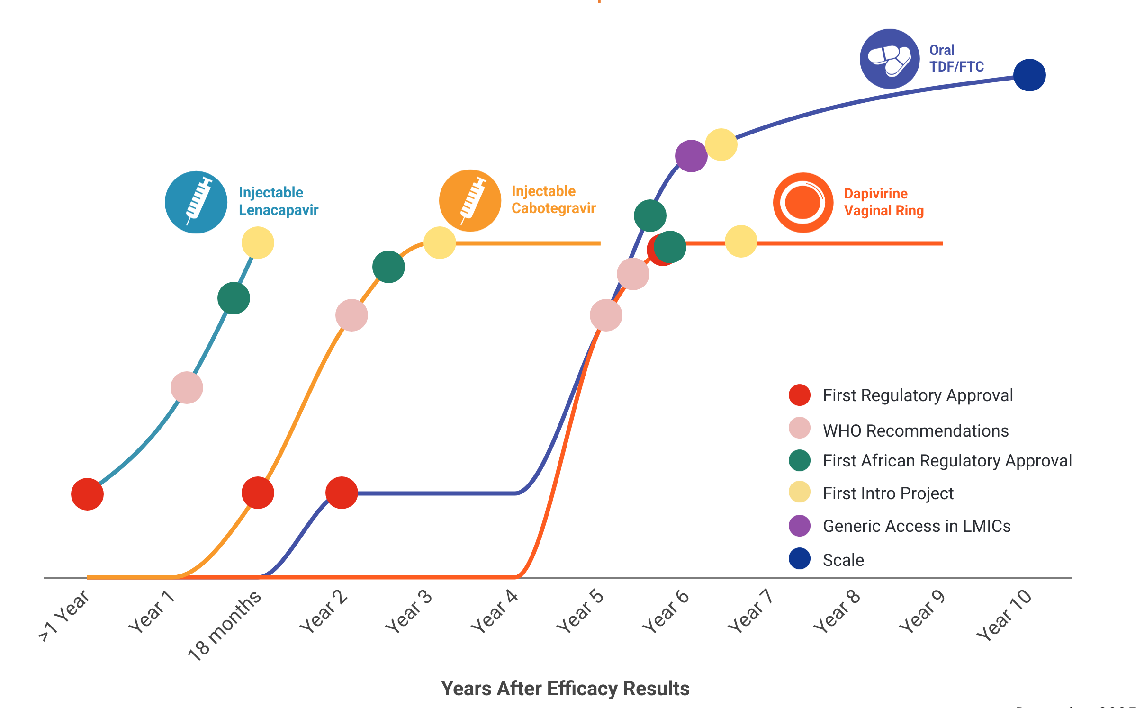
Can We Go Faster?
Learning Lessons, Accelerating Access, Reducing Time to Impact
In the first year since efficacy results were reported, LEN for PrEP has achieved critical milestones in record time compared to oral TDF/FTC, DVR, and CAB
Now, speed, scale and equity are still needed to deliver impact

Slide 16
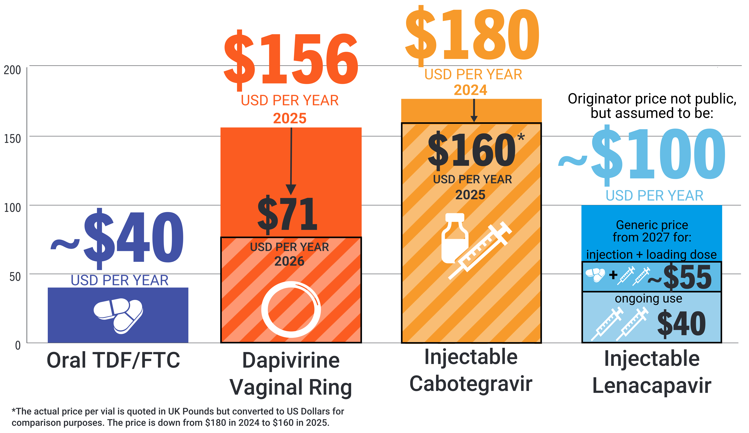
PrEP Prices for LMICs
Price comparison per person per year

Slide 17
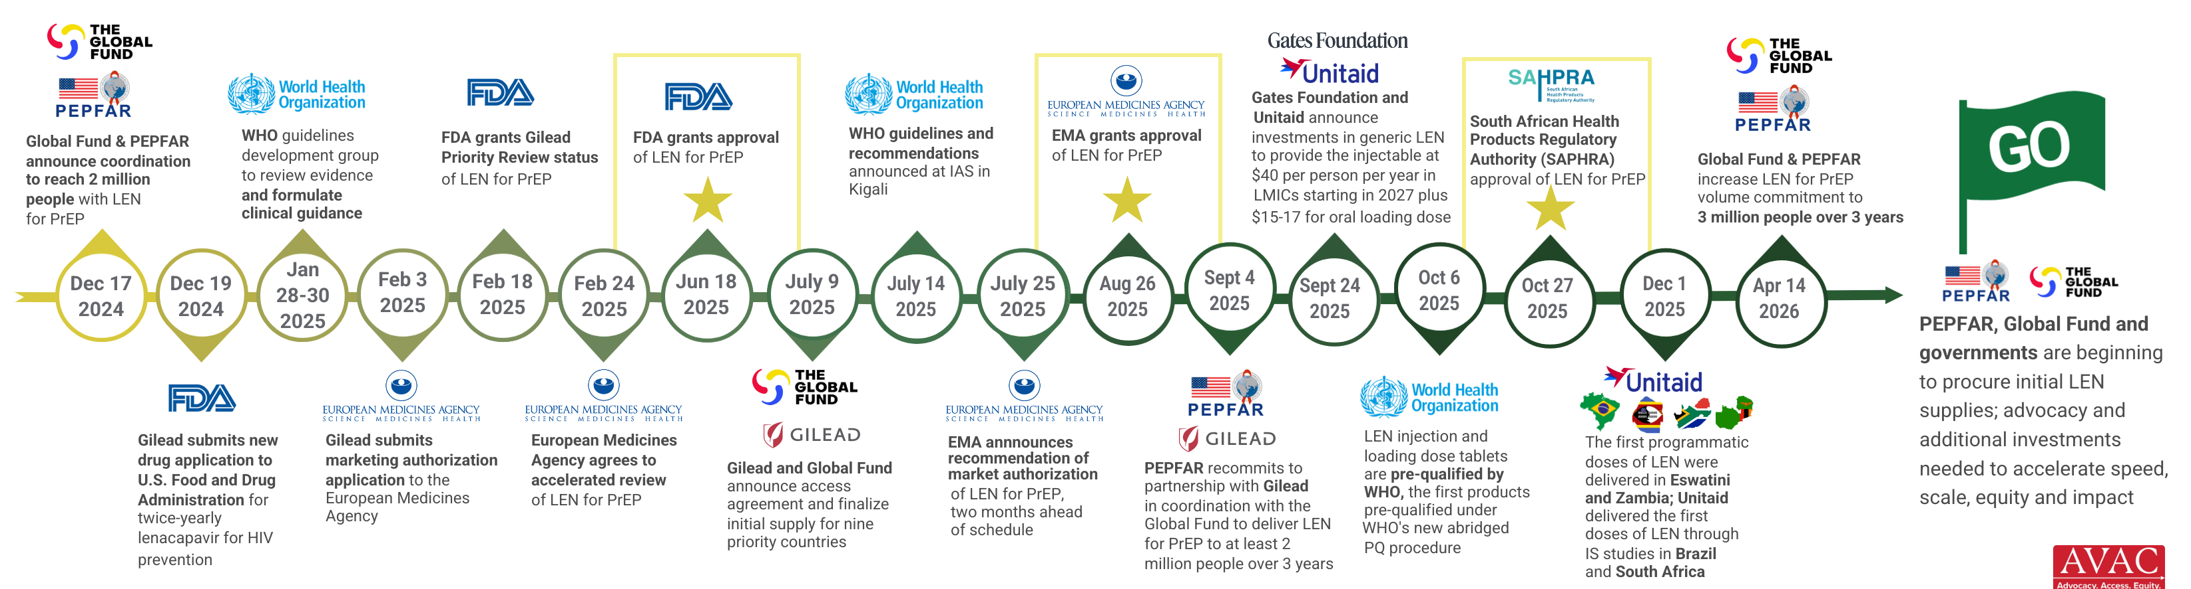
Where We Are Now with LEN for PrEP

Slide 18
Lenacapavir Regulatory Approval
17 regulatory approvals, 7 pending approvals as of July 2026

Slide 19
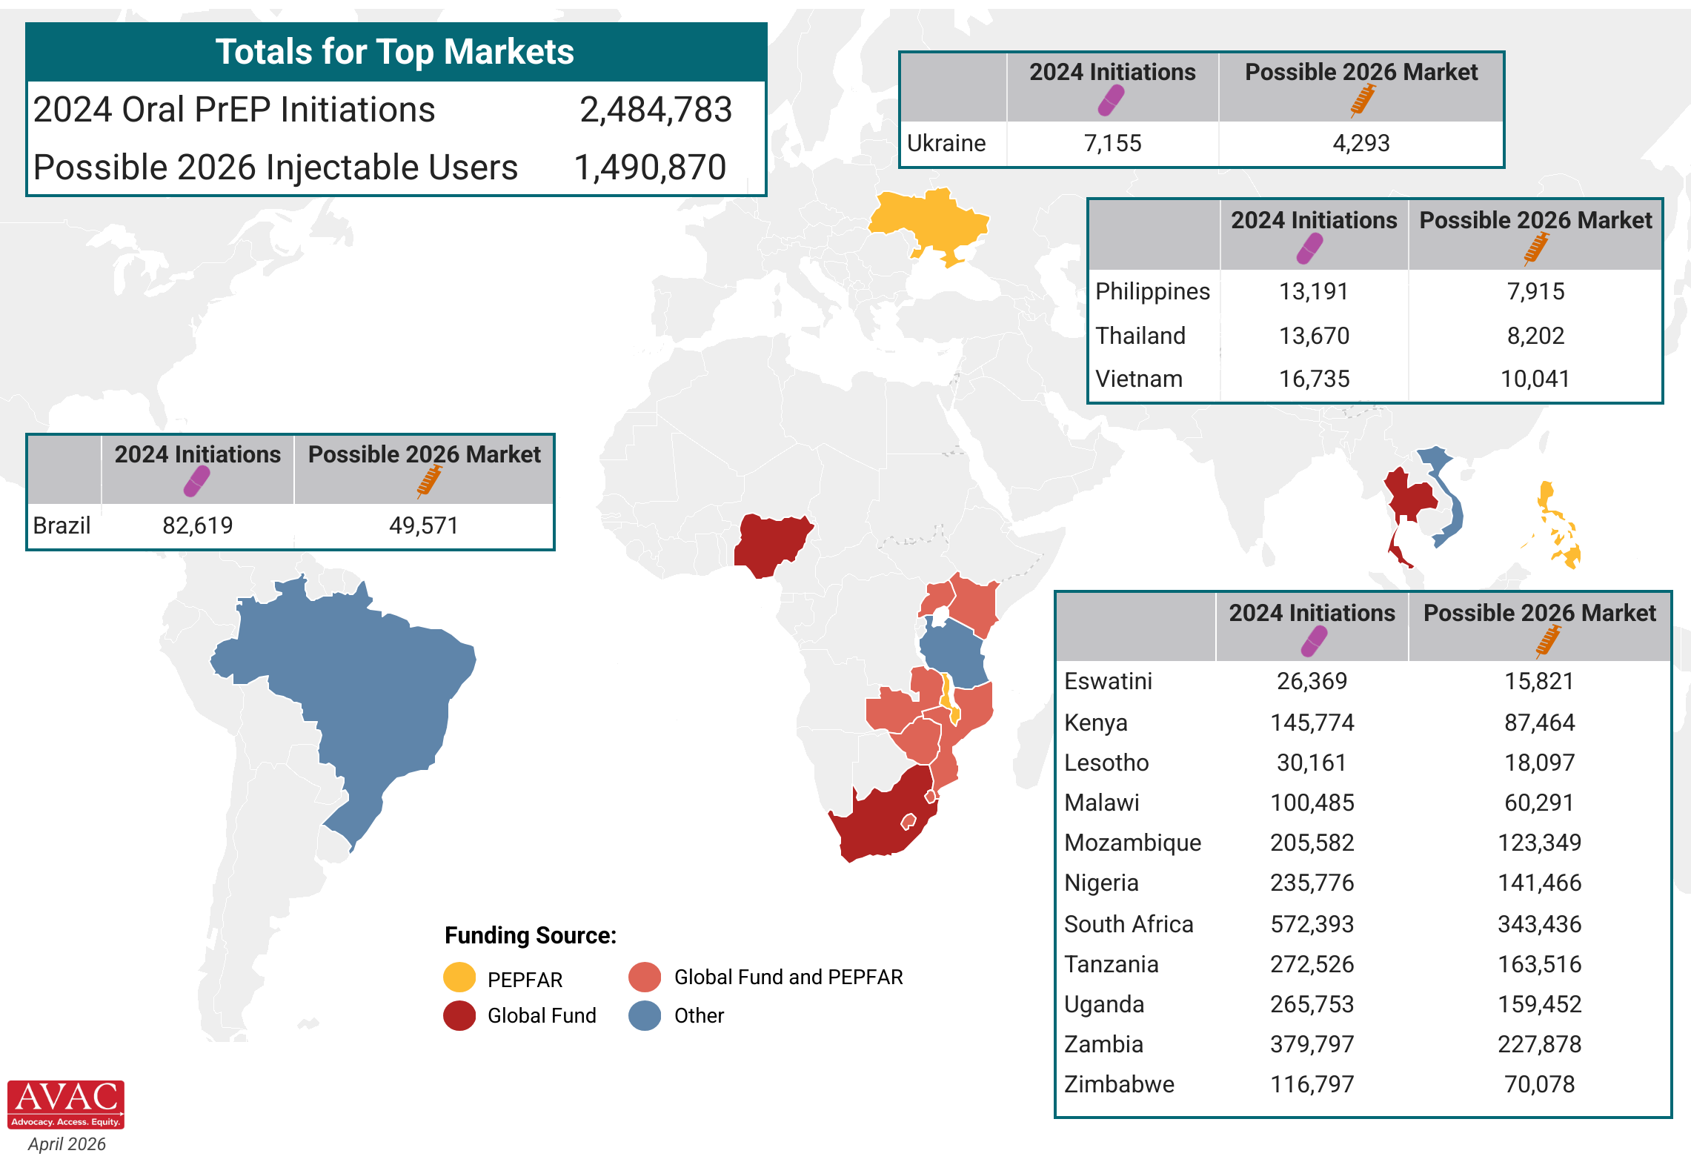
Potential Market of LEN for PrEP
Top 16 PrEP markets, based on 2024 oral PrEP initiations and possible 2026 injectable market, assuming 60% of new PrEP users choose an injectable, as seen in implementation studies

Slide 20
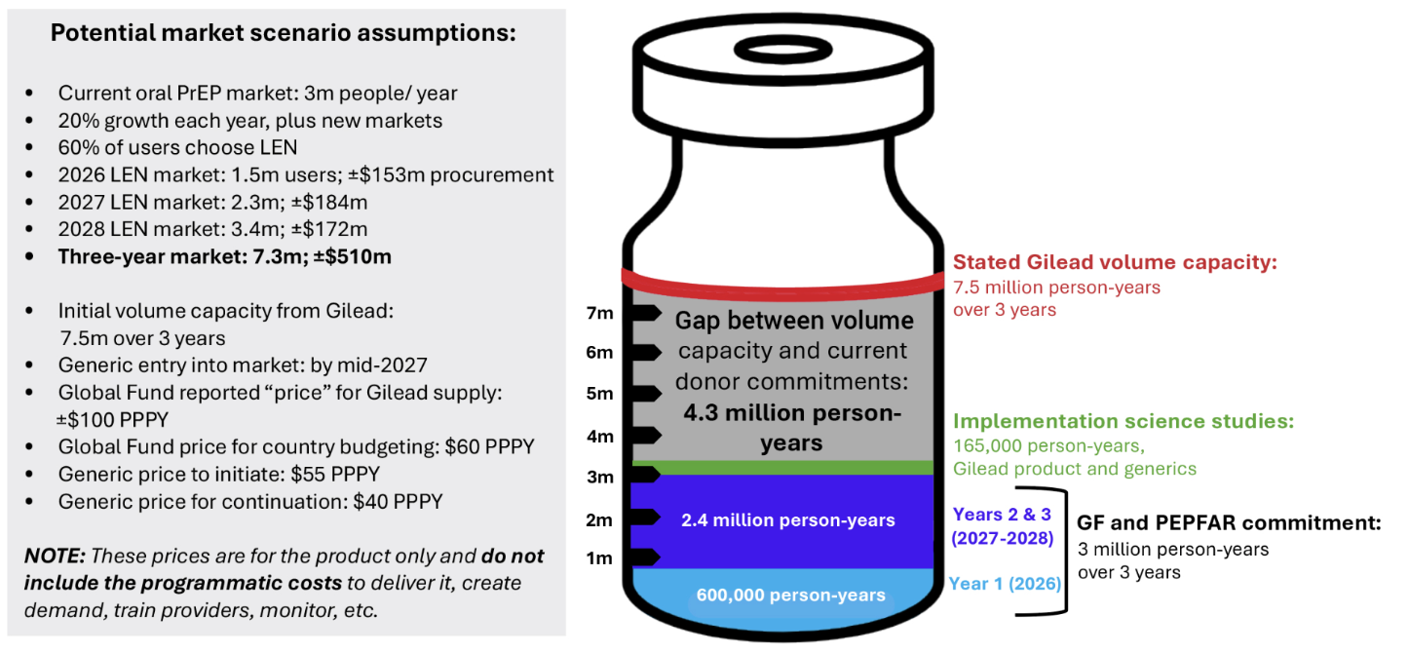
Potential Lenacapavir Supply: 2026-28

Slide 21
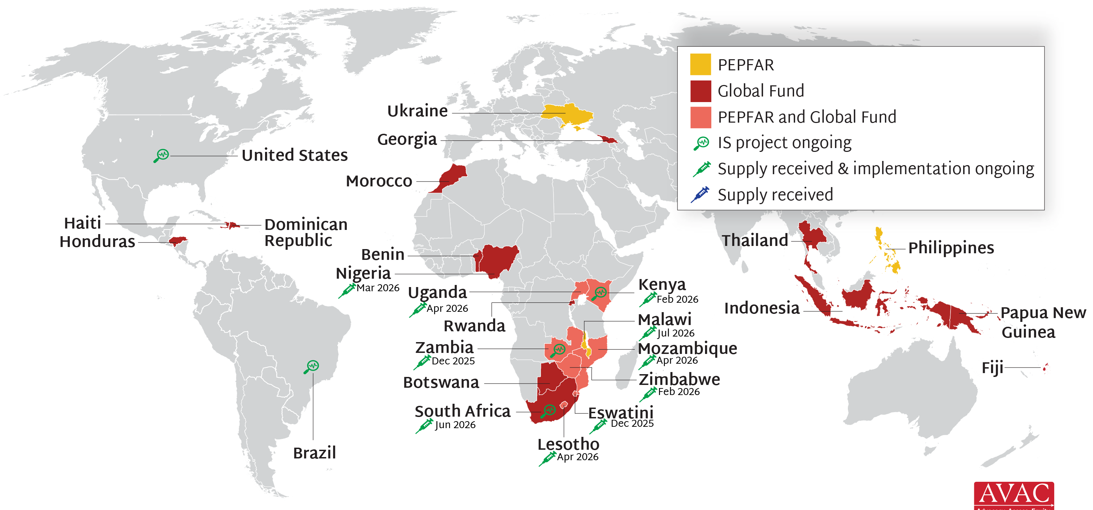
Lenacapavir for PrEP Rollout
PEPFAR & Global Fund supporting 24 countries with early LEN access; first supplies in Eswatini & Zambia in Nov 2025; balance arriving throughout 2026 & 2027. Gates Foundation, Gilead, NIH and Unitaid also supporting 21 implementation science (IS) projects in 9 countries.

Slide 22
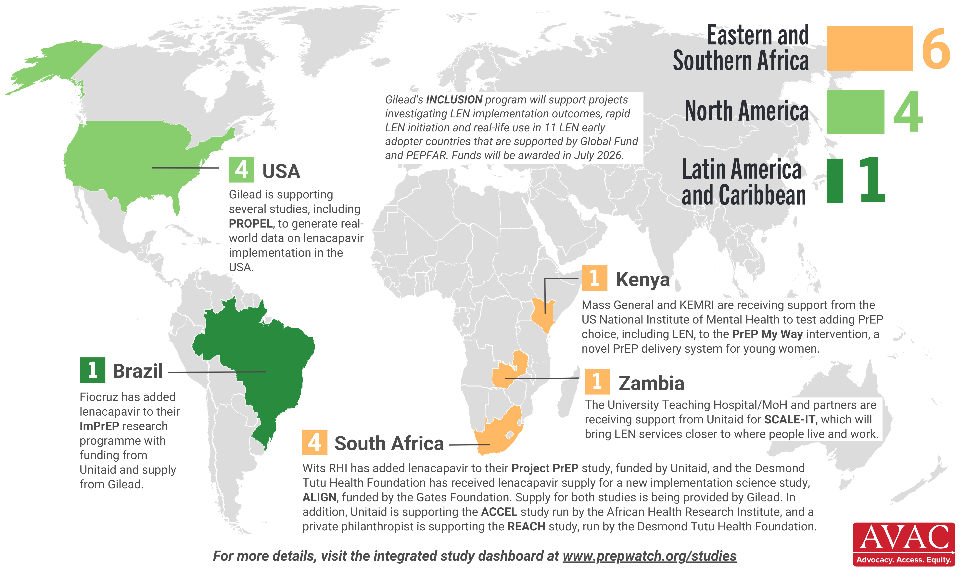
Lenacapavir Implementation Studies
11 implementation studies ongoing in 5 countries, as of June 2026

Slide 23
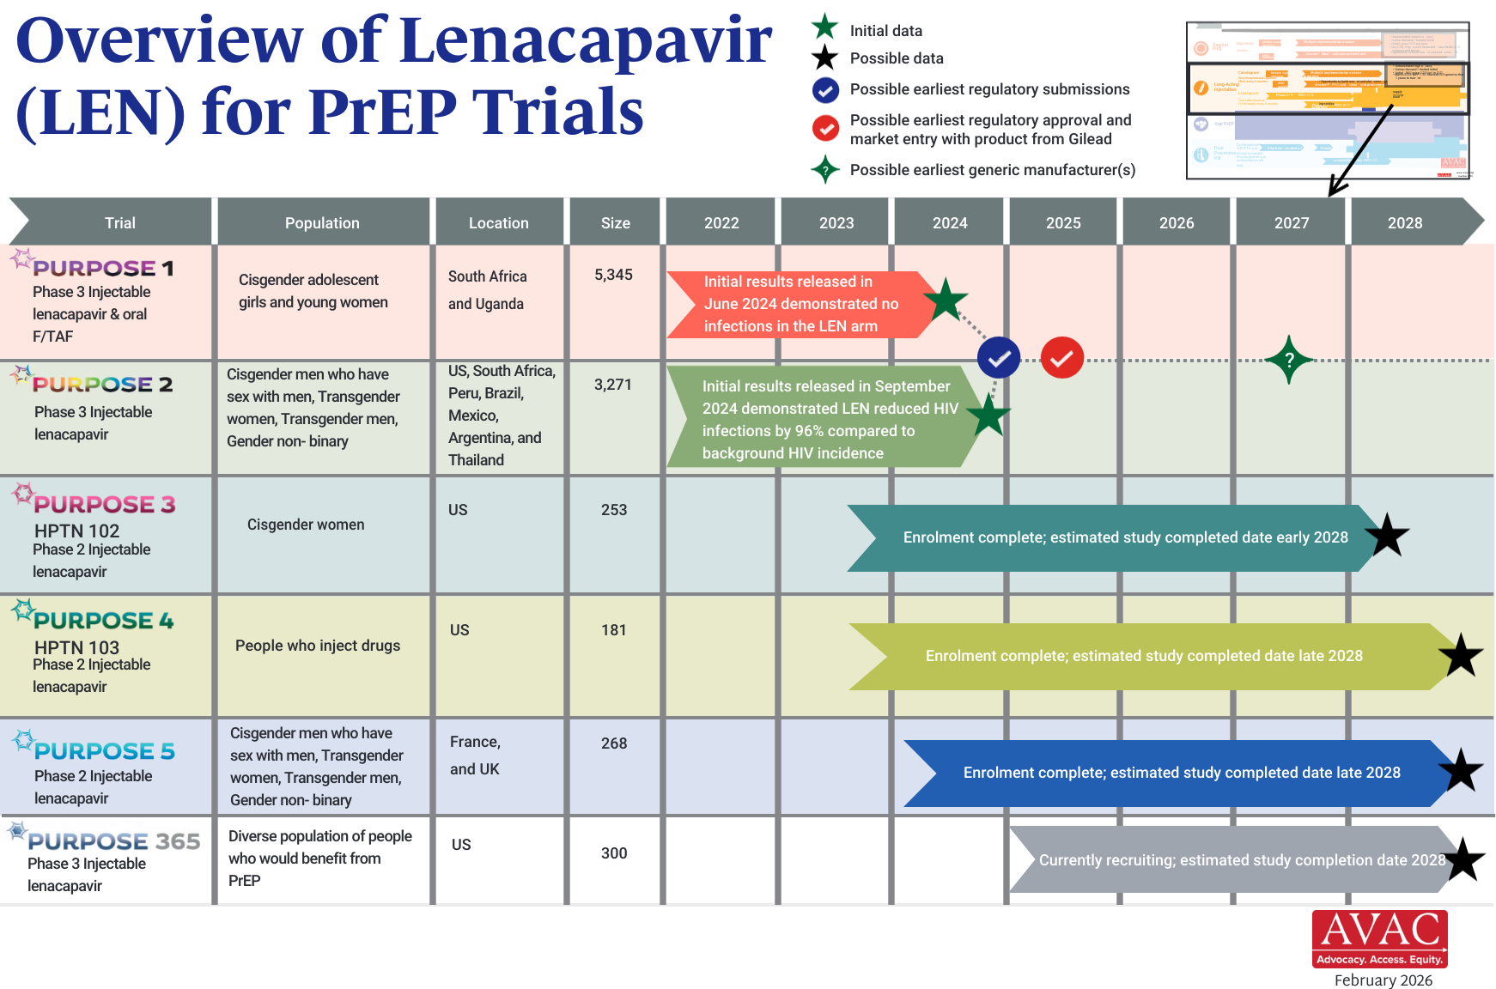
Overview of Lenacapavir Trials
Updated Feb 2026

Slide 24
Cabotegravir Implementation
38 implementation studies completed, ongoing or planned and 2 on hold in 22 countries, as of July 2026

Slide 25
Multipurpose Prevention Technologies (MPTs) & STIs

Slide 26
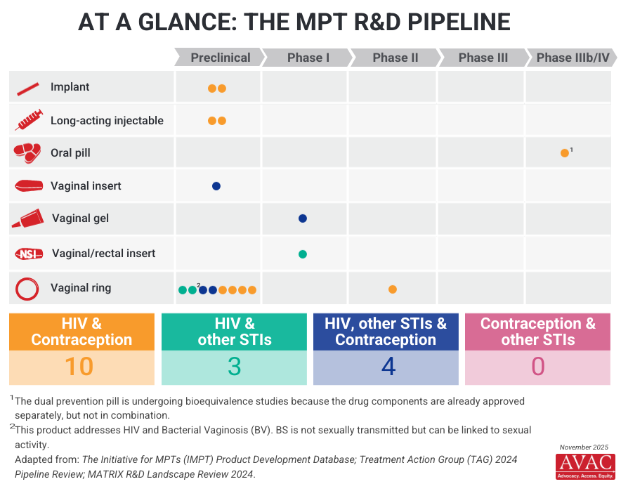
Multipurpose Prevention Technology (MPT) R&D Pipeline

Slide 27
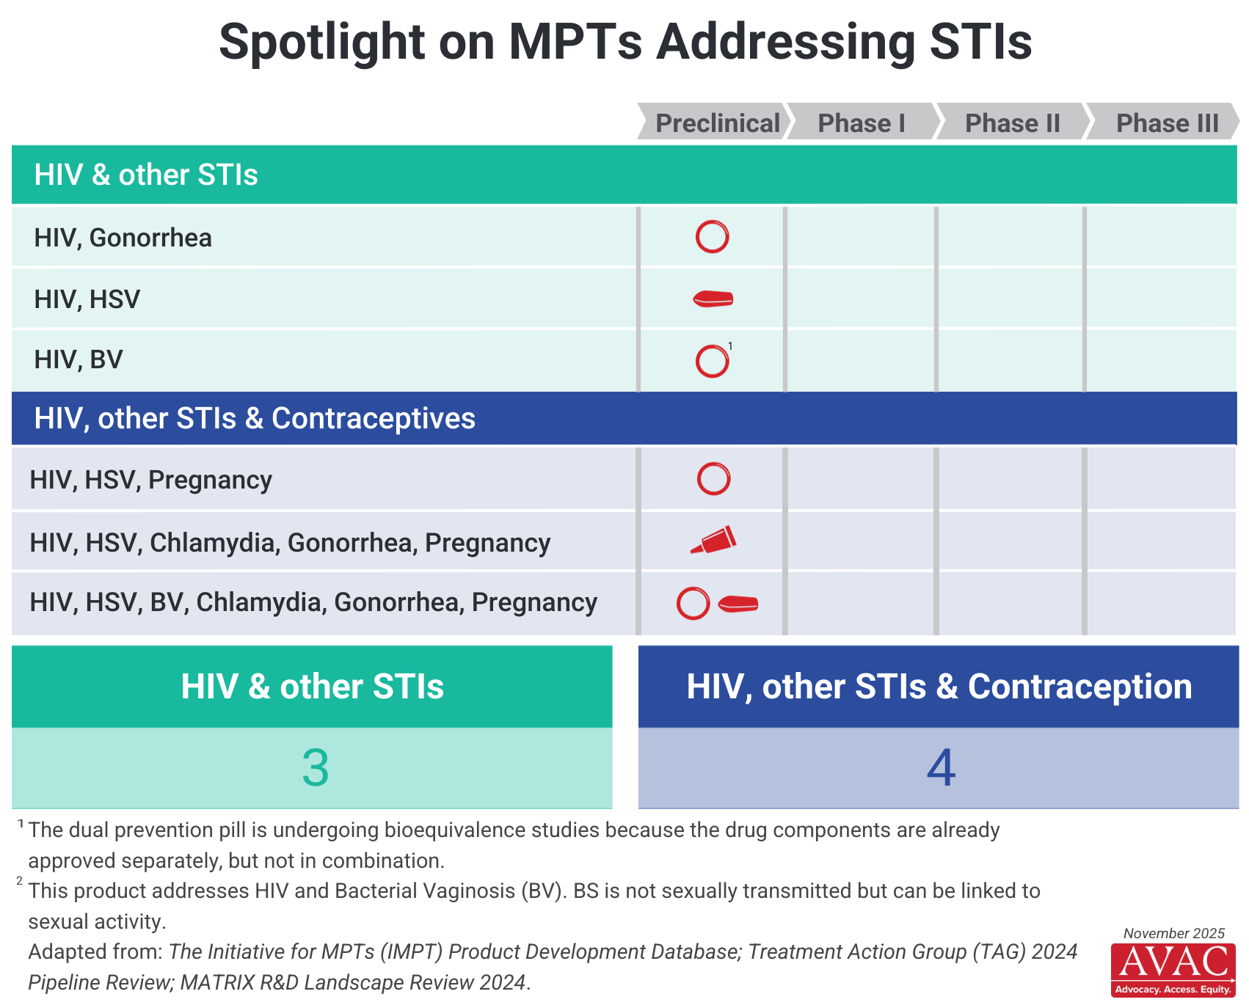
Spotlight on MPTs Addressing STIs

Slide 28
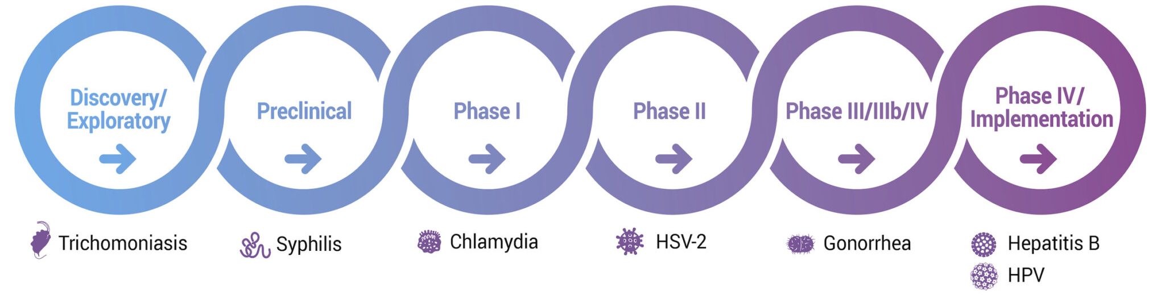
Current Status of STI Vaccine Development
For more, visit STIWatch.org

Slide 29
Preventive Vaccines

Slide 30
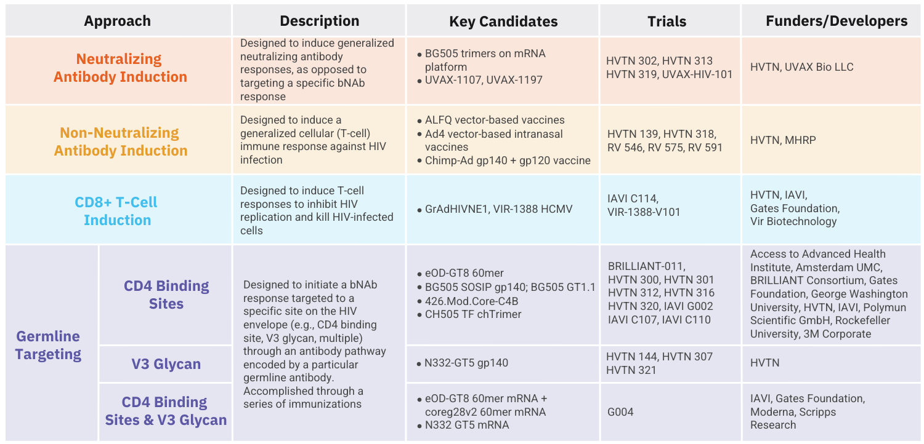
HIV Vaccine Clinical Trials Pipeline
All vaccine candidates shown above are currently in Phase I trials. More details can be found in AVAC's Pipeline Tracker.

Slide 31
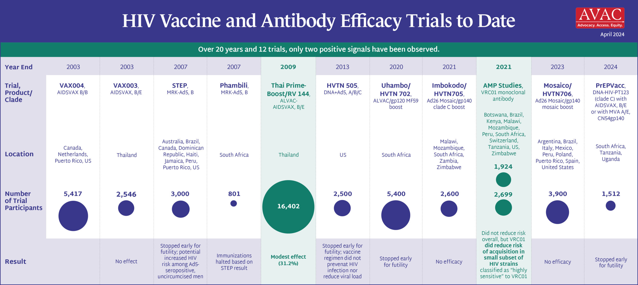
HIV Vaccine & Antibody Efficacy Trials to Date

Slide 32
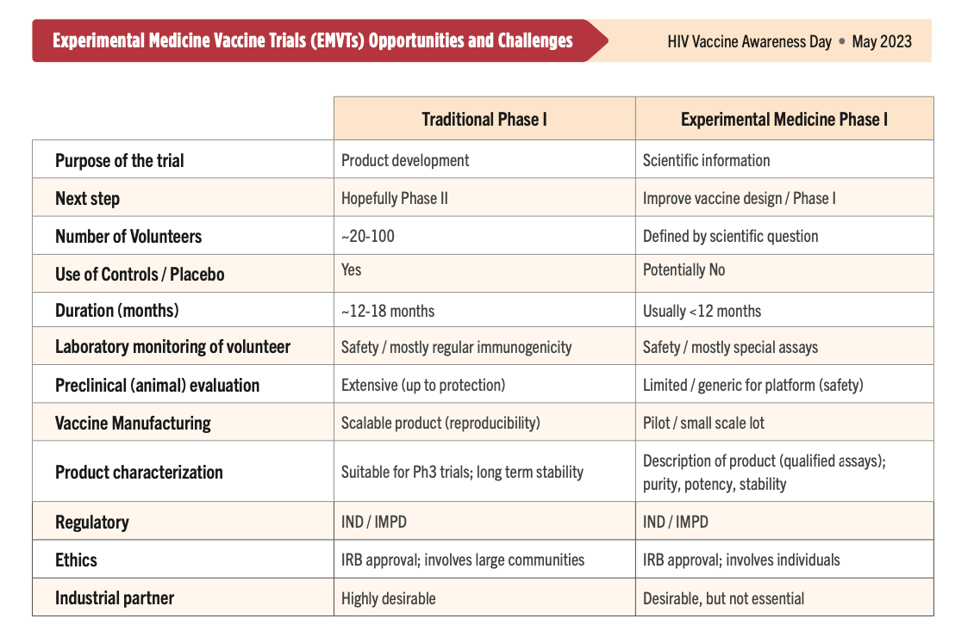
Discovery Medicine for HIV Vaccines

Slide 33
bNAbs

Slide 34
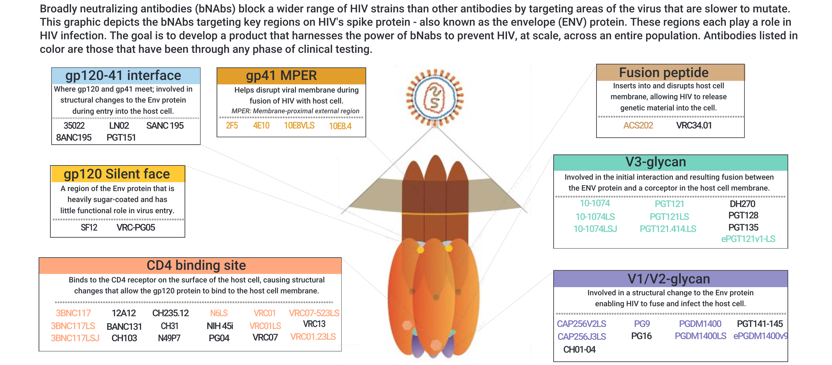
Broadly Neutralizing Antibodies and HIV

Slide 35
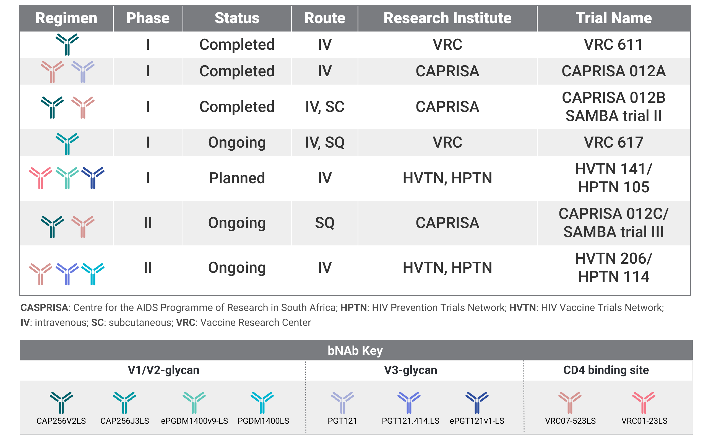
Broadly Neutralizing Antibody (bNAb) Combinations
Results expected at AIDS 2026

Slide 36
Long-Acting HIV Treatment

Slide 37
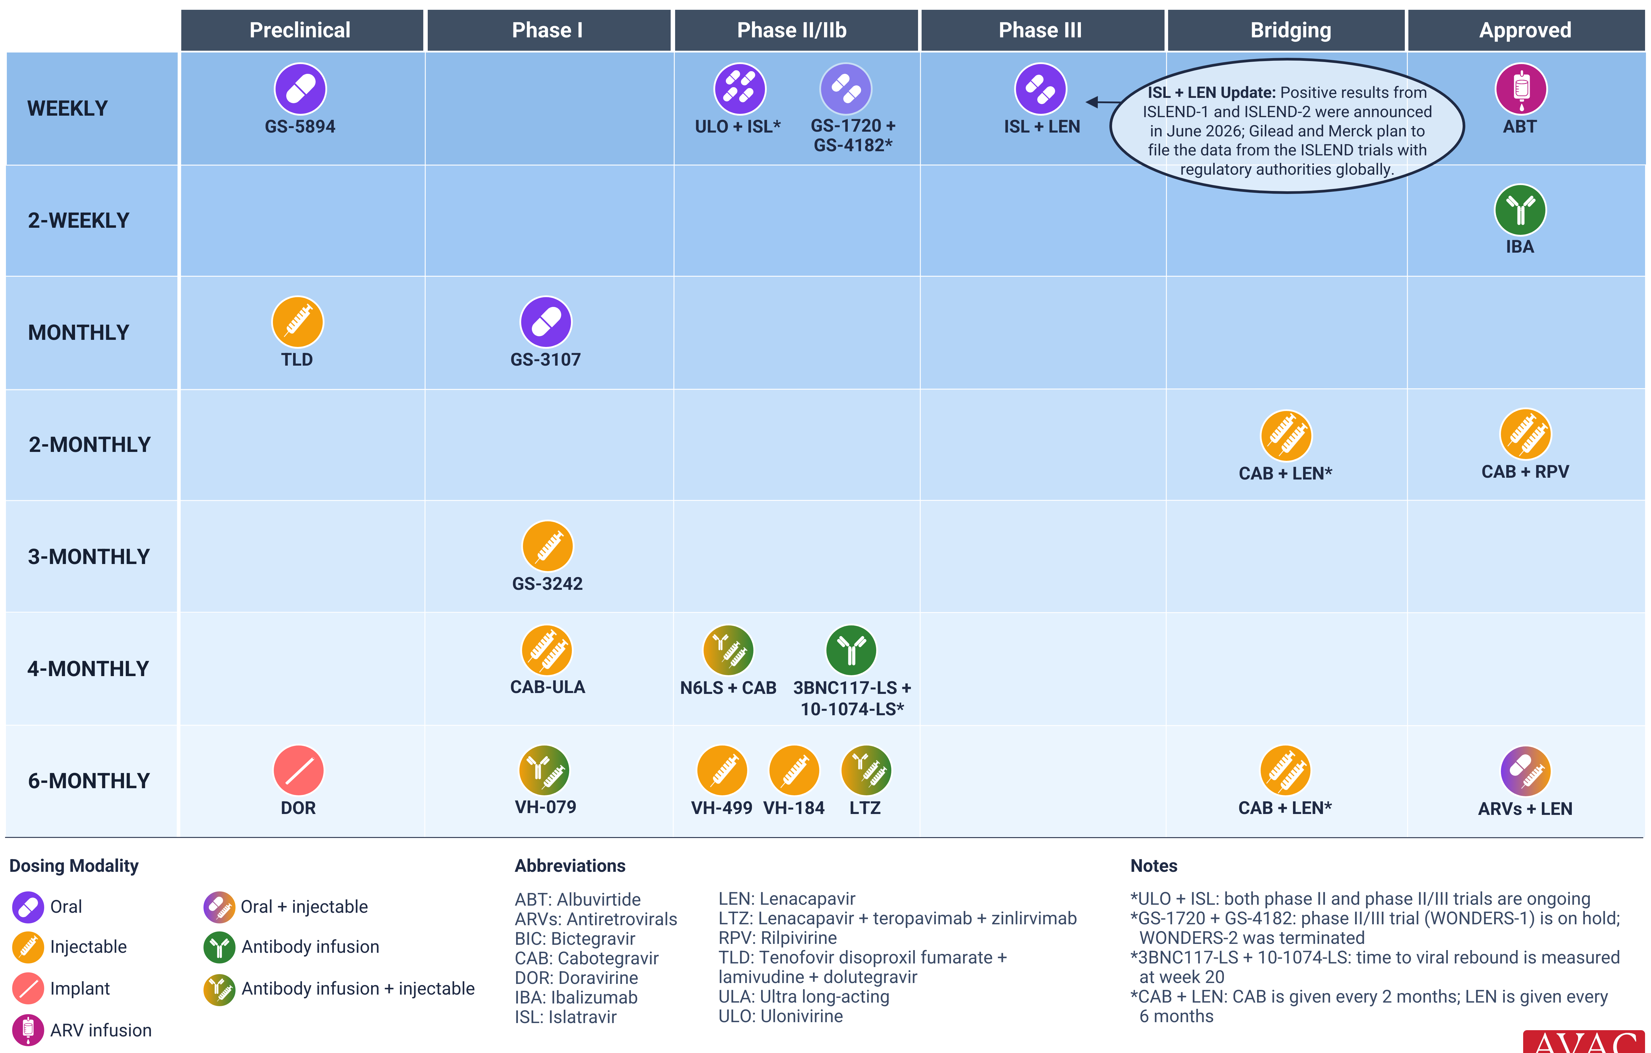
Long-Acting Treatment Pipeline

Slide 38
HIV Cure

Slide 39
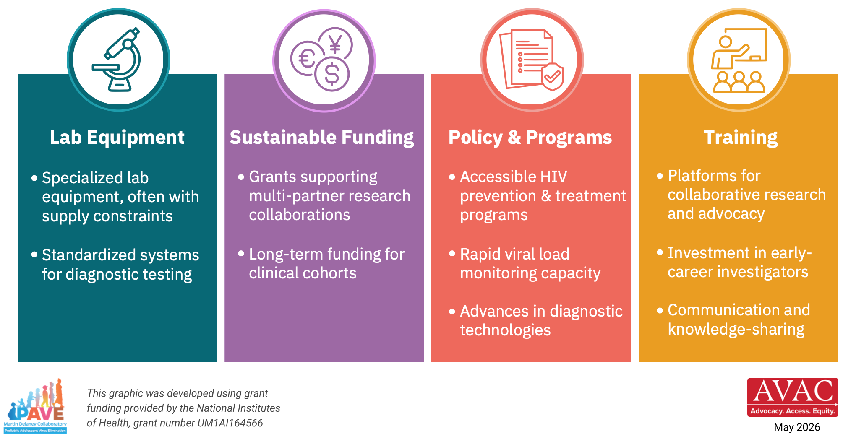
What Does it Take to Conduct HIV Cure Research?
Progress depends on strengthening four critical systems

Slide 40
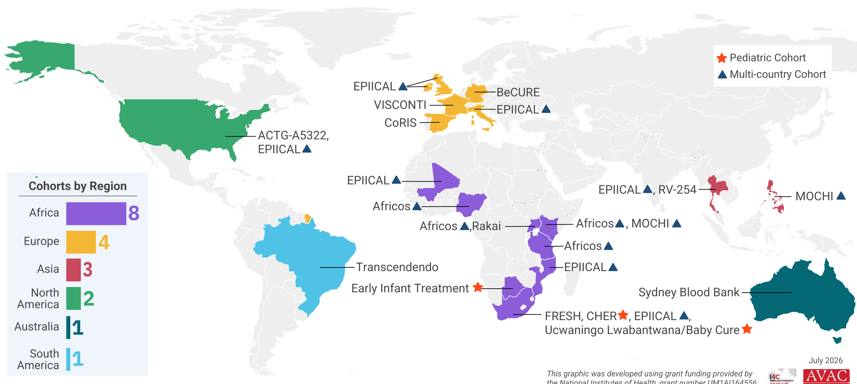

HIV Cure Research Cohorts
Groups of people living with HIV volunteer to participate in long-term studies exploring how HIV persists in the body and testing various strategies to achieve long-term viral remission without antiretroviral therapy; these cohorts are fundamental to the pursuit of an HIV cure
This graphic was developed using grant funding provided by the National Institutes of Health, grant number UM1AI164556

Slide 41
PEPFAR Funding Cuts

Slide 42
PEPFAR Data Release
April 2026

Slide 43
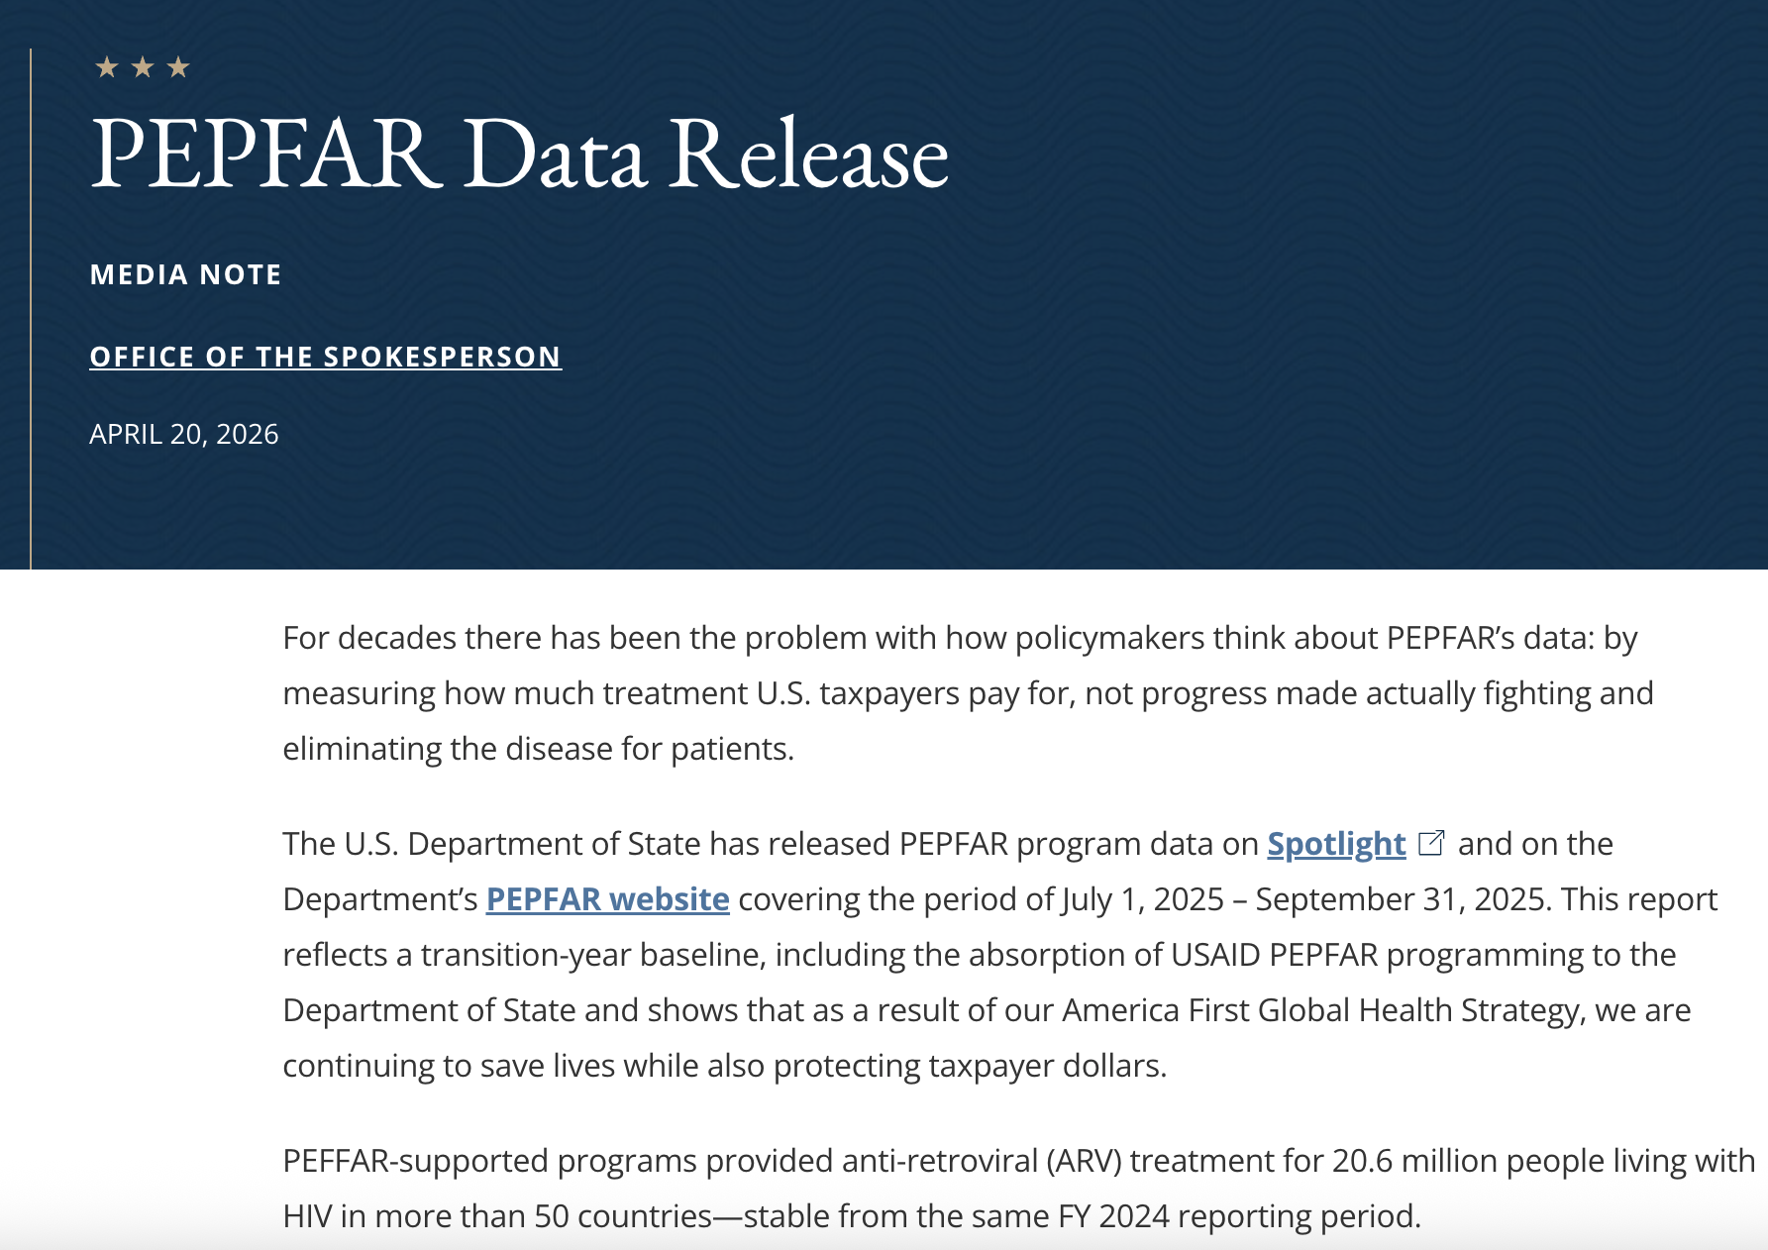
PEPFAR’s Perspective
On April 17, 2026, PEPFAR released long-awaited Q4 FY25 data
  Only one quarter’s (July-Sept 2025) data released, no data from last six months of implementation
State Department states:
  20.3-20.6 million people on treatment
    But the data and the press release have different numbers
  Increased country ownership
    But not clear how defined or quantified
  Increase in PrEP use by pregnant and breastfeeding women
    But massive decrease in PrEP overall & data is newer & reporting has been optional
Notes:
Release has been a long time coming. We enjoyed quarterly releases of data by PEPFAR that has been a central component to meaningful advocacy in the COPs process from years past.
Since the foreign aid freeze, stop work order, and subsequent cutting of programs, civil society and the GAPP have advocated for data releases to provide critical insight on the impact of these moves made by the administration to gut global health programs
3 Congressional hearings were scheduled by House Oversight and separately by House authorizers, but failed to materialize – mostly through administration restricting access, and delaying data, and Republicans unwilling to risk foreign aid (and their standing) further by calling the administration out
Administration is presenting a narrative that is pushing the program as doing “very good” mostly through tunnel-vision and focusing on treatment numbers. Citing ”stable” treatment continuity, increased country ownership of localized epidemics via the bilateral MOU process, and the scale-up of PrEP initiations by pregnant and breastfeeding women which has been a priority population
But we should, as with most things with administration, take this information in with a lot of questions and potentially a bag of salt. We have to keep in mind that this is an administration that continously and never corrects for errors, bends data to fit their own purposes and messaging. And so we should approach them with a dose of skepticism and rely on our expertise within AVAC, our data analytics team, and partners to truly tell the story of what's happening here

Slide 44
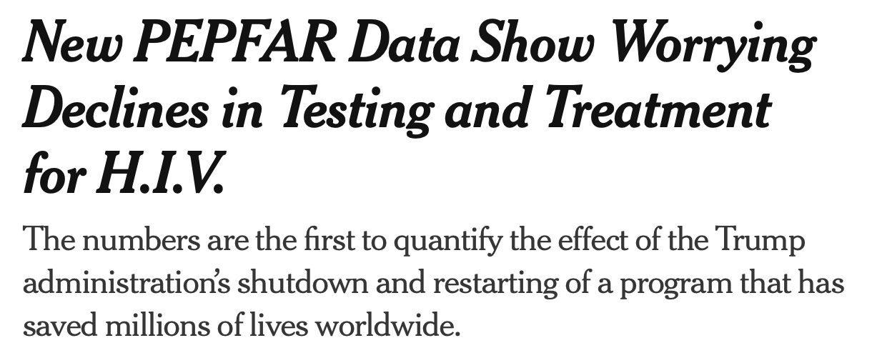

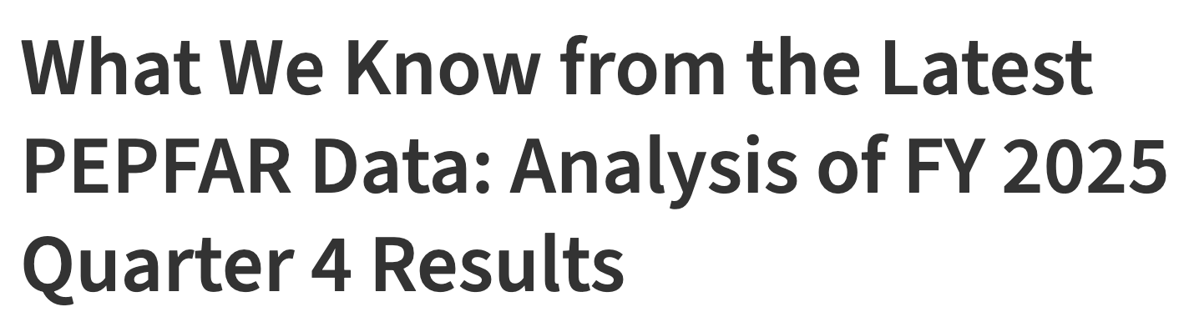
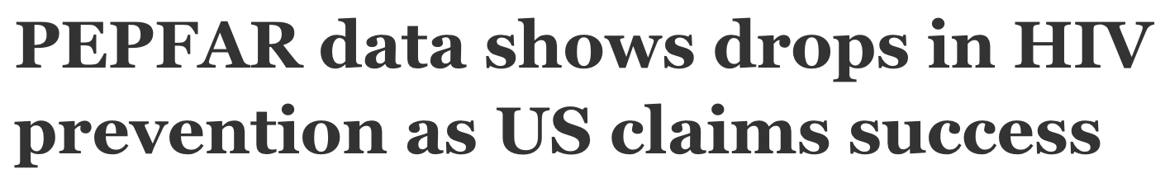
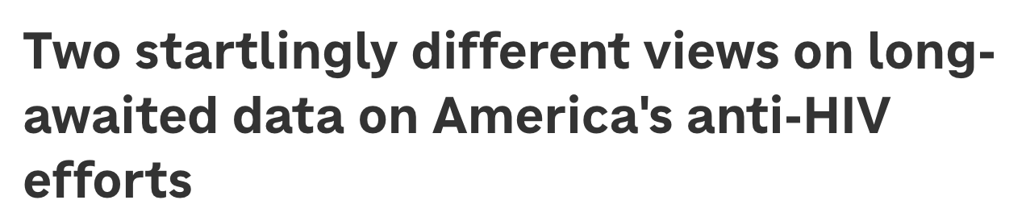
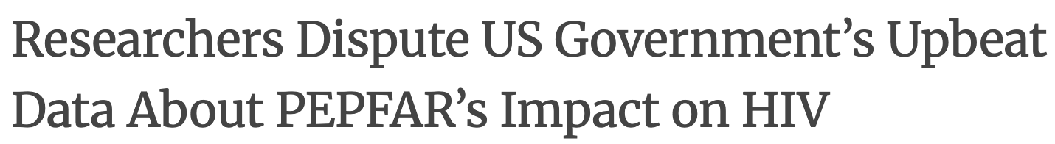
Other Perspectives, April 2026
Click here to read
Click here to read
Click here to read
Click here to read
Click here to read
Click here to read
Notes:
This is where we can look to sources countering the evolving narrative that the administration is attempting to create, and give us a deeper look of what is actually going on with PEPFAR and critically assessing the state of programs.
Just want to make sure I am giving credit where credit is due. For the purposes of this presentation I am mostly drawing from and summarizing the excellent analyses from our friends at amfAR and longtime AVAC collaborator Jirair Ratevosian, who have very recently published across journalistic, academic, and mass media platforms on the data release.
While PEPFAR leadership is clearly pushing the narrative that they are "doing more, with less" to justify the wanton destruction of global health partners, our partners and the community are utilizing this very data to illustrate the dangerous trajectory of where PEPFAR is heading. And from this, where we as an organization can and should be advocating

Slide 45
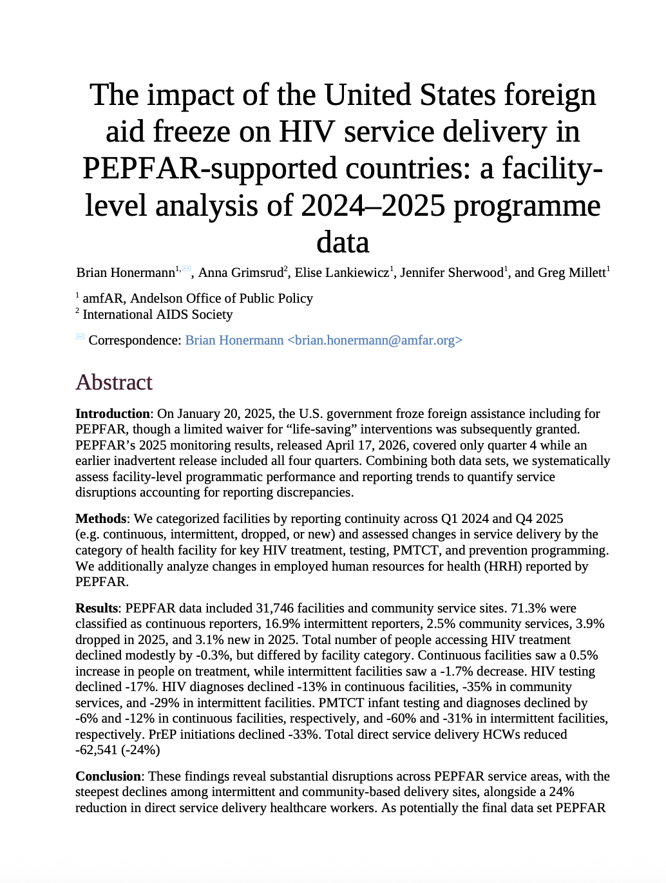
The Stats: Q1 2024 >> Q4 2025
HIV testing dropped -17%
HIV diagnoses dropped
  -13% in continuous facilities
  -35% in community-based facilities
  -29% in intermittent facilities
PMTCT infant testing
  -6% in continuous facilities
  -60% in intermittent facilities
PMTCT infant diagnoses
  -12% in continuous facilities
  -31% in intermittent facilities
PrEP initiations dropped -33% overall
  -27% in continuous facilities
  -62% in intermittent facilities
Data shared from analysis by amfAR
Notes:
In contrast to messaging from the feds, here’s what amfAR’s analyses say about the numbers from Q1 of 2024 through Q4 2025. The obviously trend is that from testing to diagnoses to PrEP intiations are all significantly down.
It’s important to note the stark difference between continuous facilities and intermittent facilities – in which intermittent facilities are increasingly the programs that are feeling the most hurt from the ripple affects of the freeze on foreign assistance and stop work orders.
Continuous: Fully operational facilities providing uninterrupted, comprehensive HIV care, treatment, and laboratory monitoring,
Intermittent: Facilities experiencing irregular, disrupted, or temporary service delivery, often affecting specific care types rather than all services, such as when HIV prevention programs were paused during COVID-19 or when key population services are hampered.

Slide 46
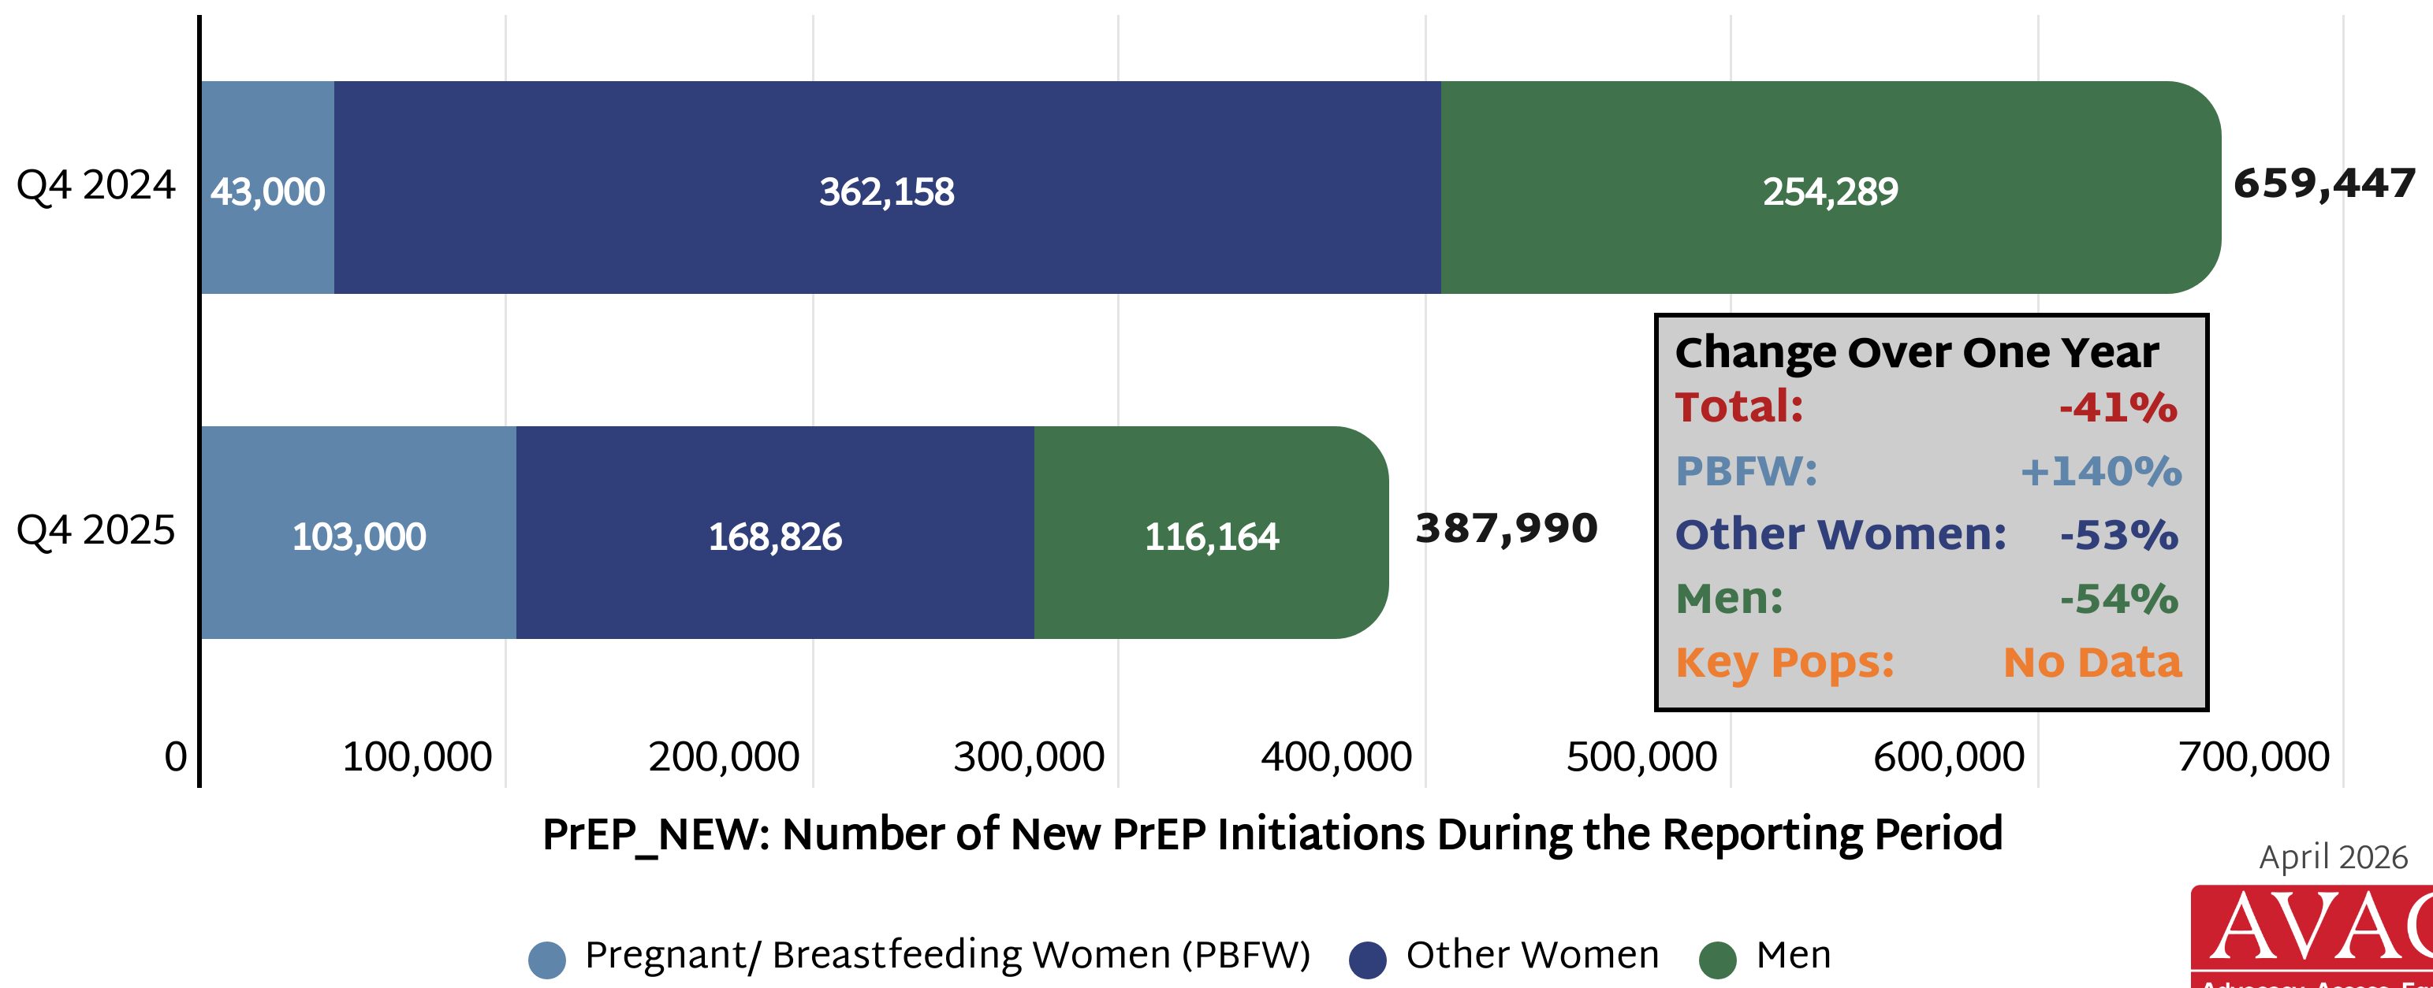
Decline in PEPFAR Supported PrEP Initiations
Comparison of PEPFAR data from Q4 2024 (July – Sept) to Q4 2025 (July – Sept)

Slide 47
Significant Reductions in PrEP Services
17 of 51 countries (33%) with PEPFAR-funded PrEP programs in 2024, primarily in Asia and South America, were completely cut in 2025
Top 16 PrEP markets (based on 2024 data) saw the most drastic cuts, representing poor prioritization of resources
  PrEP initiations fell 41% overall
  Down 43% in higher-burden countries, compared to a 26% decrease in lower-burden countries
No publicly available data on PrEP initiations for key populations
Pronounced and worrying drops in PrEP initiations among adolescent girls and young women (15–24-year-olds) compared to older women
 | New PrEP Initiations Q4 2024 | New PrEP Initiations Q4 2025 | % Decrease in PrEP Initiations
All Women | 405,158 | 271,826 | -33%
AGYW (15-24) | 204,029 | 124,326 | -39%
Other Women (25-49) | 194,312 | 143,392 | -26%

Slide 48
Critical KP & Px Programs and Reporting Halted
Programs and interventions for priority populations, including MSM, transgender people, sex workers, and AGYW were particularly impacted
PEPFAR no longer requires reporting on prevention services for priority populations – services that reached over 3 million individuals in Q4 2024
  Many of these programs were also eliminated, but the magnitude of those cuts is challenging to quantify without any data
Staggering cuts to DREAMS programs – packages of prevention services to address the high incidence of HIV among AGYW
  Likely a key driver in the significant reduction in AGYW initiating PrEP
  Almost 1.9 million AGYW received prevention services in Q4 2024; only 253,000 received services in Q4 2025 (86% decrease)

Slide 49
Impact of US Funding Cuts on Research and Programs

Slide 50
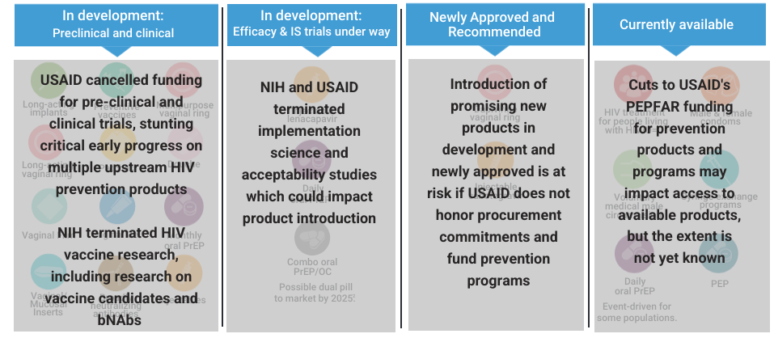
HIV Prevention Pipeline: Impact of USAID & NIH Cuts

Slide 51
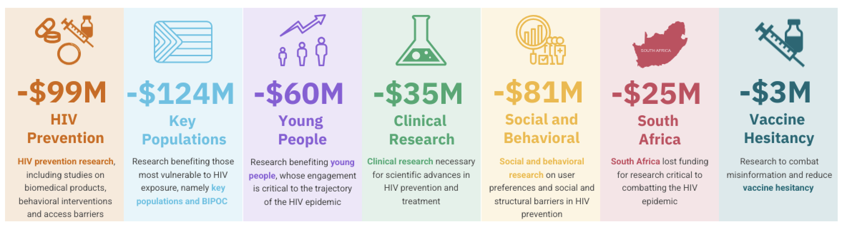
The Cost of Cutting HIV Research
NIH terminated 191 HIV-specific grants in 2025, slashing over $200 million from key HIV prevention research grants¹
¹Grants may cover more than one research area, so total across categories shown here exceeds $200 million in total funding lost

Slide 52
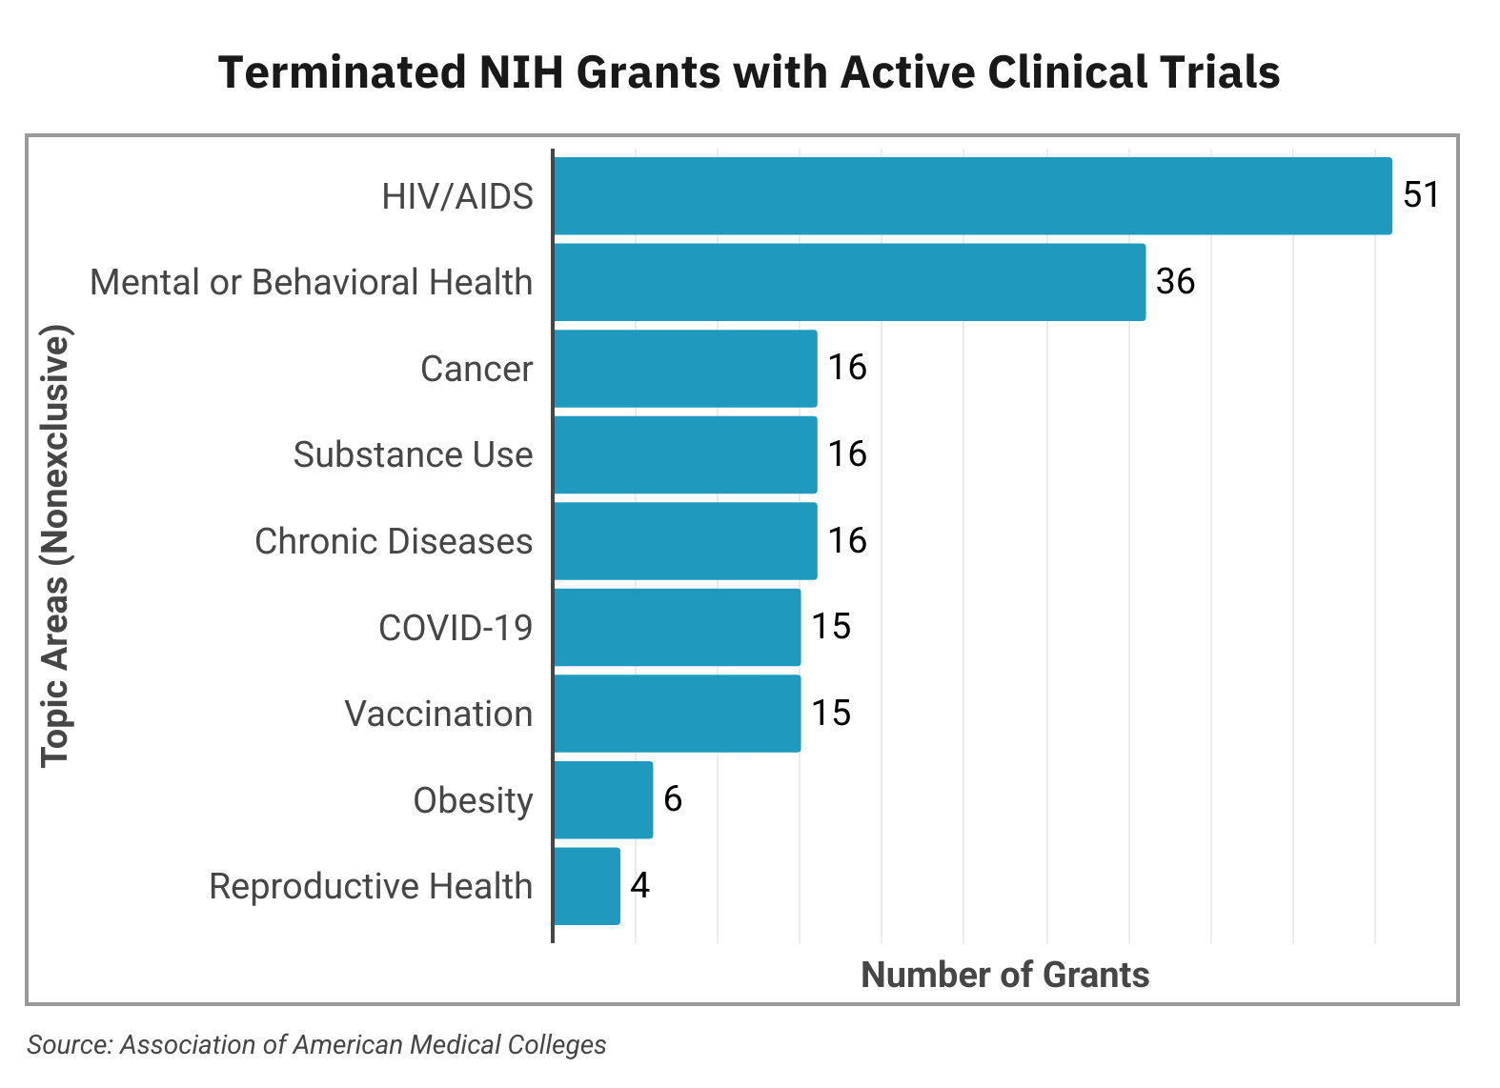
NIH: Cuts to Clinical Trials
Total NIH termination of grants—unprecedented in history of agency
  $19B lost funding = 777 terminated grants
  $643M = 113 active clinical trials terminated
  56% ($~360M) of terminated clinical trials related to HIV

Slide 53
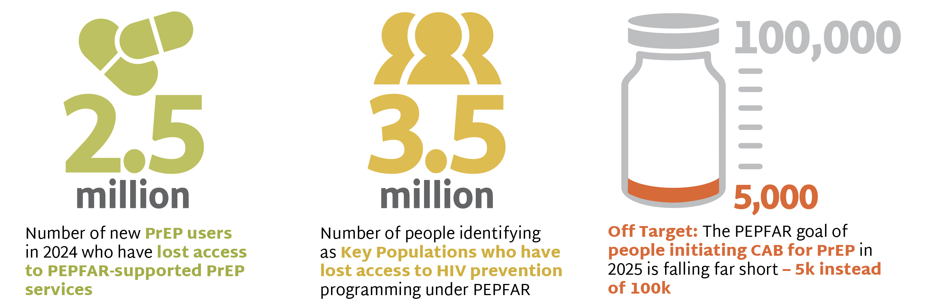
PrEP Delivery Imperiled

Slide 54
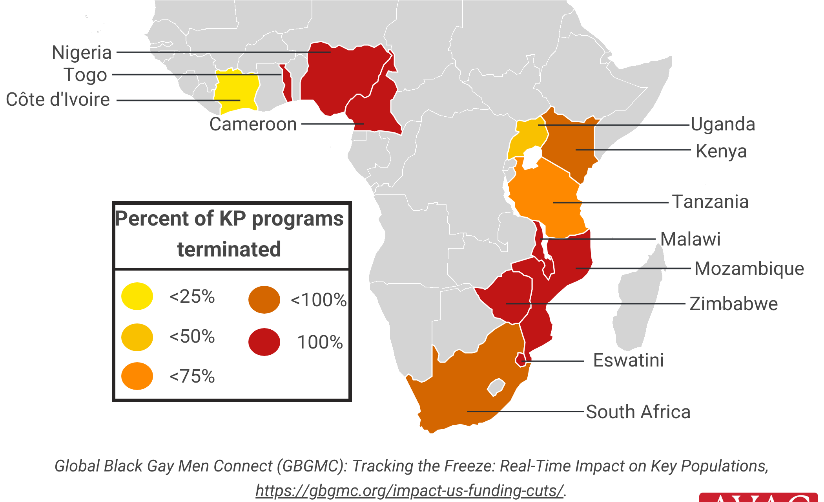
Impact of US Funding Cuts on KP Services
Percentage of KeyPop (KP)-serving implementing partners that have reported full or partial termination of the provision of KP services due to US funding cuts as of April 2025

Slide 55
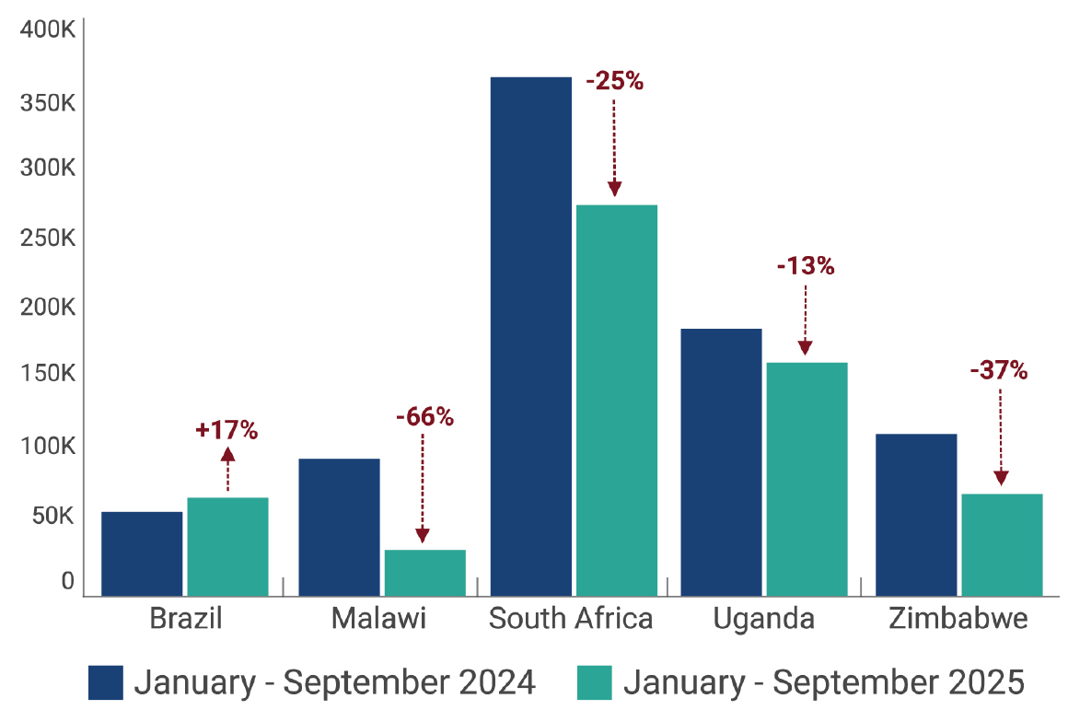
Change in PrEP Initiations
Data from five countries from 2024 – 2025 demonstrates changes following foreign assistance cuts

