Slide 1
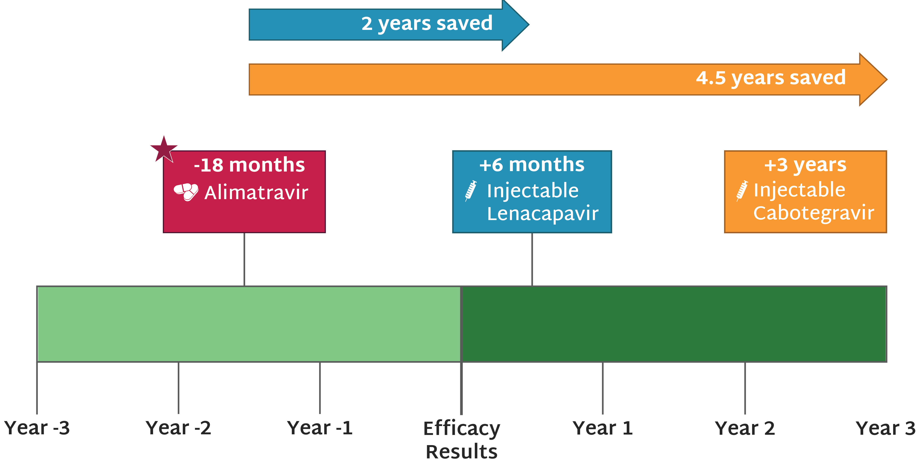
Alimatravir (AMI) Licensing Timeline
Merck/MSD announced voluntary license agreements with 7 generics to produce investigational monthly oral Alimatravir (AMI) for PrEP – well ahead of efficacy results, building on years of advocacy to shorten the timeline between scientific breakthroughs and public health impact
Updated Aug 2026

