Slide 1
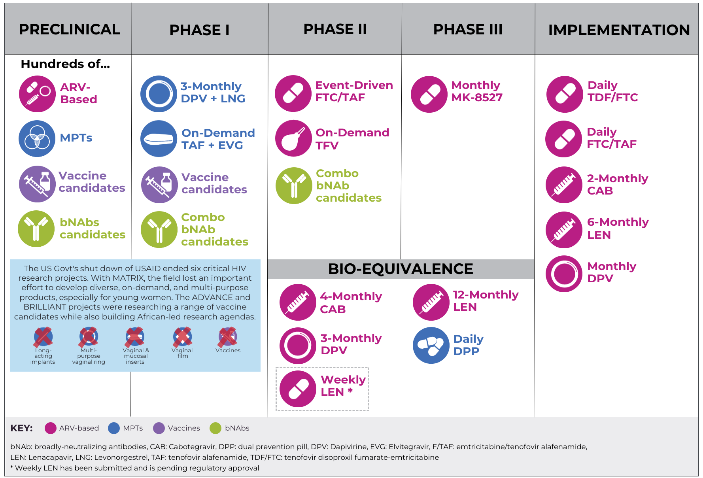
HIV Prevention Pipeline: Products to Watch

