Slide 1
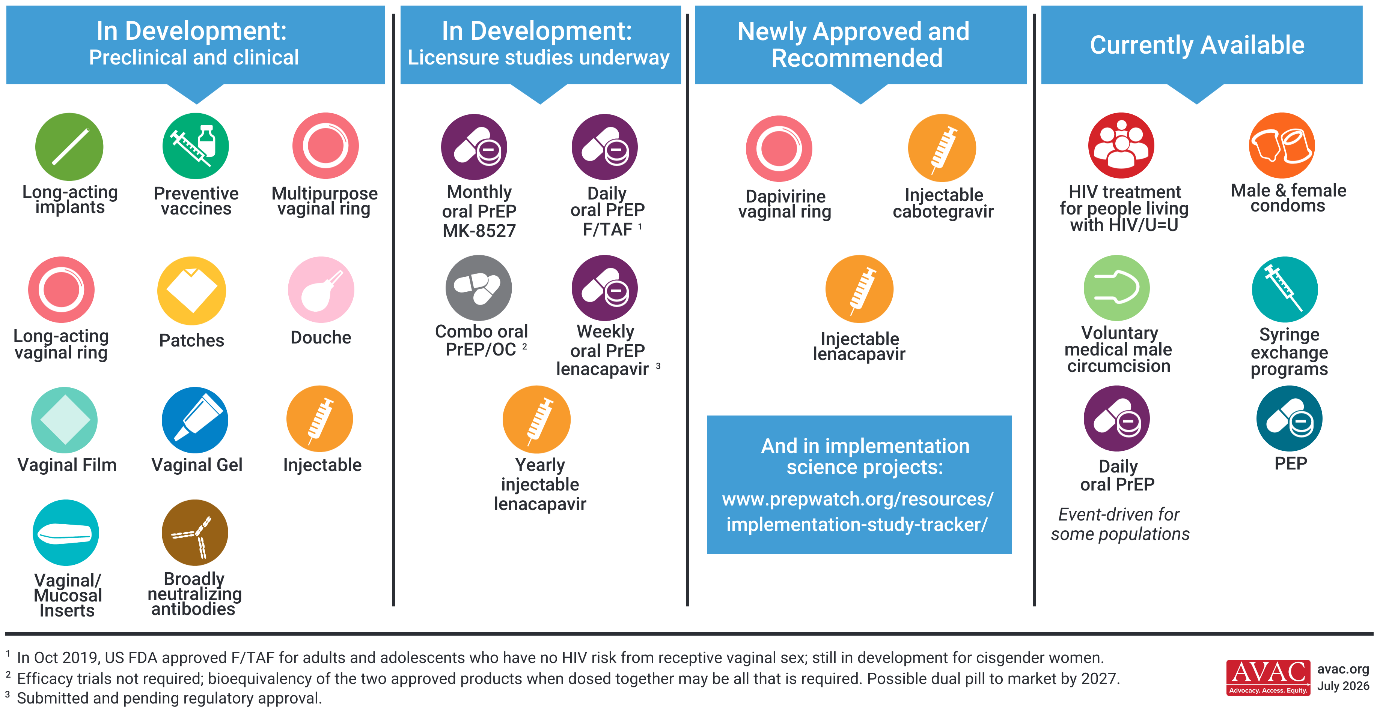
The HIV Prevention Pipeline

