Slide 1
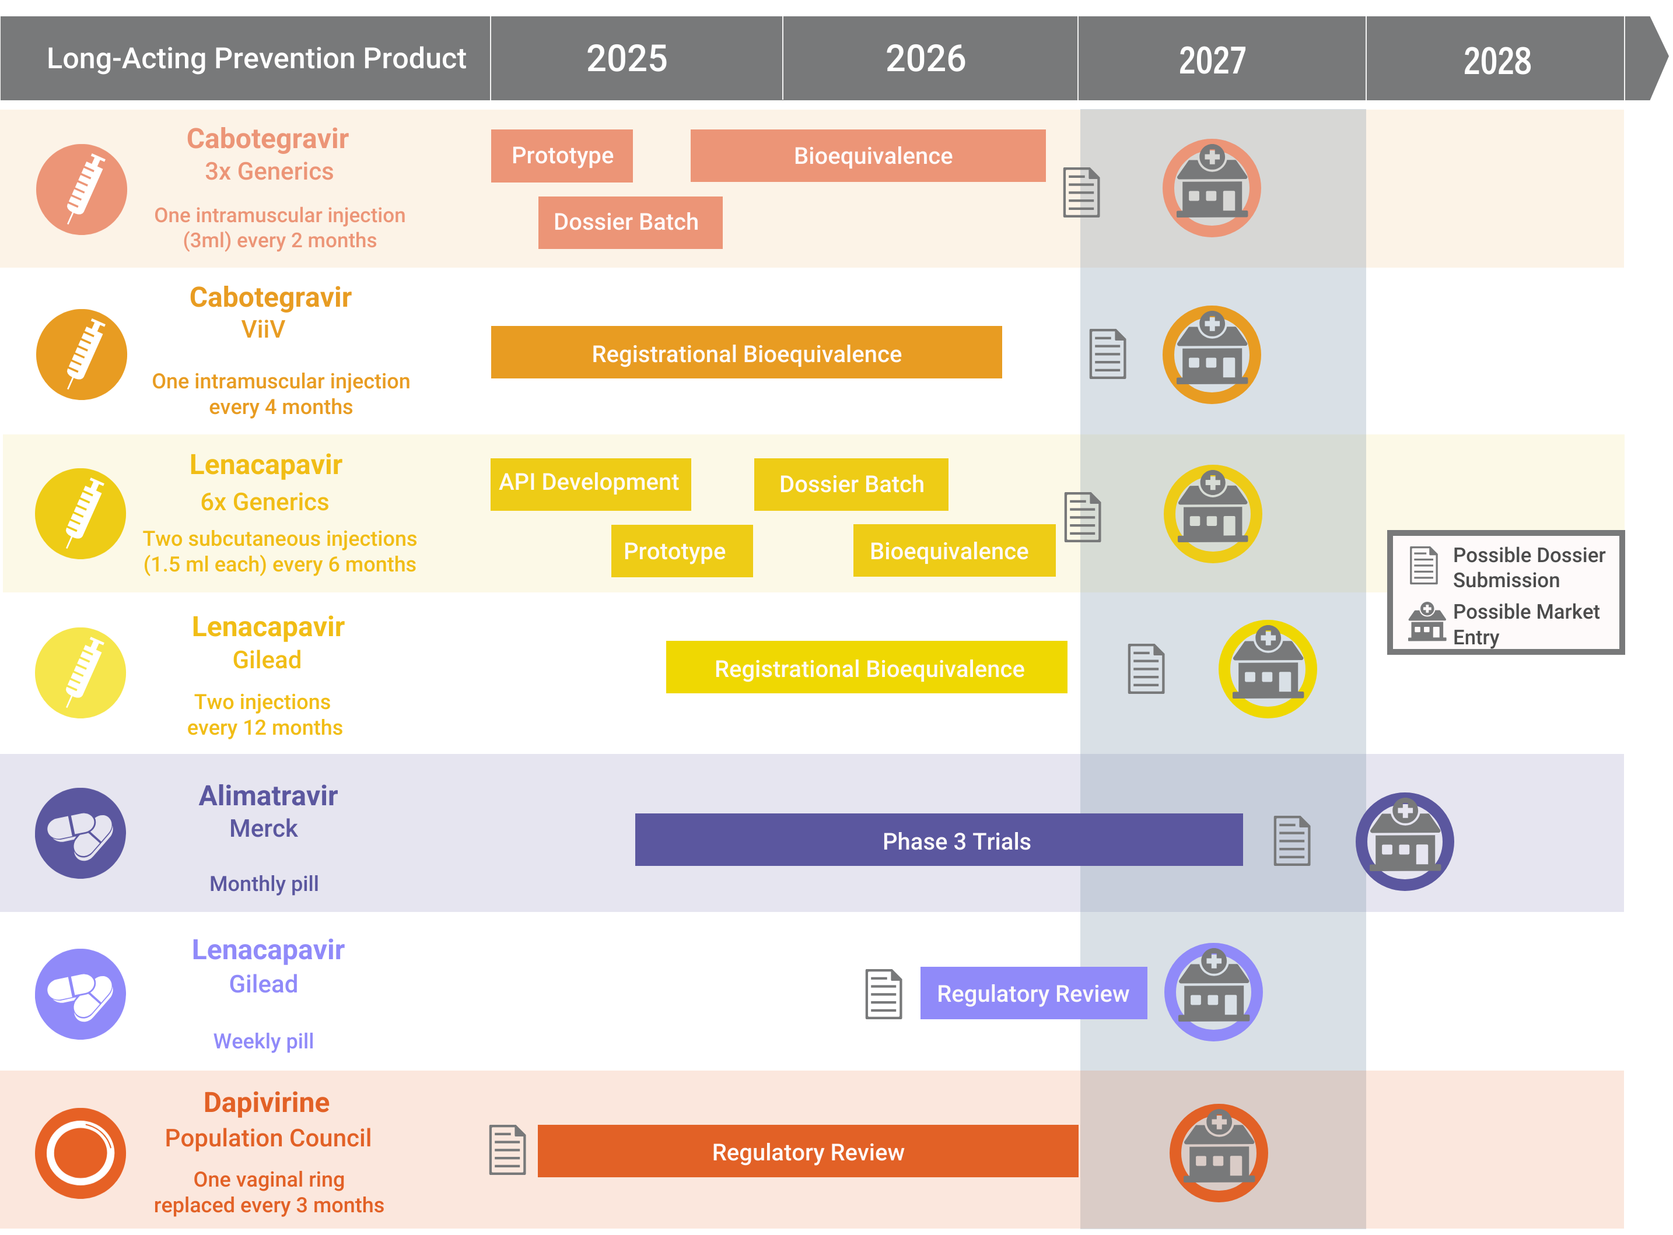
Innovation Pile-Up in Next-Generation PrEP
Updated August 2026

