Slide 1
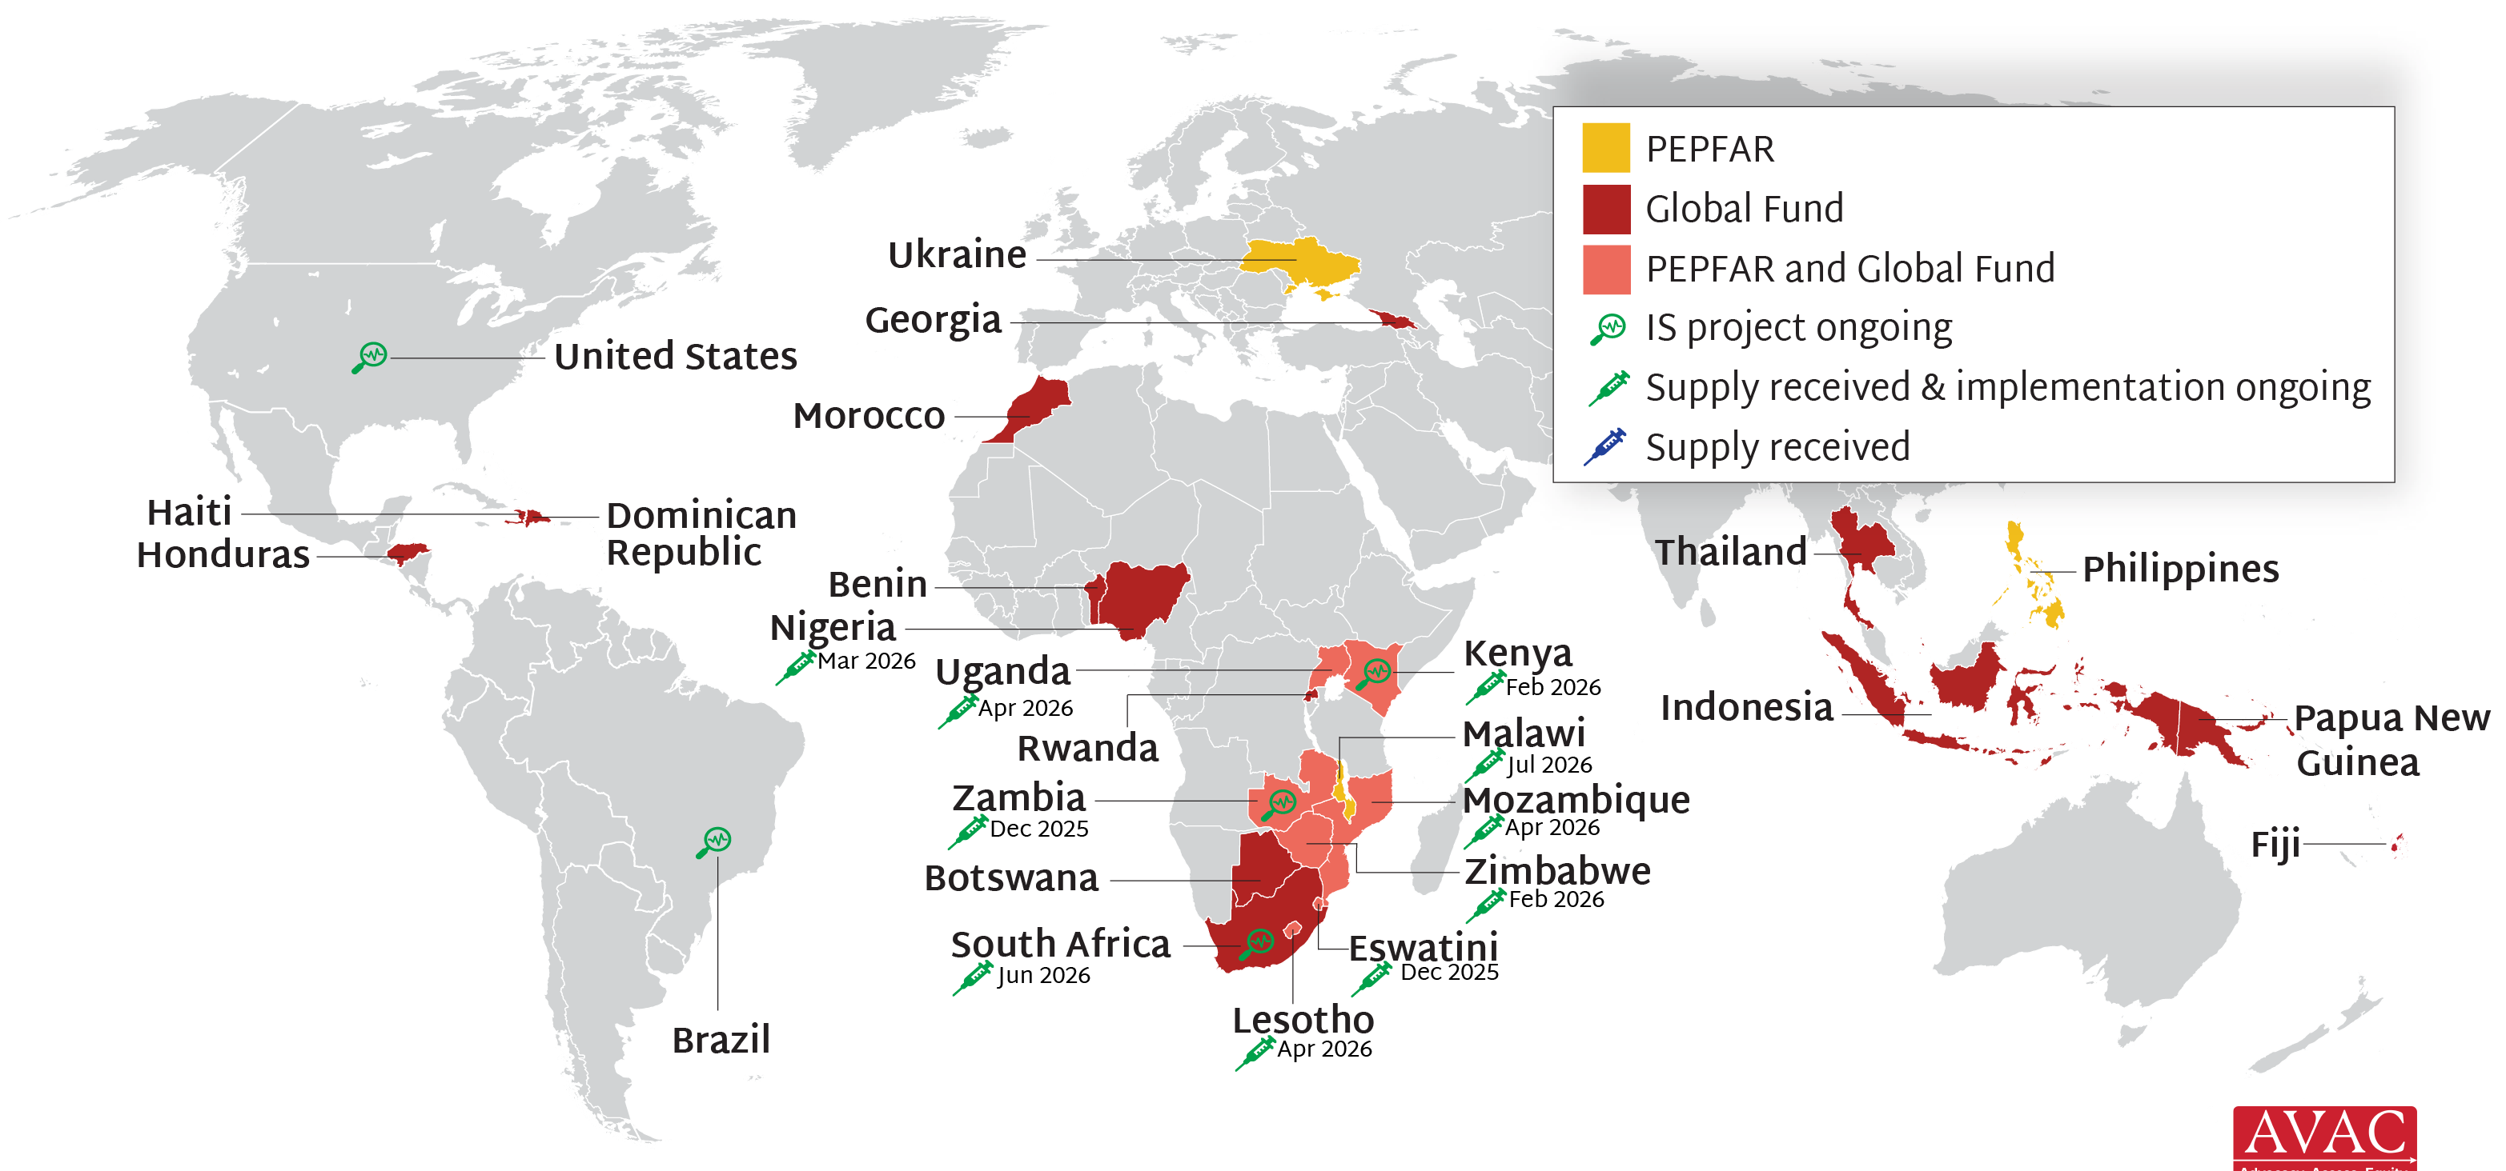
Lenacapavir for PrEP Rollout
PEPFAR & Global Fund supporting 24 countries with early LEN access; first supplies in Eswatini & Zambia in Nov 2025; balance arriving throughout 2026 & 2027. Gates Foundation, Gilead, NIH and Unitaid also supporting 21 implementation science (IS) projects in 9 countries.

