Slide 1
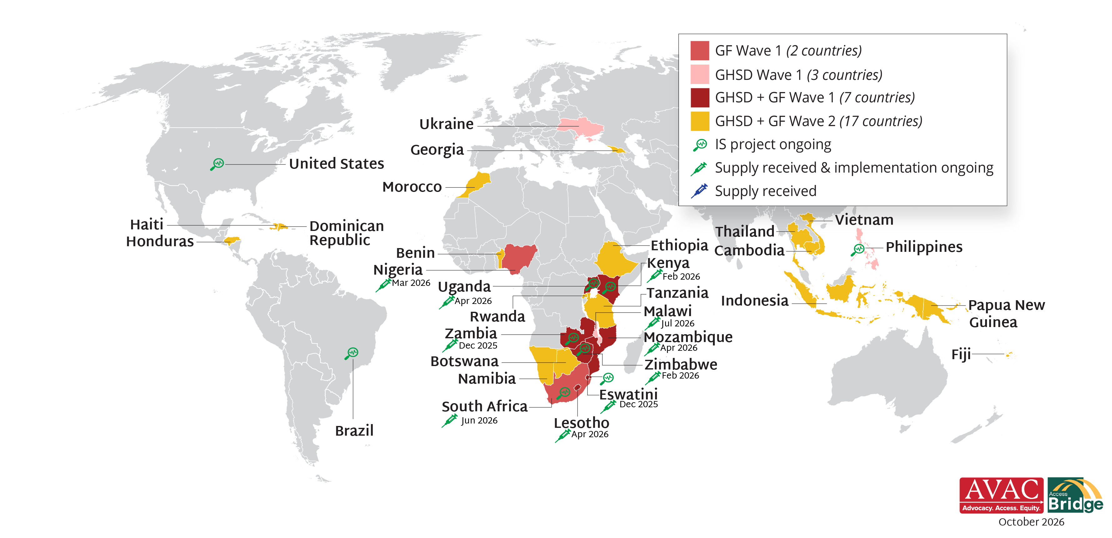
Lenacapavir for PrEP Rollout
The Bureau of Global Health Security and Diplomacy (GHSD) and Global Fund are supporting 29 low- and middle-income countries (LMICs) with early access to programmatic supply of LEN. The first supply arrived in Eswatini and Zambia in November 2025 and the rest will be arriving throughout 2026 and early 2027. The Gates Foundation, Gilead, the NIH and Unitaid are also supporting 36 implementation science (IS) projects in 9 countries.

