Slide 1
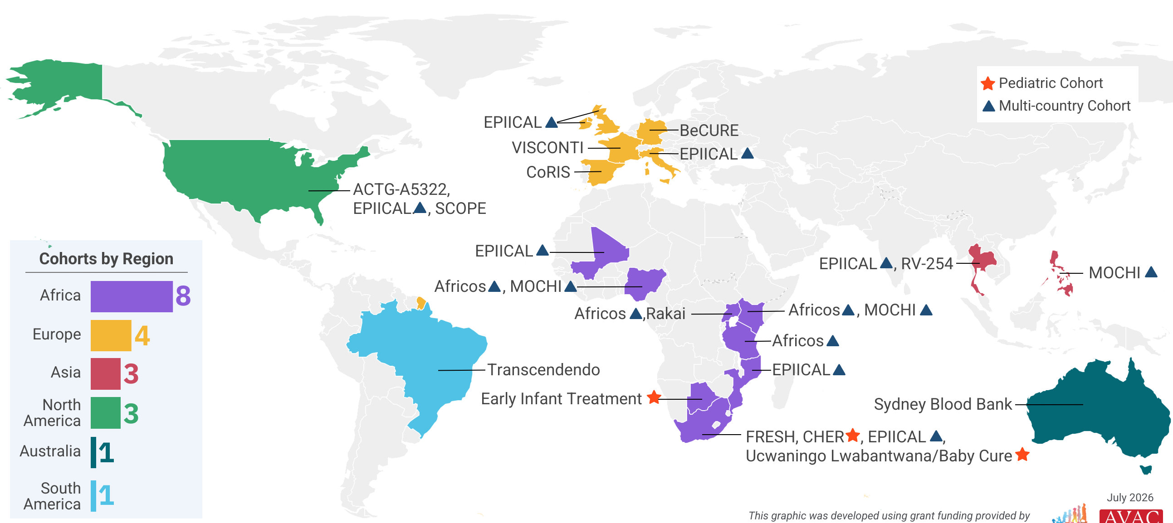
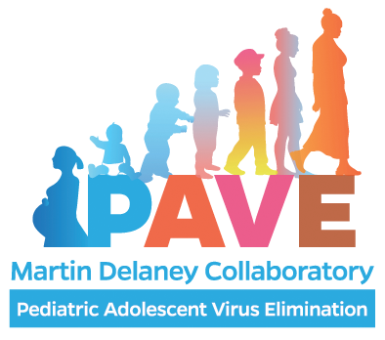
HIV Cure Research Cohorts
Groups of people living with HIV volunteer to participate in long-term studies exploring how HIV persists in the body and testing various strategies to achieve long-term viral remission without antiretroviral therapy; these cohorts are fundamental to the pursuit of an HIV cure
This graphic was developed using grant funding provided by the National Institutes of Health, grant number UM1AI164566

