Slide 1
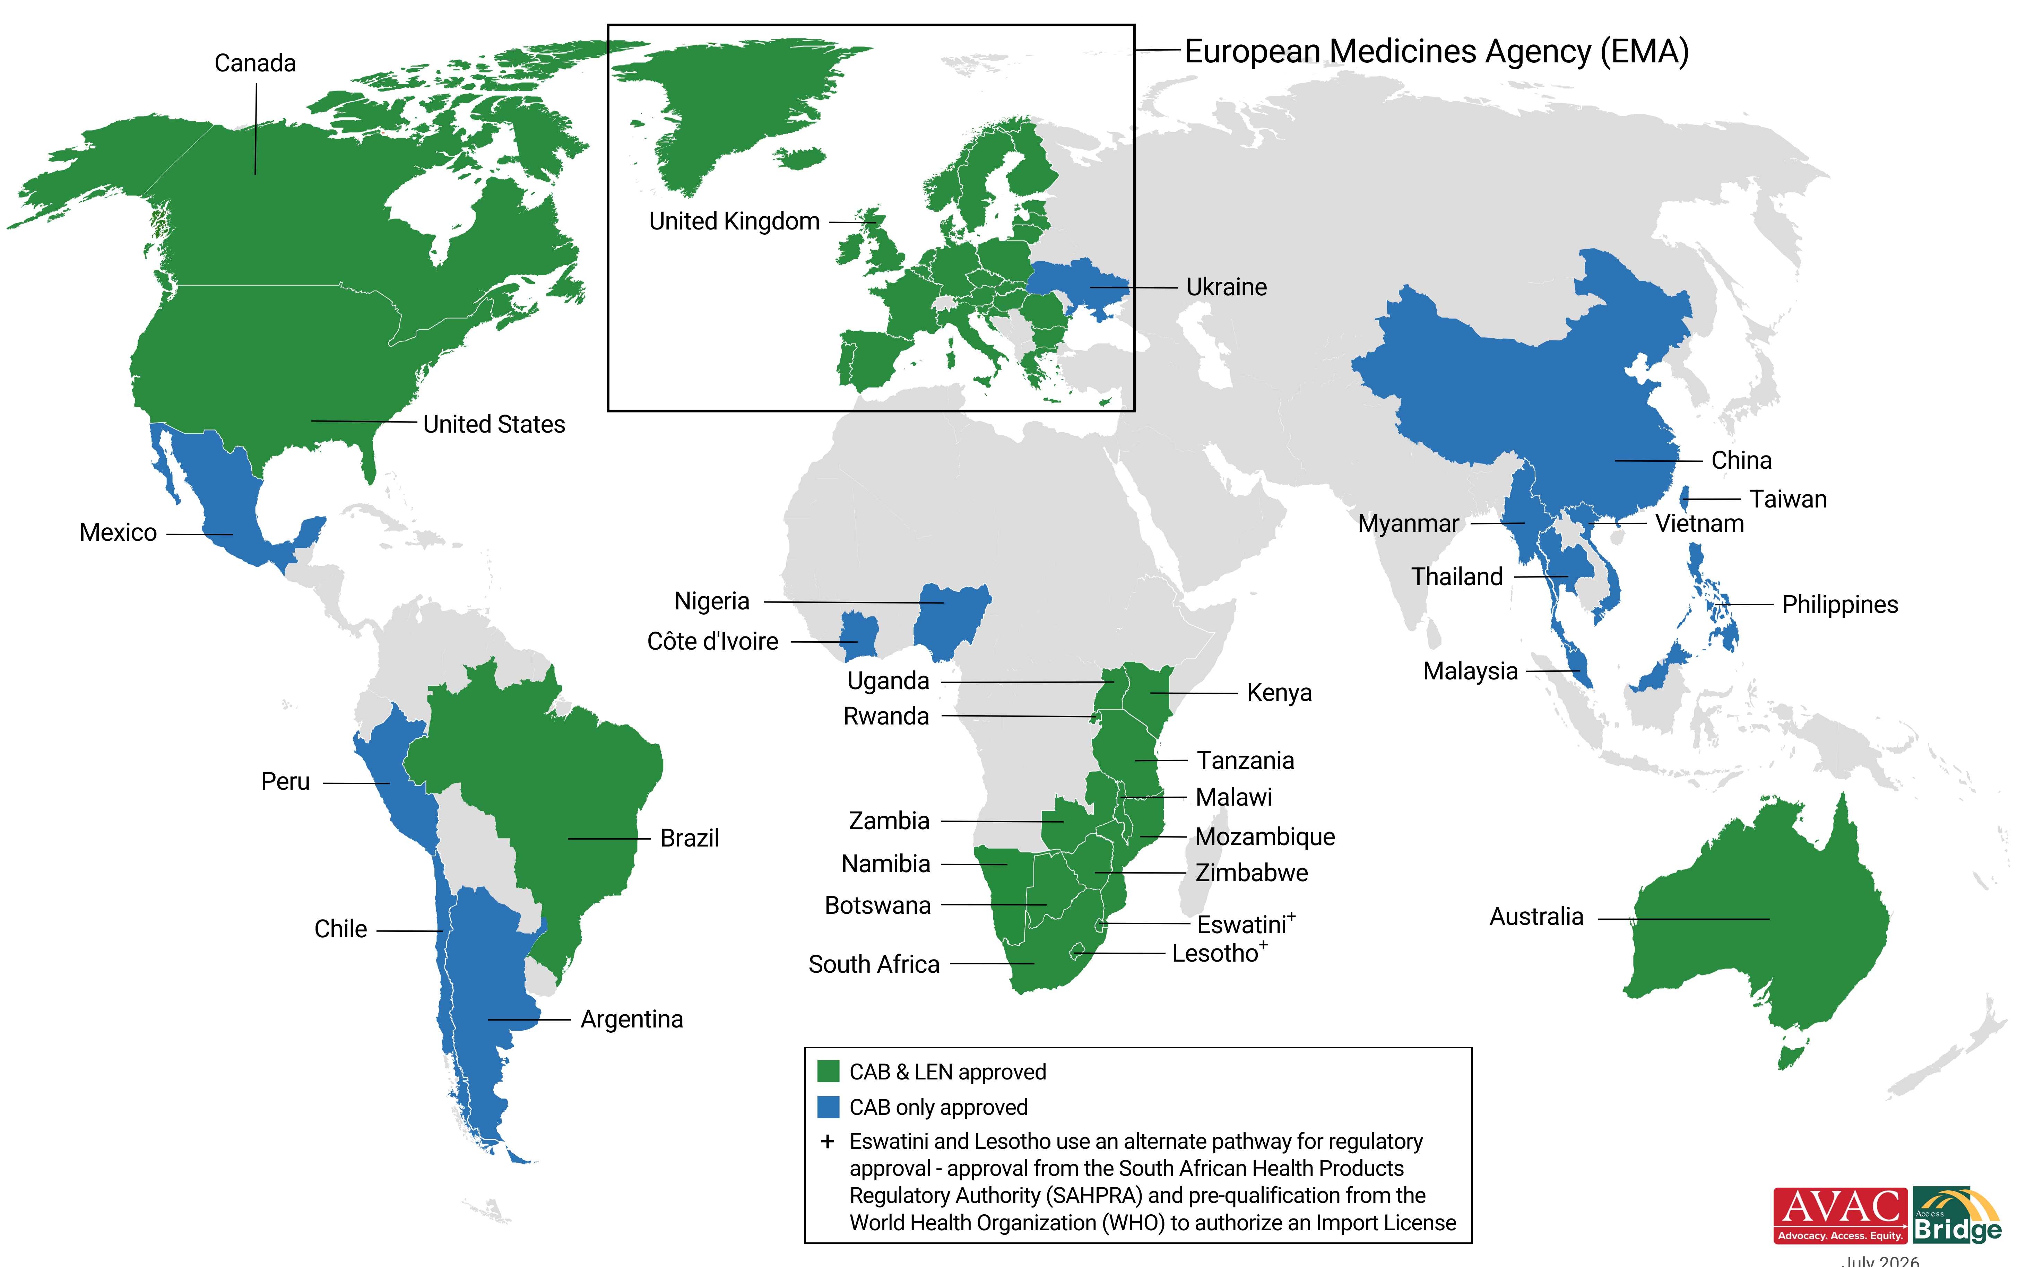
Injectable PrEP Regulatory Approvals
30 approvals for Cabotegravir; 18 approvals for Lenacapavir as of July 2026
Updated July 2026

