Slide 1
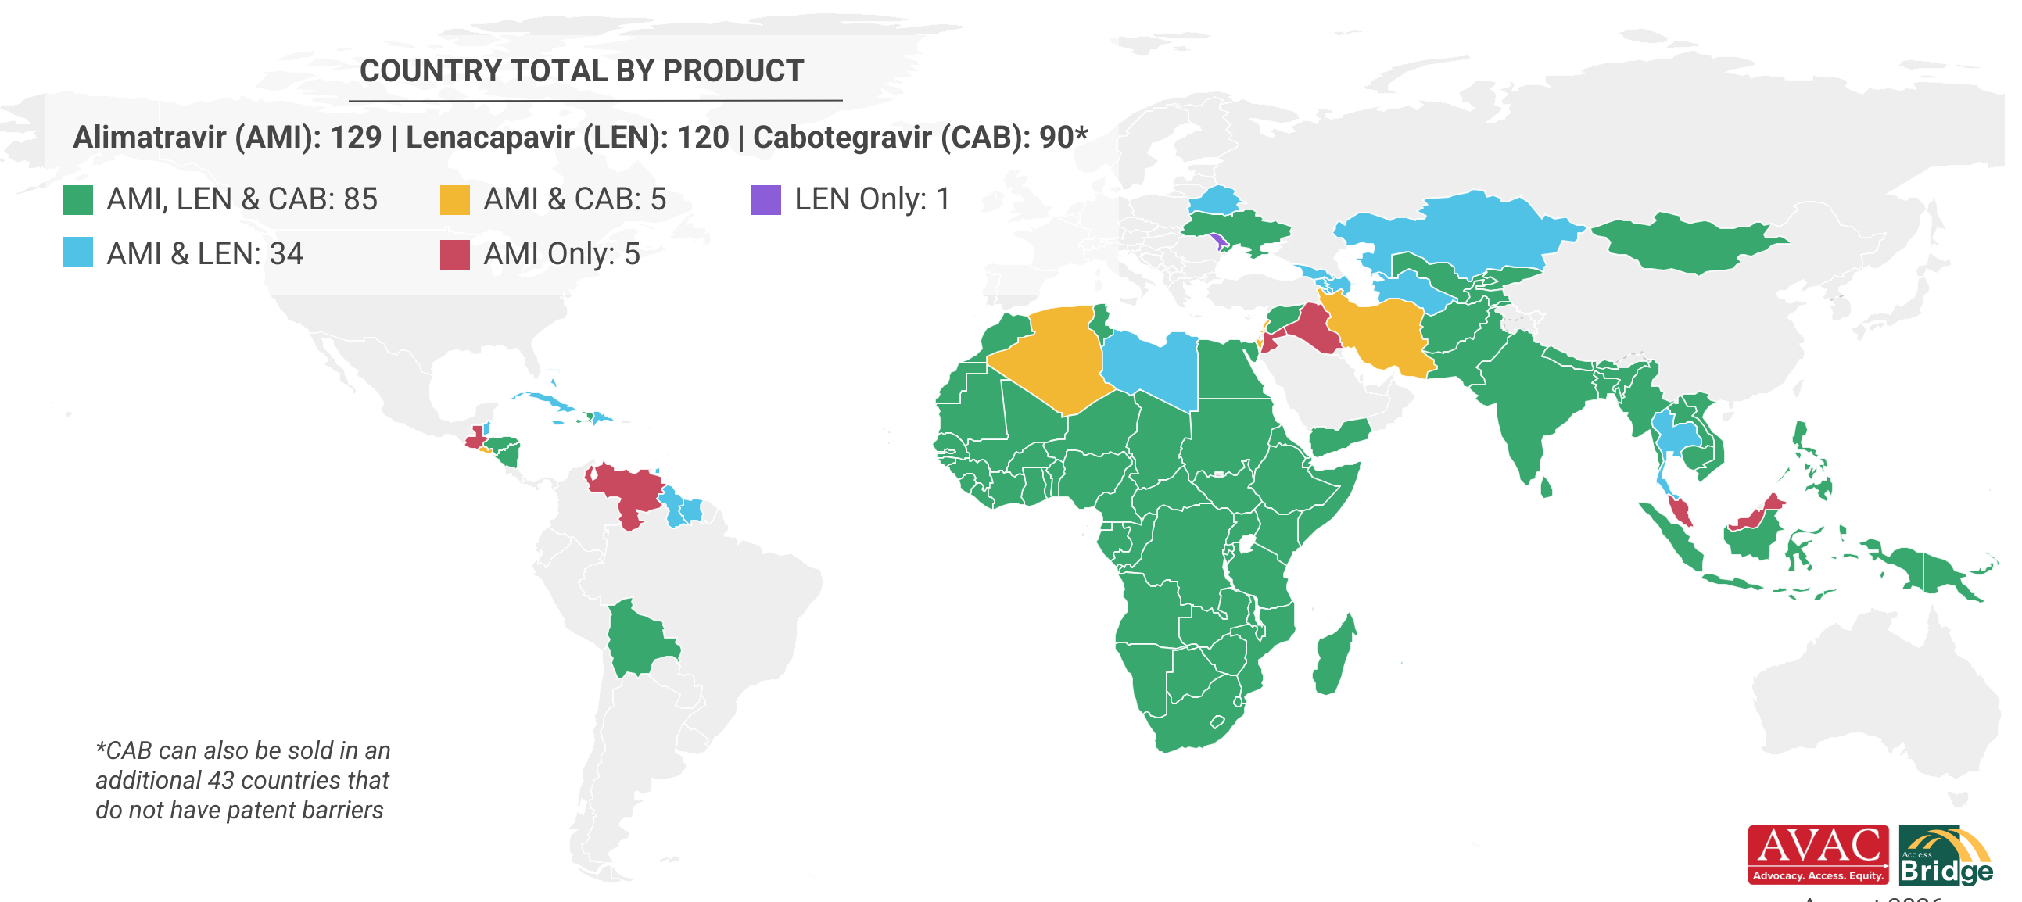
Long-Acting PrEP Generic Licensing
Despite being part of HPTN 084, PURPOSE 2 & EXPrESSIVE-11, many Latin American countries are not covered by any of the generic licenses
Countries will have to explore alternative options, such as direct and compulsory licensing
Updated August 2026

