Slide 1
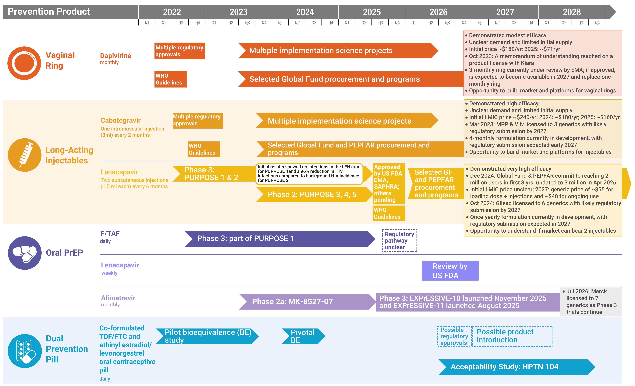
Years Ahead in HIV Prevention Research:
Time to Market
Updated August 2026

