Slide 1
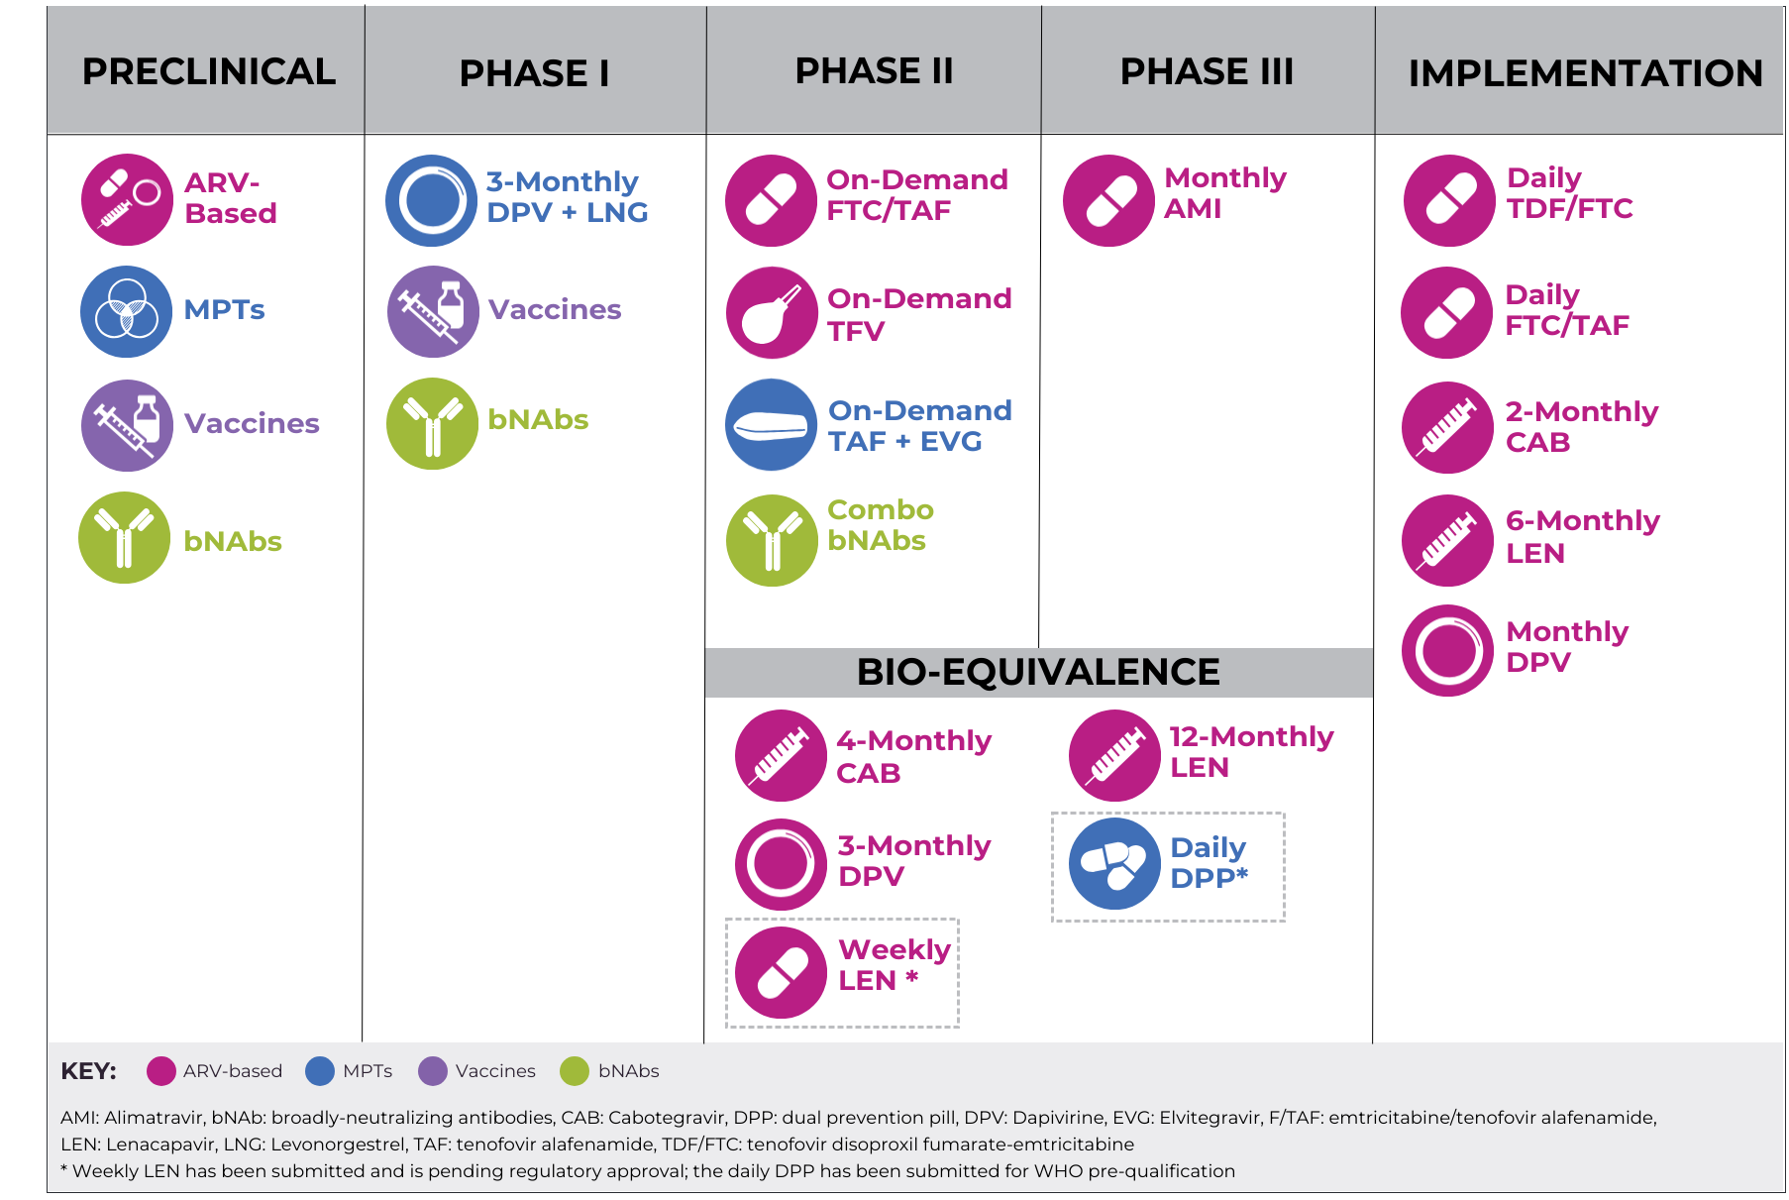
High-Level Overview of the HIV Prevention Pipeline

