Slide 1
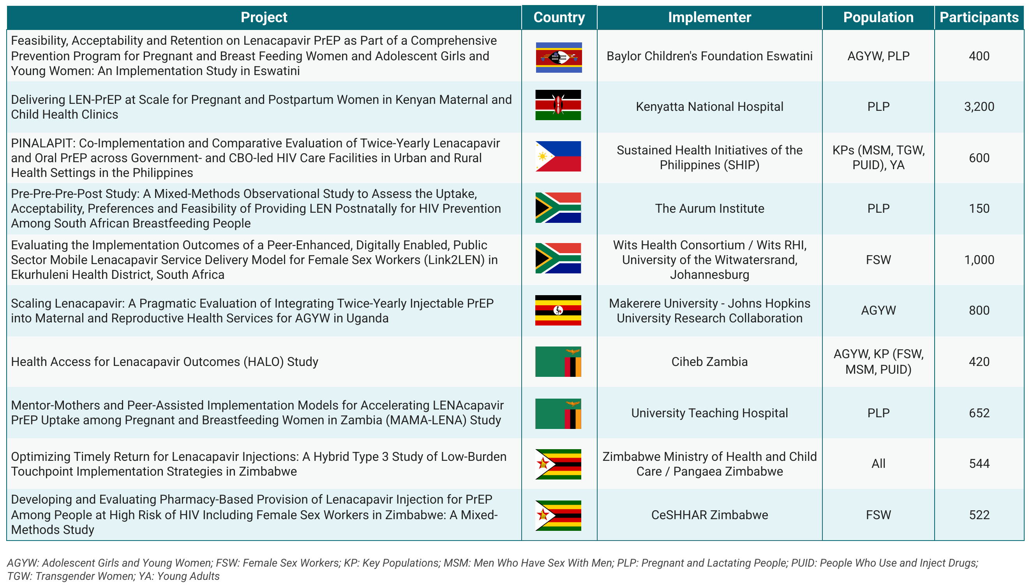
INCLUSION Global Study Details
Gilead, Unitaid and the US National Institutes of Health are funding 36 ongoing studies to investigate implementation outcomes, rapid initiation and real-life use of injectable lenacapavir (LEN) for PrEP in 9 countries. Gilead's INCLUSION program (INCLUSION Global in Africa and Asia and INCLUSION-US in the United States) accounts for 26 of these studies. This table provides details on the INCLUSION Global projects planned for 2026-2028 in 7 LEN early adopter countries.
For more details on all ongoing LEN implementation studies, see our map and visit the integrated study dashboard.
Updated August 2026

