Slide 1

Artificial Intelligence in the HIV response:
All the good stuff from AIDS2026
Jirair Ratevosian
Duke Global Health Institute

Slide 2
Disclosures
Track F co-chair
Previous Senior Advisor, Audere Africa
Member of the Lancet Commission on HIV and AI

Slide 3
Talk Outline
Quick analysis of Abstract Book
Key themes from AI use cases
Emerging trends in governance, policy and financing

Slide 4
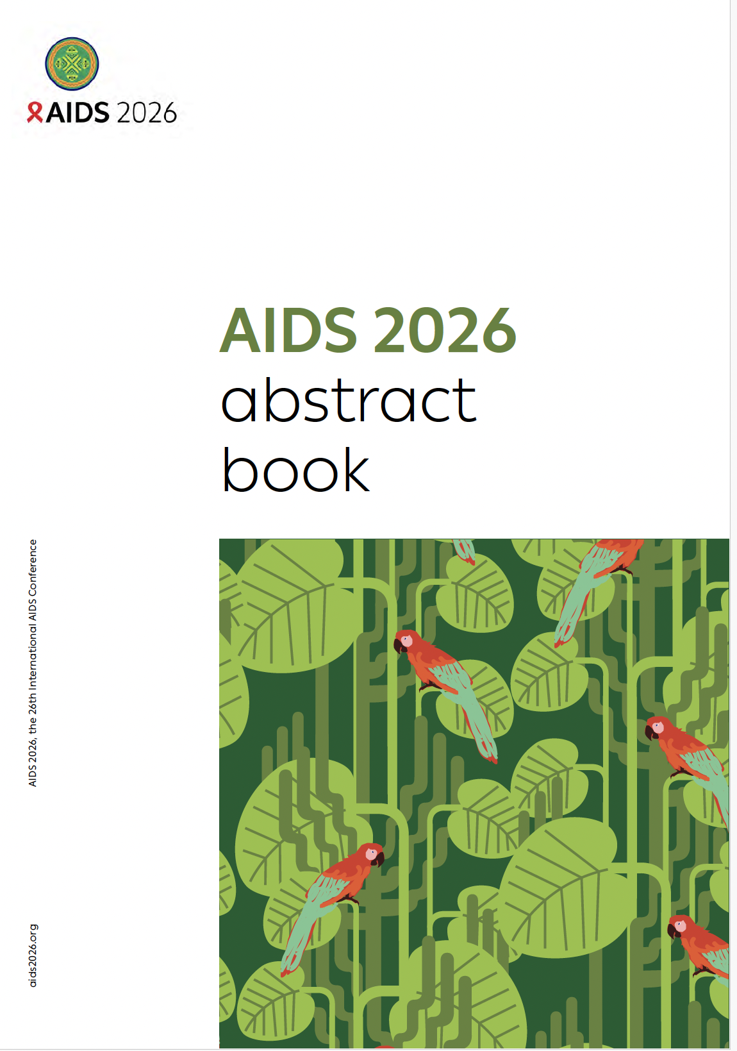
Submitted Abstracts
https://www.iasociety.org/sites/default/files/AIDS2026/AIDS-2026_Abstracts.pdf

Slide 5
AI has moved well beyond pilots and opinion pieces—but most abstracts still show feasibility, model performance or implementation, not attributable health impact.
85
63
47
2
AI-related abstracts under an inclusive definition
treat AI as the core intervention or analytic method
focus on sub-Saharan Africa
evaluate outcomes experimentally
Source: AIDS 2026 Abstract Book; AI analysis (ChatGPT Pro) and reviewed by author
2

Slide 6
Thematic overview of selected abstracts
53
abstracts—62% of the set—focus on the service interface, diagnostics or program operations.
Source: AIDS 2026 Abstract Book; author analysis
3
Notes:
The dominant themes are closest to patients and programs. Research and surveillance remain important, but service delivery now drives the center of gravity.
[Sources]
- AIDS 2026 Abstract Book: https://www.iasociety.org/sites/default/files/AIDS2026/AIDS-2026_Abstracts.pdf
- AIDS2026_AI_Abstracts_Matrix.xlsx; thematic classification of all 85 abstracts

Slide 7
Most evidence stops before impact
57 / 85
are implementation reports or model-development studies
2 / 85
evaluate outcomes experimentally: one RCT and one quasi-experimental study
Source: AIDS 2026 Abstract Book; author analysis
10
Notes:
The systematic reviews reinforce the same gap. WEPEE487 found 10 chatbot studies with only 138 participants; EP106 found early PrEP promise but limited controlled evidence.
[Sources]
- WEPEE487, p. 795; EP106, p. 1371 in https://www.iasociety.org/sites/default/files/AIDS2026/AIDS-2026_Abstracts.pdf
- AIDS2026_AI_Abstracts_Matrix.xlsx; evidence-maturity coding of 85 abstracts

Slide 8
The portfolio is geographically mixed
27
abstracts come from four repeated platform families
14 Audere / Shout-It-Now
6 Nigeria AI-CAD / portable X-ray
4 EPCON geospatial platform
3 MARVIN / LLM triage
Source: AIDS 2026 Abstract Book; author analysis
11
Notes:
Sub-Saharan Africa accounts for 55% of the set, which is a strength. But repeated analyses of the same platforms mean abstract count should not be equated with independent replication.
[Sources]
- AIDS 2026 Abstract Book: https://www.iasociety.org/sites/default/files/AIDS2026/AIDS-2026_Abstracts.pdf
- AIDS2026_AI_Abstracts_Matrix.xlsx; region and repeated-platform coding

Slide 9
What do the accepted abstracts tell us about the applications of AI in HIV?

Slide 10
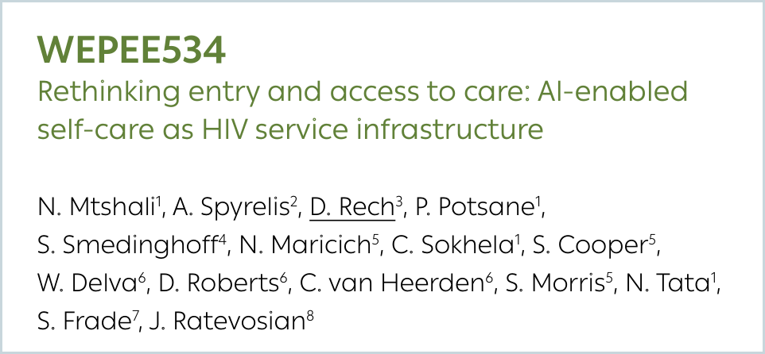
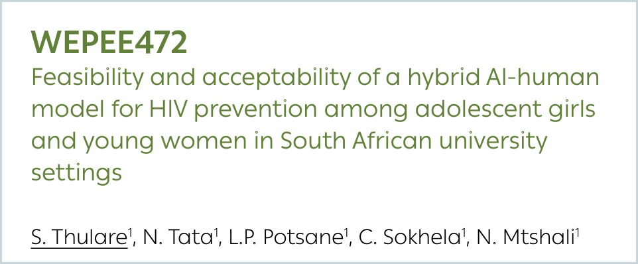
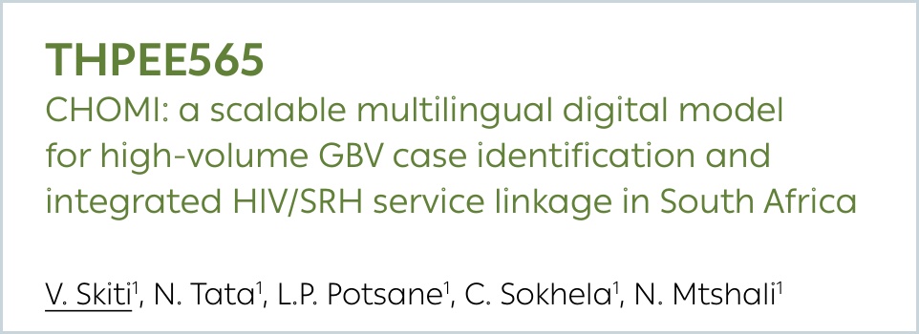
AI is becoming a new front door to HIV services
Conversational AI is shifting from information delivery to measurable entry, triage and linkage across the HIV/SRH continuum.
45%
95.8%
99.8%
of Aimee users who chatted with AI took up HIV testing and/or PrEP
on-site testing completion in a hybrid AI–human university model
resolution of support-linkage requests among 10,155 CHOMI users
WEPEE534
WEPEE472
THPEE565
Emerging insight: the AI product is increasingly the service pathway itself.
Source: WEPEE534, WEPEE472, THPEE565
4
Notes:
Stress the operational shift: these tools generate demand, support risk assessment and connect users to testing, prevention, treatment and human care.
[Sources]
- WEPEE534, p. 821; WEPEE472, p. 785; THPEE565, p. 1239 in https://www.iasociety.org/sites/default/files/AIDS2026/AIDS-2026_Abstracts.pdf

Slide 11
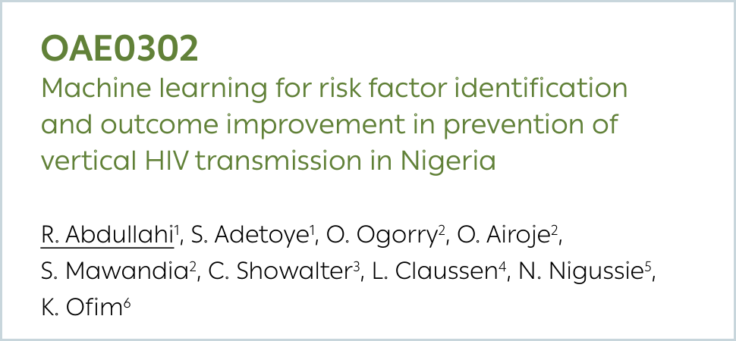
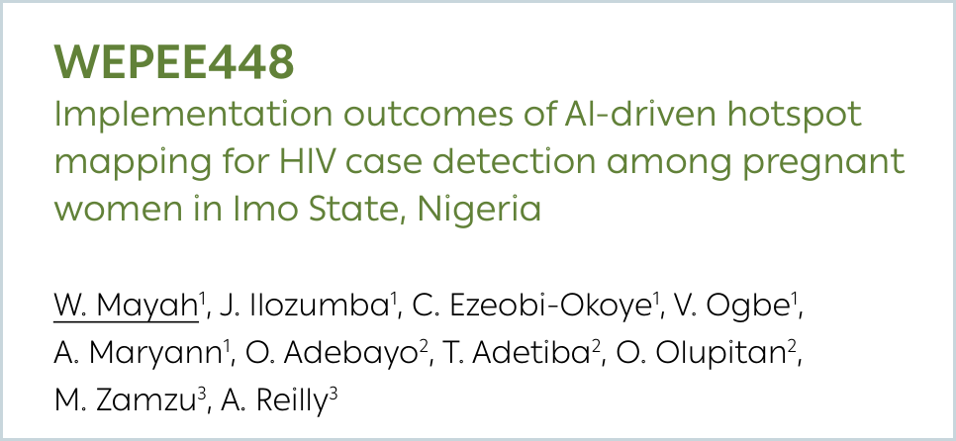
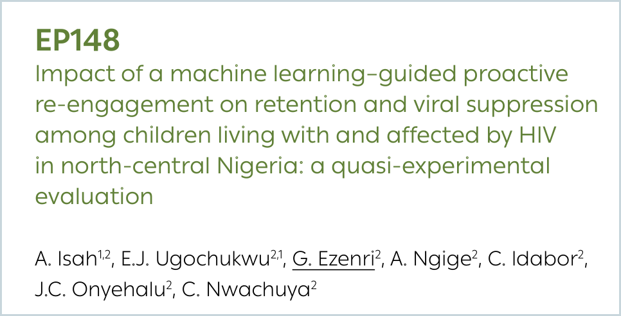
Prediction is beginning to steer outreach
ABSTRACT
USE CASE
SIGNAL
PROGRAM VALUE
OAE0302
Vertical transmission
AUC 0.773
Identified modifiable risks; authors estimate two-thirds of high-risk transmissions may be preventable
WEPEE448
Hotspot mapping
2× cases
Reach expanded from 5,675 to 26,900 pregnant women; detected cases more than doubled
EP148
Pediatric re-engagement
+20.7 pts
Six-month retention rose from 61.4% to 82.1% in a quasi-experimental evaluation
Source: OAE0302, OAE0303, WEPEE448, EP148
5
Notes:
The strongest case is not that AI predicts risk. It is that prediction can focus outreach, clinical attention and scarce implementation capacity. EP148 is one of only two outcome evaluations in the set.
[Sources]
- OAE0302, pp. 86–87; OAE0303, p. 87; WEPEE448, p. 772; EP148, p. 1394 in https://www.iasociety.org/sites/default/files/AIDS2026/AIDS-2026_Abstracts.pdf

Slide 12
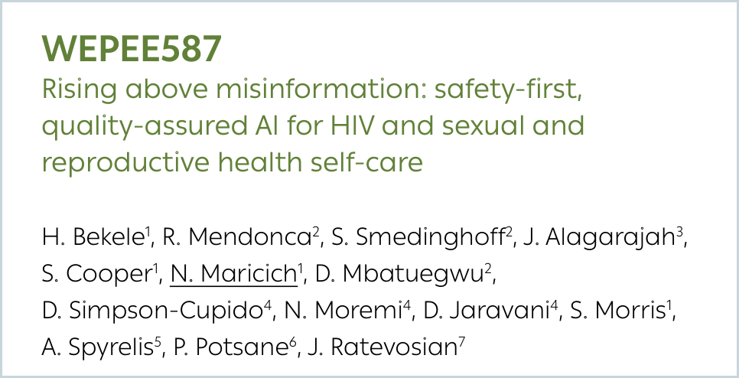
Trust requires more than accuracy
Community voices and implementation studies converge on three requirements for responsible AI in HIV services.
1
Transparency + privacy
Explain what data are used, protect sensitive STI/HIV information and connect predictions to tangible services.
2
Grounded, context-specific outputs
Adapt moderation and clinical content to local language, culture and epidemiology; document model limitations.
3
Human escalation + continuous monitoring
Use explicit safety protocols, dual escalation pathways and routine review of errors and near misses.
8
Notes:
OAE0304 found strong community interest alongside concern about privacy and transparency. WEPEE587 reported no harmful misinformation across more than 300,000 interactions under layered safeguards; present this as developer-reported implementation evidence, not definitive independent proof.
[Sources]
- OAE0304, p. 87; WEPEE587, p. 852; THPED418, p. 1153 in https://www.iasociety.org/sites/default/files/AIDS2026/AIDS-2026_Abstracts.pdf

Slide 13
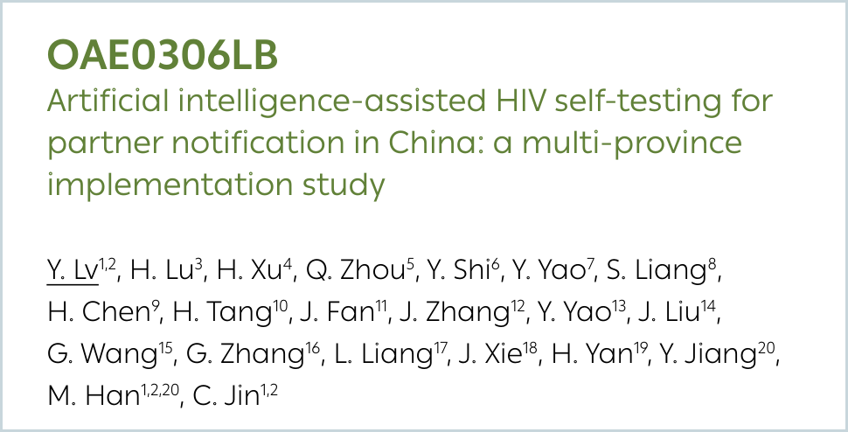
AI partner testing returned 488 positive results
OAE0306LB · Multi-province implementation study · China
The combination of automated result reading, encrypted reporting and referral produced unusually high-yield partner testing across 17 provinces.
80.8%
result-return rate
12.1%
positivity among returned partner tests
Earlier + cheaper
Among 258 positive partners with CD4 data, late diagnosis was 31% versus a 40% national benchmark; one-city cost per diagnosis was about one-third of facility testing.
Source: OAE0306LB, pp. 1528–1529
14
Notes:
This is the strongest overall abstract because it combines scale, high diagnostic yield, earlier diagnosis and an initial cost signal. Keep the causal language disciplined: it was an implementation study, not a randomized comparison.
[Sources]
- OAE0306LB, pp. 1528–1529 in https://www.iasociety.org/sites/default/files/AIDS2026/AIDS-2026_Abstracts.pdf

Slide 14
Targeted outreach improved pediatric HIV outcomes
EP148 · Quasi-experimental evaluation · 623-child intervention cohort · Nigeria
Machine-learning-guided outreach was associated with substantial gains across re-engagement, retention and viral suppression.
Outcome rate (%)
+24.7
points in re-engagement
+20.7
points in six-month retention
+11.6
points in viral suppression
Source: EP148, p. 1394
15
Notes:
This abstract offers the clearest signal of improved HIV outcomes, including viral suppression. The design is quasi-experimental, so present the magnitude as promising evidence that warrants replication.
[Sources]
- EP148, p. 1394 in https://www.iasociety.org/sites/default/files/AIDS2026/AIDS-2026_Abstracts.pdf

Slide 15
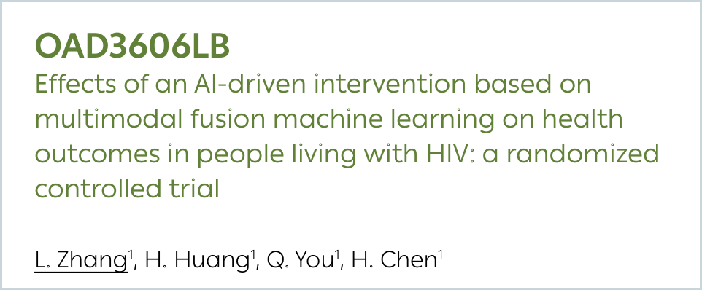
OAD3606LB · Randomized controlled trial · 100 adults · China
Participants received routine follow-up alone or routine care plus an AI-enabled WeChat management platform, assessed at one and three months.
Self-management
Improved
100
Disease knowledge
Improved
participants
Quality of life
Improved
50
Self-efficacy
Improved
AI intervention
50
routine follow-up
Medication adherence
No significant difference
Source: OAD3606LB, p. 1527
16
Notes:
This was the only randomized controlled trial among the 85 AI-related abstracts. It improved several patient-reported outcomes, but not adherence. The small sample and three-month follow-up limit conclusions about durable clinical impact.
[Sources]
- X , p. 1527 in https://www.iasociety.org/sites/default/files/AIDS2026/AIDS-2026_Abstracts.pdf

Slide 16
Hotspot mapping doubled diagnoses
WEPEE448 · Before-and-after implementation study · Pregnant women · Nigeria
AI-guided geographic targeting shifted house-to-house testing toward predicted hotspots in Imo State.
5,675
65
100%
→ 26,900
→ 131
linkage to ART
pregnant women reached
HIV diagnoses
reported in both periods
4.7× expansion
2.0× increase
Source: WEPEE448, p. 772
17
Notes:
This is strong operational evidence that targeting can expand reach. The interpretation needs nuance: diagnoses doubled, but the positivity rate declined as testing expanded. The before-and-after design also leaves room for other explanations.
[Sources]
- WEPEE448, p. 772 in https://www.iasociety.org/sites/default/files/AIDS2026/AIDS-2026_Abstracts.pdf

Slide 17
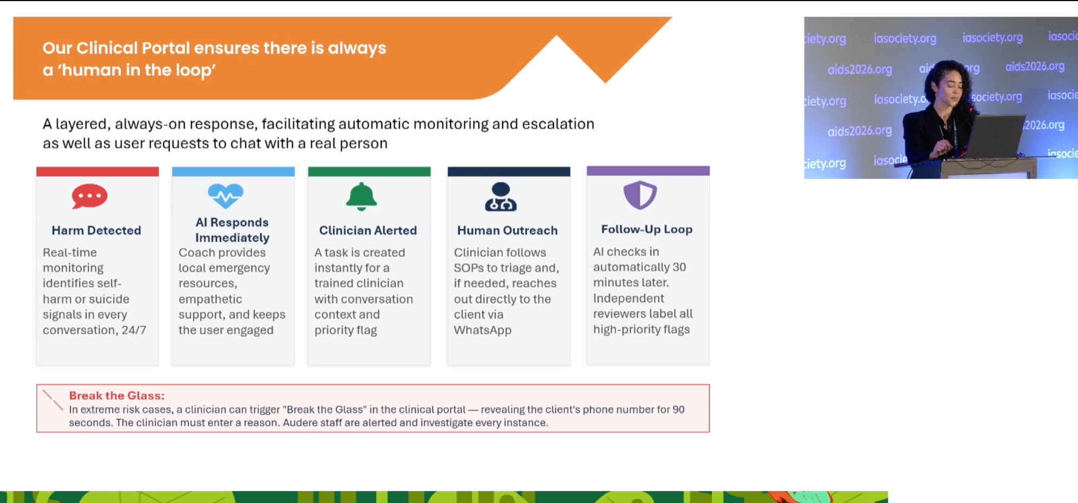
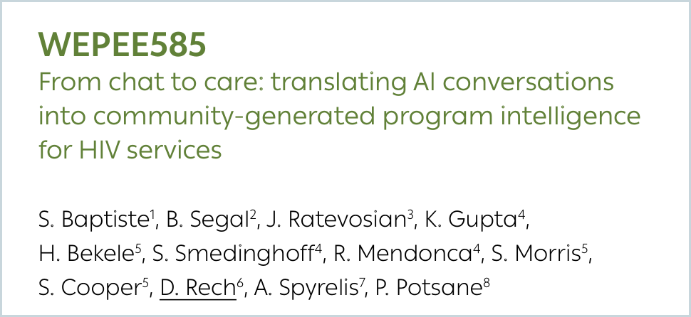
AI conversations can guide HIV programs
WHAT IT ADDS
WEPEE585 | TWO COUNTRIES | 2025
WHAT IT ADDS
Conversations → structured signals → program action
AI responds immediately while a clinician is alerted.
01
Conversations produce real-time, community-level intelligence.
01
01
120+
03
Conversations
Program action
02
120+ indicators feed dashboards, risk flags and outreach.
02
Escalation carries conversation context and priority.
AI + clinician-mediated
structured signals
dashboards • risk flags
nudges • targeted outreach
HIV/SRH • mental health • SDOH
03
Aimee: 45% linked to testing or PrEP care.
of Aimee users who chatted with AI linked to downstream care
03
Follow-up and independent review close the safety loop.
45%
HIV testing or PrEP initiation/refill • self-reported and provider-validated
Safety depends on roles, timing and auditability.
AI can augment CLM—but it cannot replace community oversight.
Source: AIDS 2026 abstract WEPEE585 · Baptiste et al.
23
Notes:
WEPEE585 asks whether AI conversations can do more than answer questions.
Baptiste and colleagues analyzed AI- and clinician-mediated conversations across multiple populations in two countries in 2025. The team extracted more than 120 indicators spanning HIV and sexual and reproductive health, mental health, behaviors, demographics and social determinants of health.
Sensitive needs were often disclosed spontaneously. Users attributed that comfort to anonymity, lower stigma and the ability to set the pace of the conversation.
Those signals fed dashboards, risk stratification, nudges and targeted outreach. In Aimee, 45% of users who chatted with AI subsequently linked to downstream care, including HIV testing and PrEP initiation or refill.
The key insight is that the chatbot can become a feedback loop—not just a front door. But AI should augment community-led monitoring, not replace community governance.
Caveat: The Aimee finding was observational, with uptake self-reported and provider-validated. It does not establish that the AI caused the linkage outcome.
[Sources]
- AIDS 2026 Abstract Book, WEPEE585, pp. 850–851.

Slide 18
Selected Presentations: AI and HIV Use Cases
https://www.iasociety.org/sites/default/files/AIDS2026/AIDS-2026_Abstracts.pdf

Slide 19
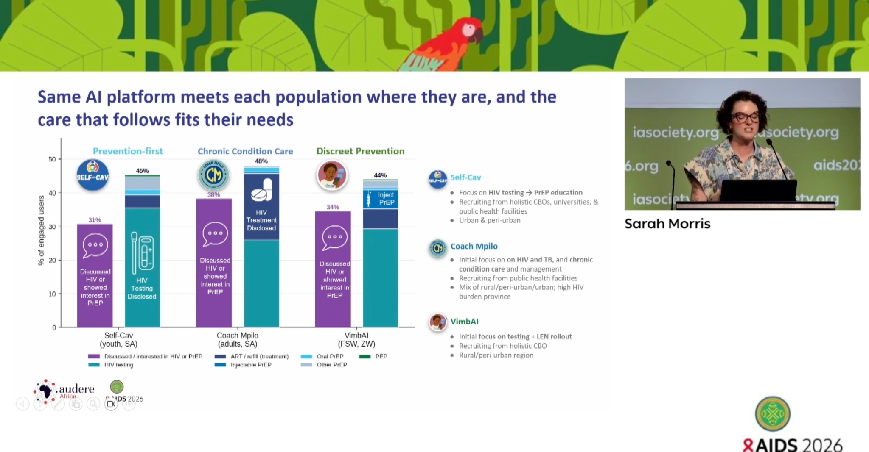
One platform can serve very different pathways
WHAT IT ADDS
01
A shared platform can support distinct service pathways.
02
Population fit changes the mix of testing, PrEP and treatment support.
03
Personalization is operational—not merely conversational.
Design the pathway around the population, not the model.
Source: AIDS 2026 presentation slide · Sarah Morris
19
Notes:
This snapshot makes the service-model point concrete: Self-Cav, Coach Mpilo and VimbAI use a common AI platform but configure recruitment, content and follow-on care differently.
[Sources]
- Sarah Morris, AIDS 2026 presentation screenshot: Screenshot 2026-08-22 at 5.19.48 PM.png
- Conference-slide metrics and claims are reproduced as presented and were not independently validated against the abstract book.

Slide 20
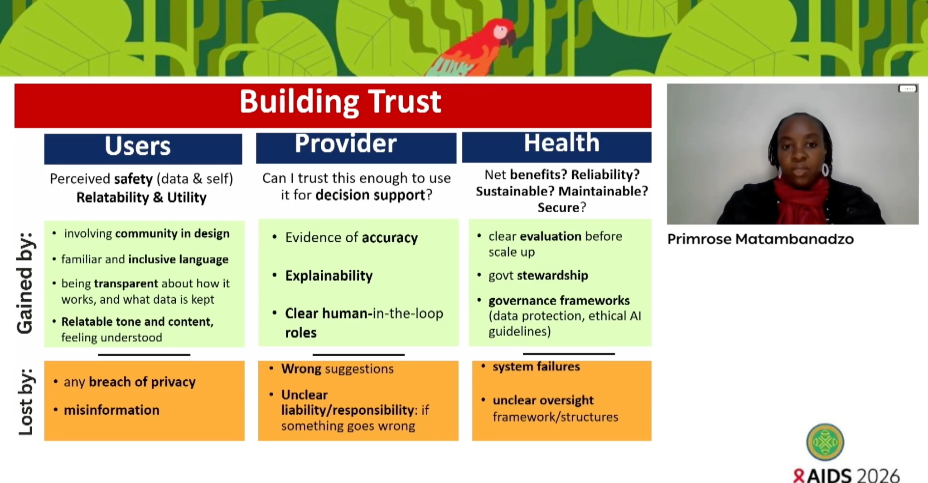
Trust must work at three levels
WHAT IT ADDS
01
Users need safety, relatability and understandable language.
02
Providers need accuracy, explainability and clear human roles.
03
Health systems need governance, security and maintainability.
Trust is a system property—not a user-interface feature.
Source: AIDS 2026 presentation slide · Primrose Matambanadzo
20
Notes:
Use this slide to broaden the trust discussion beyond model accuracy. Adoption depends on different assurances for users, providers and institutions.
[Sources]
- Primrose Matambanadzo, AIDS 2026 presentation screenshot: Screenshot 2026-08-22 at 5.22.08 PM.png
- Conference-slide metrics and claims are reproduced as presented and were not independently validated against the abstract book.

Slide 21
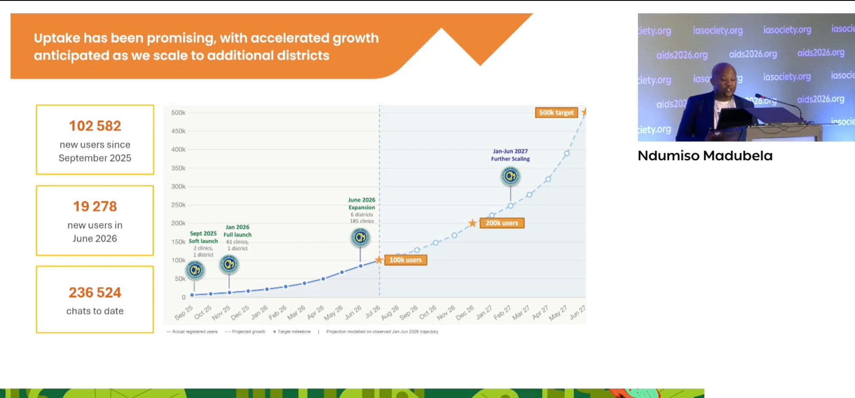
Scale is becoming visible in real-world use
WHAT IT ADDS
01
The program reported 102,582 users since September 2025.
02
June 2026 alone added 19,278 users.
03
More than 236,000 chats show repeat operational demand.
The field now needs outcomes to keep pace with adoption.
Source: AIDS 2026 presentation slide · Ndumiso Madubela
21
Notes:
This implementation snapshot shows that conversational AI is no longer uniformly small-scale. Present the figures as program-reported adoption, then return to the evidence gap on health outcomes.
[Sources]
- Ndumiso Madubela, AIDS 2026 presentation screenshot: Screenshot 2026-08-22 at 7.35.44 PM.png
- Conference-slide metrics and claims are reproduced as presented and were not independently validated against the abstract book.

Slide 22
Human oversight is becoming the norm
WHAT IT ADDS
01
AI responds immediately while a clinician is alerted.
02
Escalation carries conversation context and priority.
03
Follow-up and independent review close the safety loop.
Safety depends on roles, timing and auditability.
Source: AIDS 2026 presentation slide · Shawn Malone
22
Notes:
This slide turns 'human in the loop' into an operational sequence. Emphasize the handoffs, escalation timing, follow-up and independent review—not simply the presence of a clinician.
[Sources]
- Shawn Malone, AIDS 2026 presentation screenshot: Screenshot 2026-08-22 at 7.45.18 PM.png
- Conference-slide metrics and claims are reproduced as presented and were not independently validated against the abstract book.

Slide 23
Governance, Ethics, Financing of AI in HIV

Slide 24
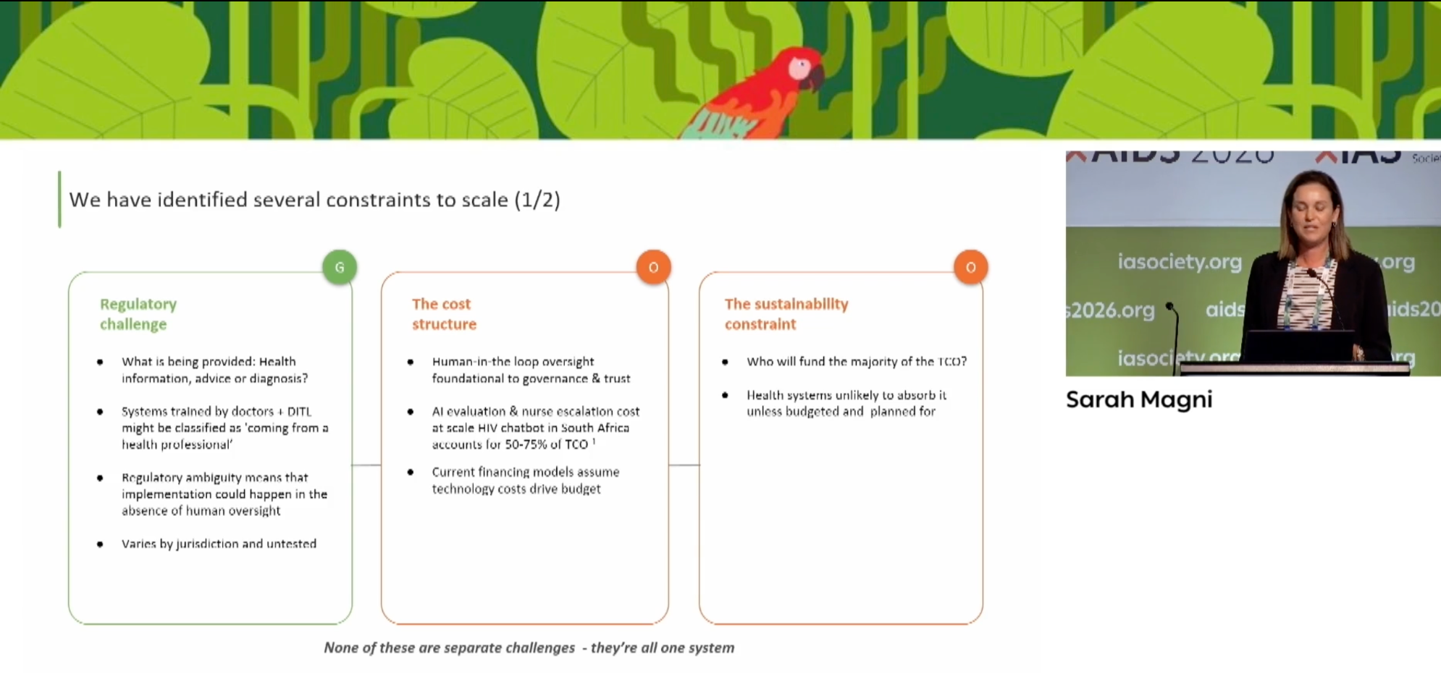
Scaling AI requires regulatory and financial realism
WHAT IT ADDS
01
Regulatory ambiguity can make human oversight unavoidable.
02
Evaluation and escalation may dominate total cost of ownership.
03
Sustainability must be budgeted before health systems inherit the tool.
Scale planning must include governance and recurring human cost.
Source: AIDS 2026 presentation slide · Sarah Magni
23
Notes:
Use this snapshot to counter the assumption that lower technology costs automatically make AI affordable. Governance, evaluation, escalation and transition financing shape the real cost structure.
[Sources]
- Sarah Magni, AIDS 2026 presentation screenshot: Screenshot 2026-08-22 at 5.24.04 PM.png
- Conference-slide metrics and claims are reproduced as presented and were not independently validated against the abstract book.

Slide 25
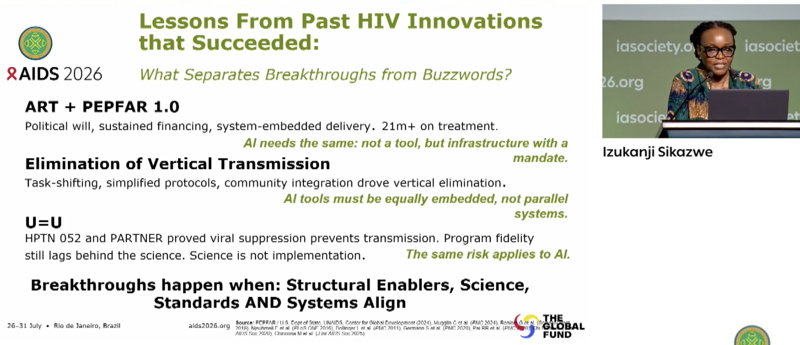

Slide 26
Governance:
Who sets the guardrails? Who owns the AI tools applied to public health data?
The gap: AI is being deployed faster than it is governed.
Governance should be defined prior to deployment and not retrofitted after an incident
Risk of void that can be exploited in the current competitive environment to scale quickly, commercial interests and lack of AI literacy
Governance supports:
Accountability – clear ownership of every AI-informed decision, and who answers when it gets something wrong.
Decision rights & Oversight – an approval gate, audit trail, human checkpoints to approve, monitor and, where needed, withdraw a tool.
Standards – alignment to recognised norms: WHO AI ethics guidance, regional policy makers, national data laws

Slide 27

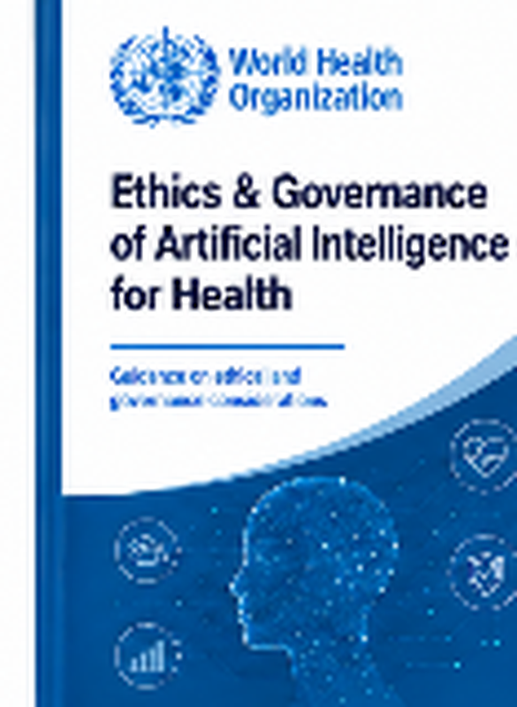

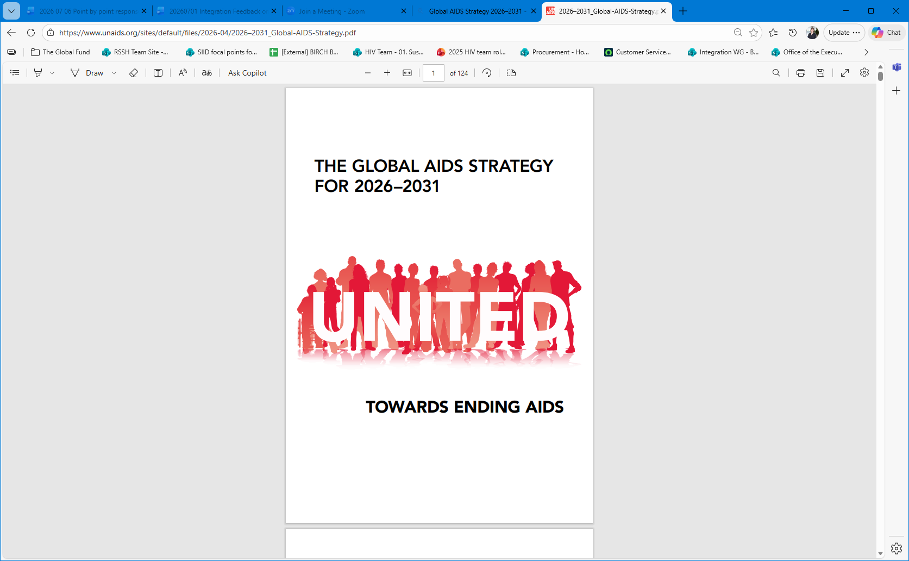

Key AI & HIV Policy Documents
WHO Guidance
Global AIDS Strategy 2026–2031
2026 UN HLM Political Declaration
Global guidance on the ethics and governance of AI for health. Emphasizes human rights, transparency, accountability, and public benefit.
Sets the global HIV agenda for 2026–2031. Prioritizes sustainability, equity, community leadership, and access to innovation.
Political declaration adopted by UN Member States to guide the next phase of the HIV response. Includes commitments on rights, equity, digital health, and AI.
The guiding documents already exist — as advocates, we should lean into their broader use to govern how AI is introduced and scaled across the HIV response.

Slide 28
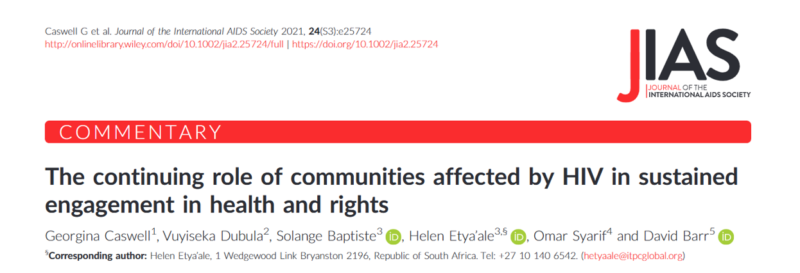
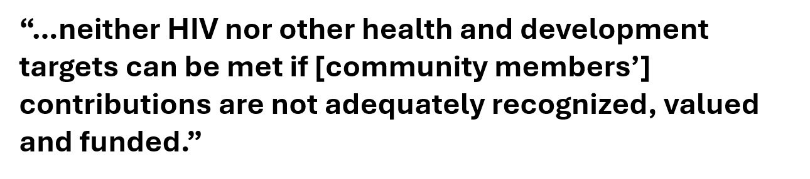
Engagement
Built without its users
HIV has a strong tradition of involvement of community activism and involvement.
  Yet, we have had to progress from Greater involvement to Meaningful involvement.
  Human-centered design approach / co-creation is also needed to design AI interventions
Communities have been central to drug access, funding, service delivery and peer care, stigma reduction, and every other component of HIV gains.

Slide 29
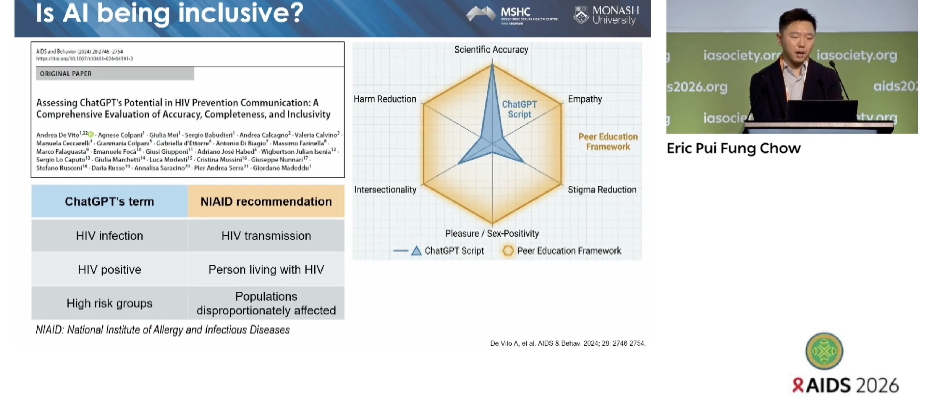
Language Matters

Slide 30
The Global Fund’s Investments in AI
Largest investment: TB Computer-aided diagnosis
Other AI investments: Pandemic response & HIV
2021-2025, over 20 countries invested US$170 million in computer-aided diagnosis of TB (CAD4TB)
2024-2026: investments in AI tools across other diseases and systems.
Spotlight: Zambia
Zambia is using AI-powered CAD4TB, deployed via a fleet of 7 mobile vans funded by the Global Fund.
Pandemic preparedness using AI-enabled skin tests for Mpox in Rwanda
Mpox skin image detection AI tool.
Used by health workers on mobile devices.
Deployed at key points of entry from Rwanda's borders to identify cases and support client tracking.
TB case notifications increased by over 65%, from 36,000 in 2017 to 54,346 in 2023.
HIV prevention for 14 countries in Eastern Europe and Central Asia
A multi-country grant supporting development of AI tools:
A chat platform for accessing HIV services and support.
An AI-driven educational tool for civil society.
An AI-supported continuity management framework for HIV response.
Zambia aims to expand this fleet to further integrate AI into healthcare delivery.

Slide 31
The Global Fund’s approach for 2027-2029 (GC8)
Scale & embed AI solutions that drive efficiency, integration & effectiveness in LMIC health systems
What GC8 will fund
The conditions GC8 sets
The Opportunities
Expanded digital health and AI interventions part of GC8 funding guidance.
AI embedded in HIV programs: predictive analytics, client-facing chat and self-care, treatment-continuity tools.
Digital infrastructure foundations: interoperable data, electronic health records
National ownership and data sovereignty, aligned to country priorities.
Transition pathways to self-reliance — exit plans and domestic co-financing from the start.
Equity and rights safeguards for key populations: privacy and protection from surveillance.
Build from proven TB computer-aided diagnosis toward predictive, sovereign, equity-by-design AI for HIV.
AI funded as infrastructure with a mandate — connective tissue between communities and health systems.
Measured by infections prevented and people kept in care, not tasks automated.
Sources: The Global Fund — Eighth Replenishment outcome (US$12.64bn) & Grant Cycle 8 investment guidance, 2025–2026; Global Fund Digital Health; Eighth Replenishment Investment Case, 2025.

Slide 32
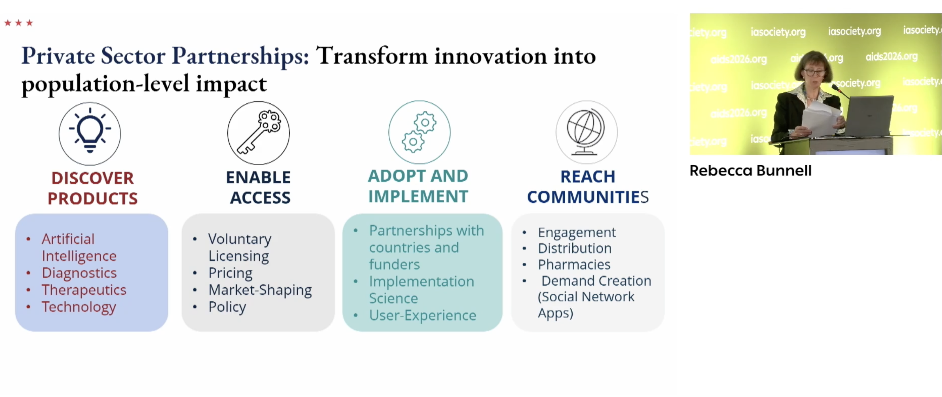
US PEPFAR/Bilateral MOUs and AI

Slide 33
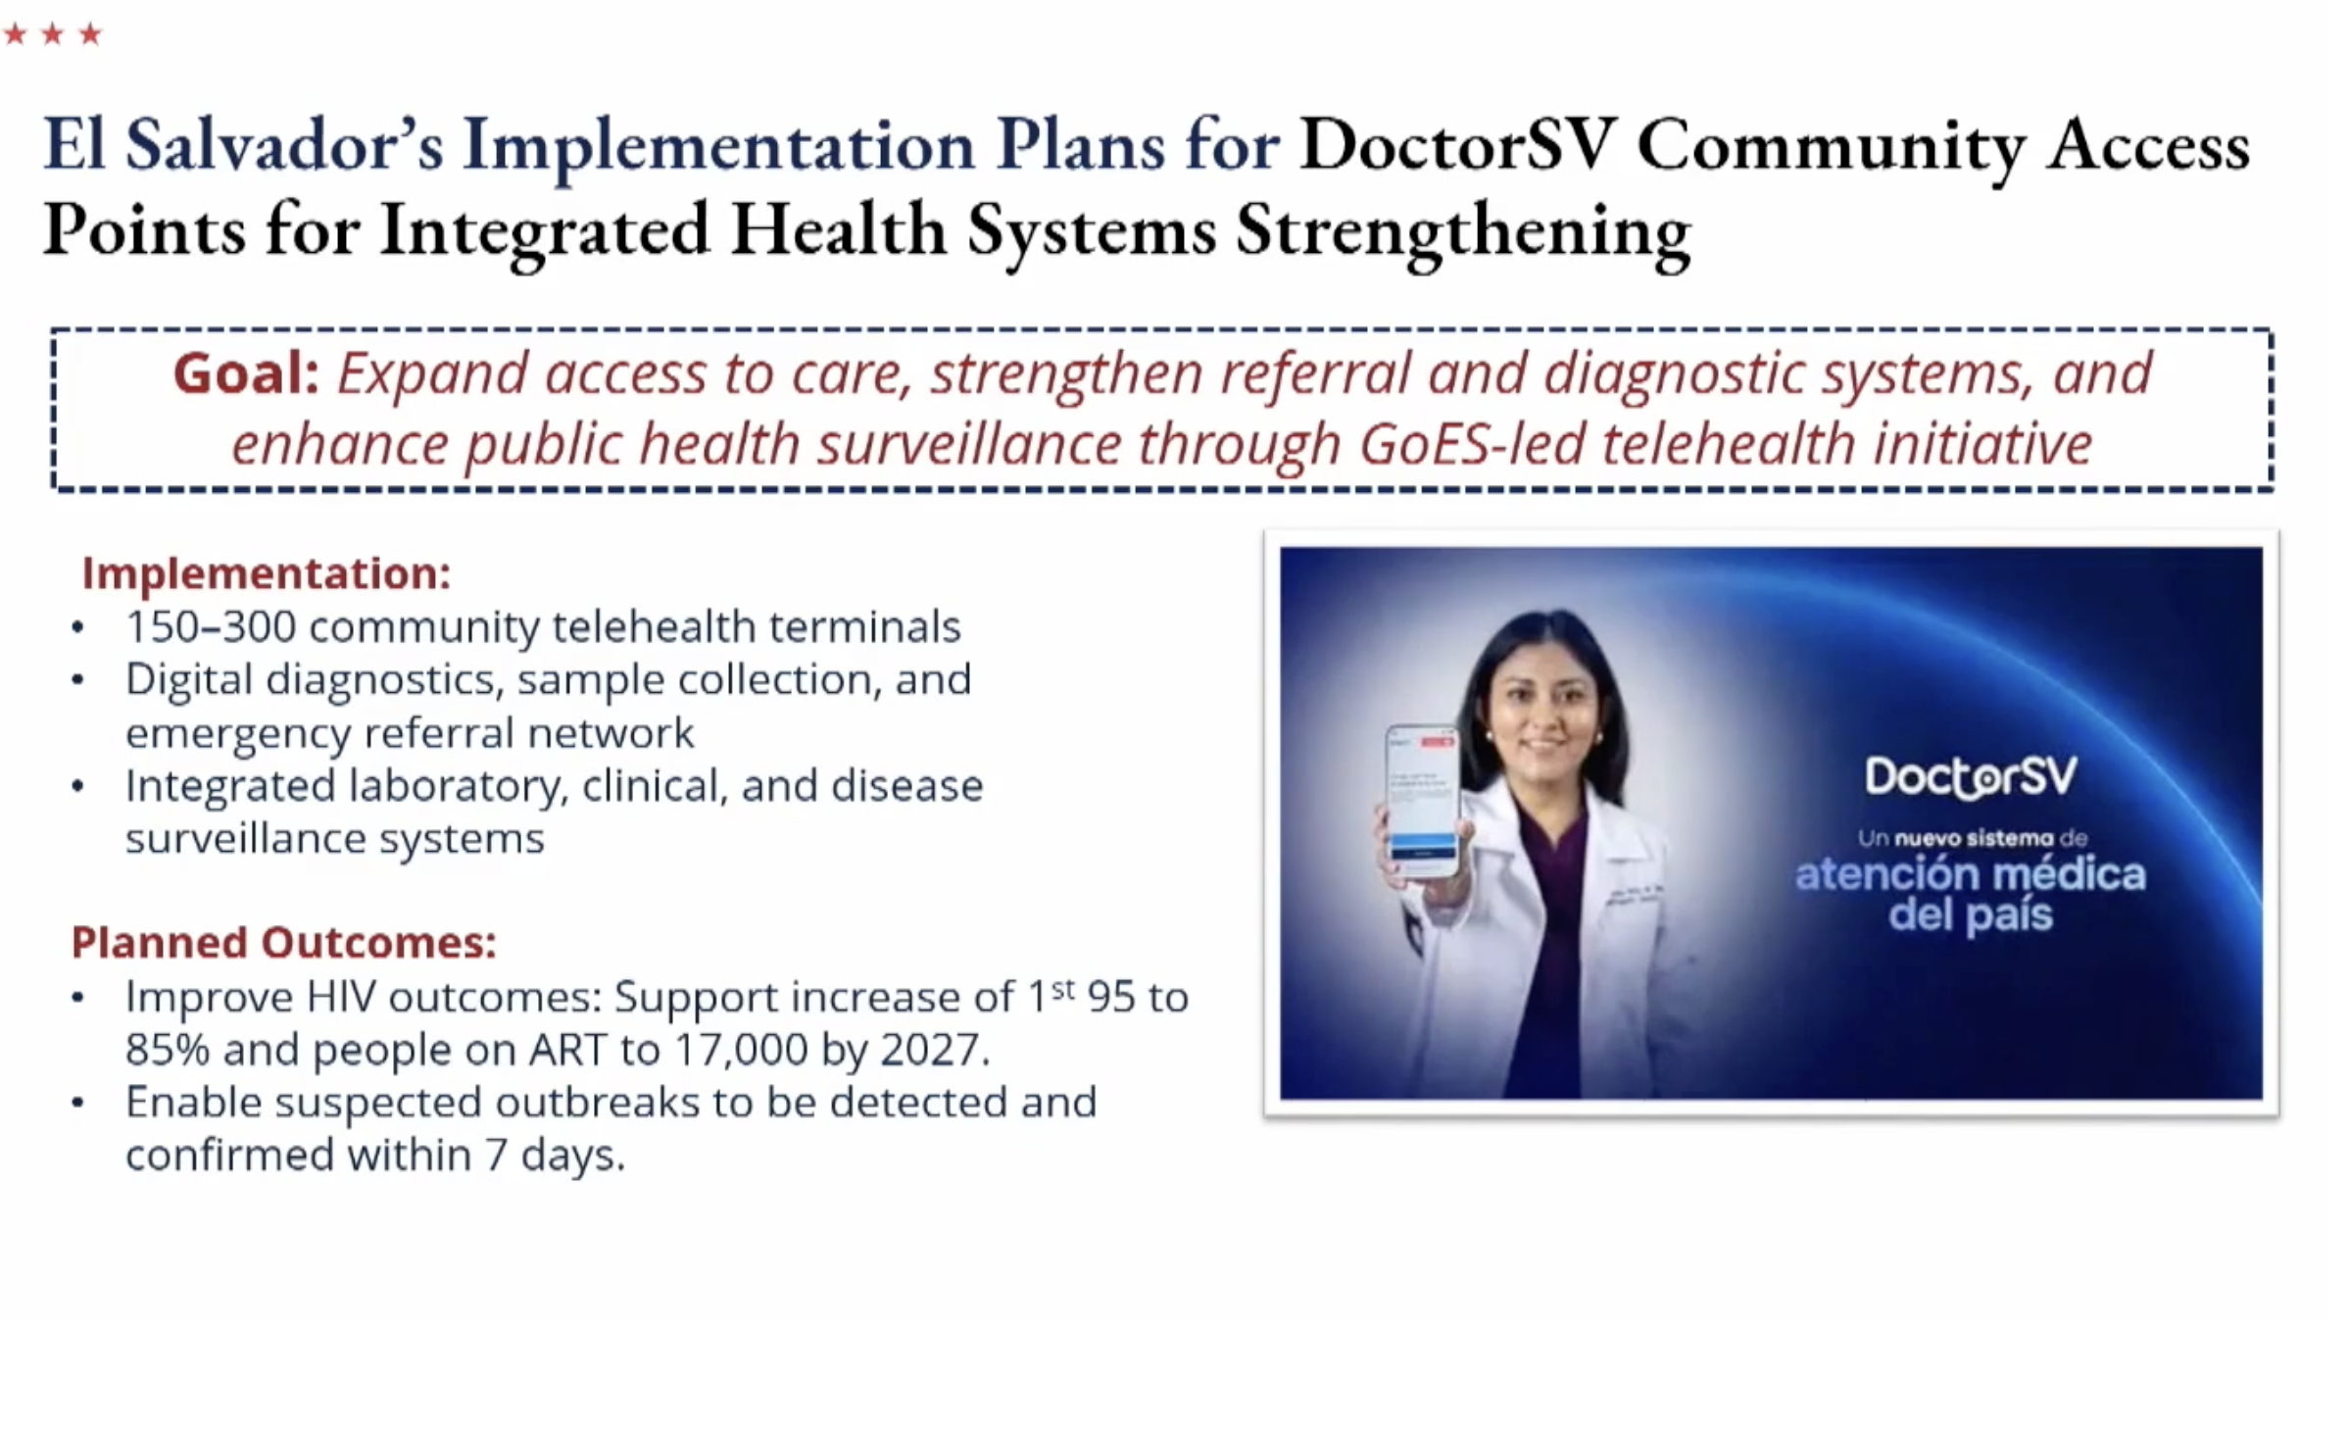
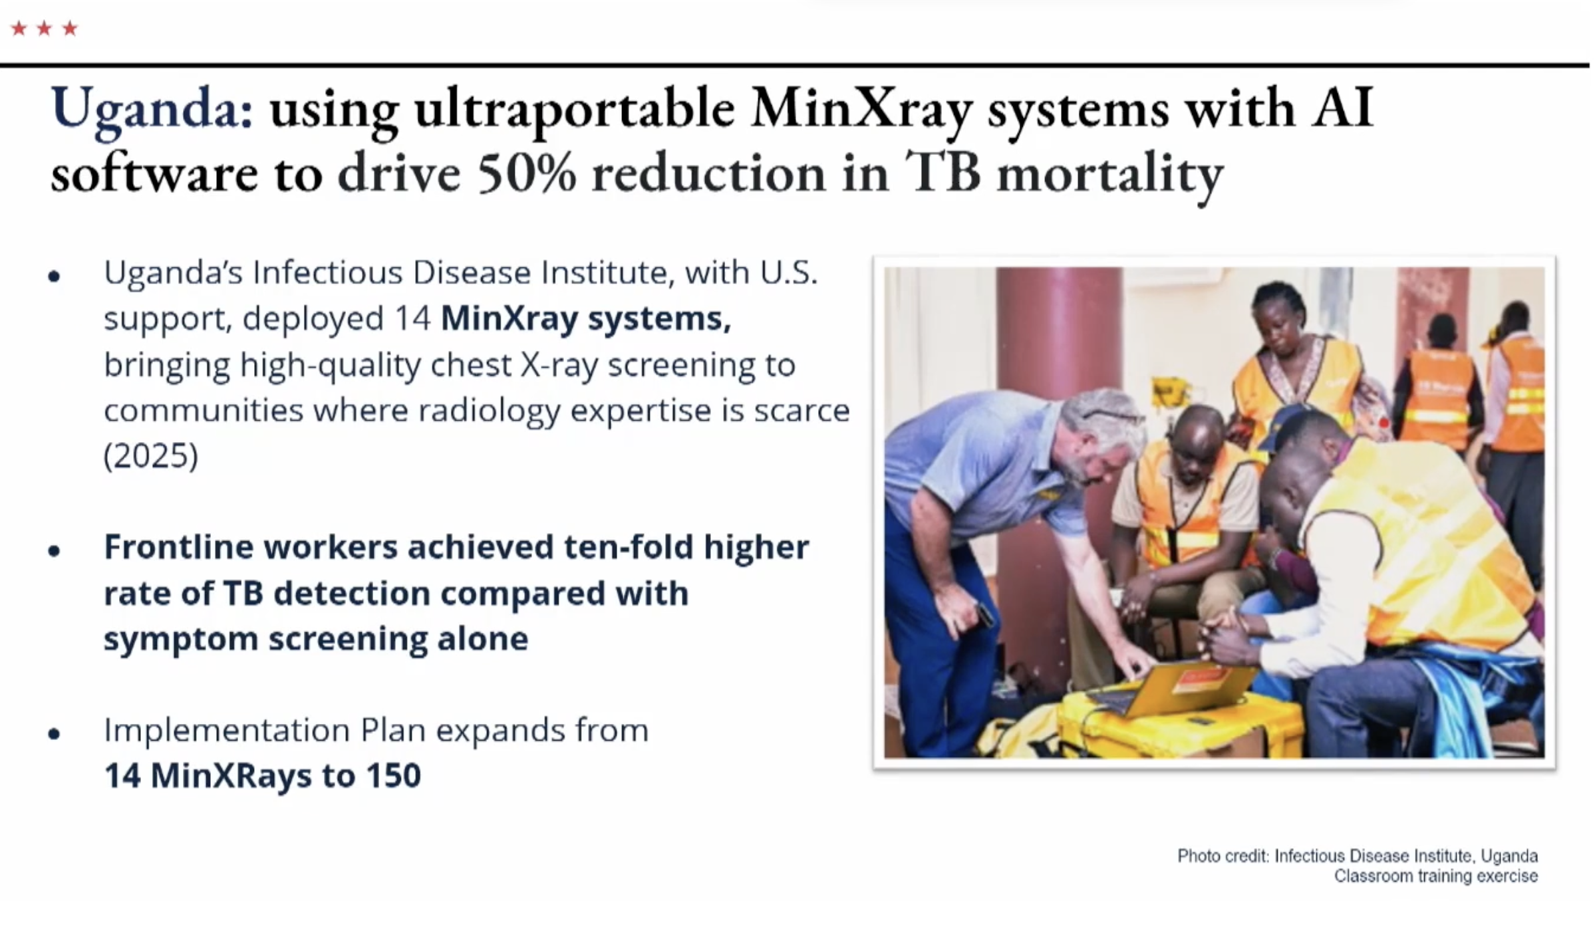
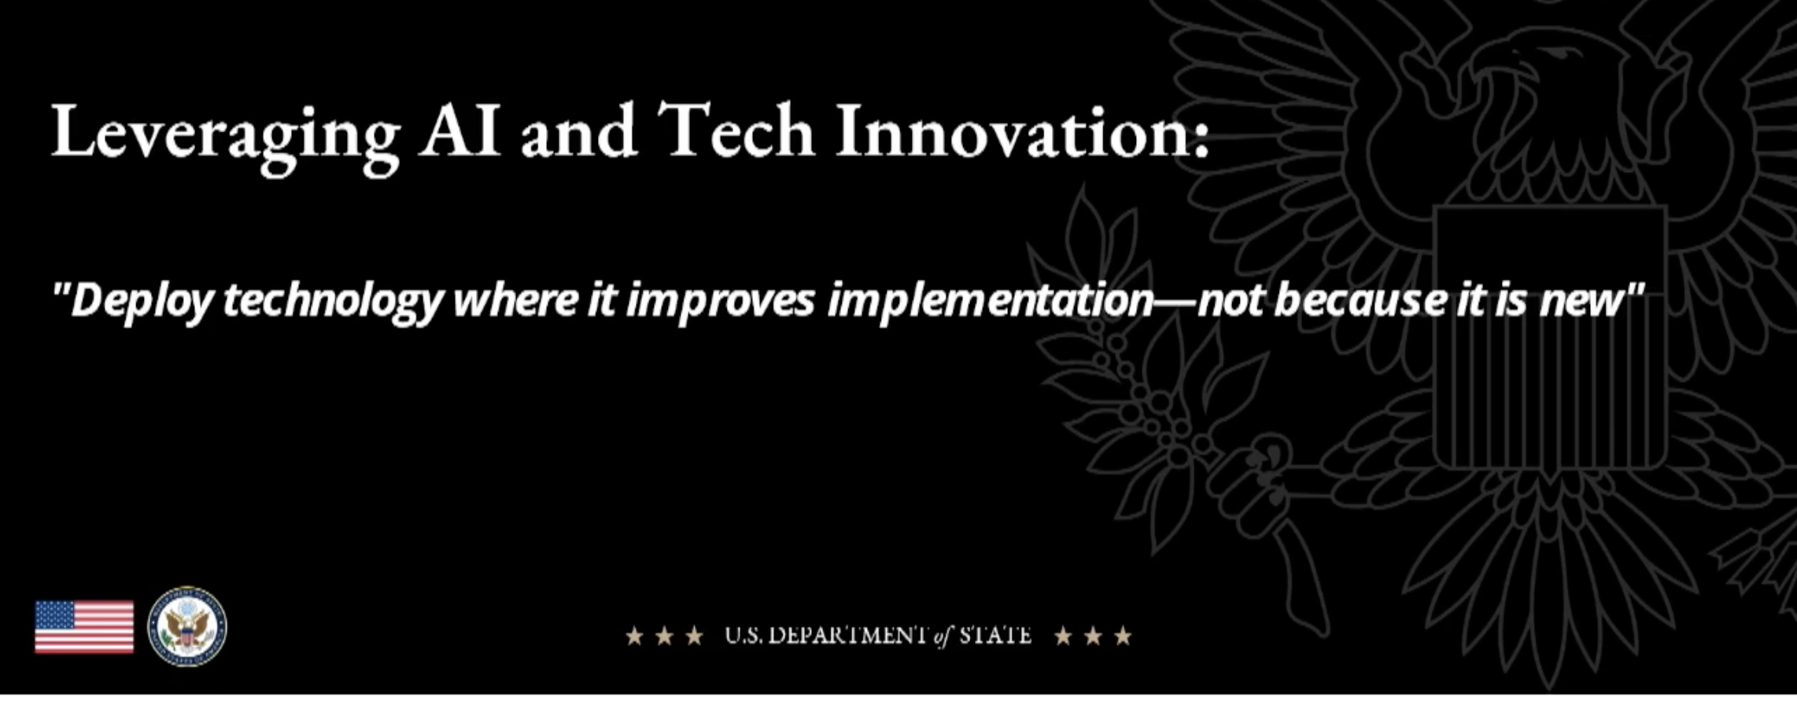

Slide 34
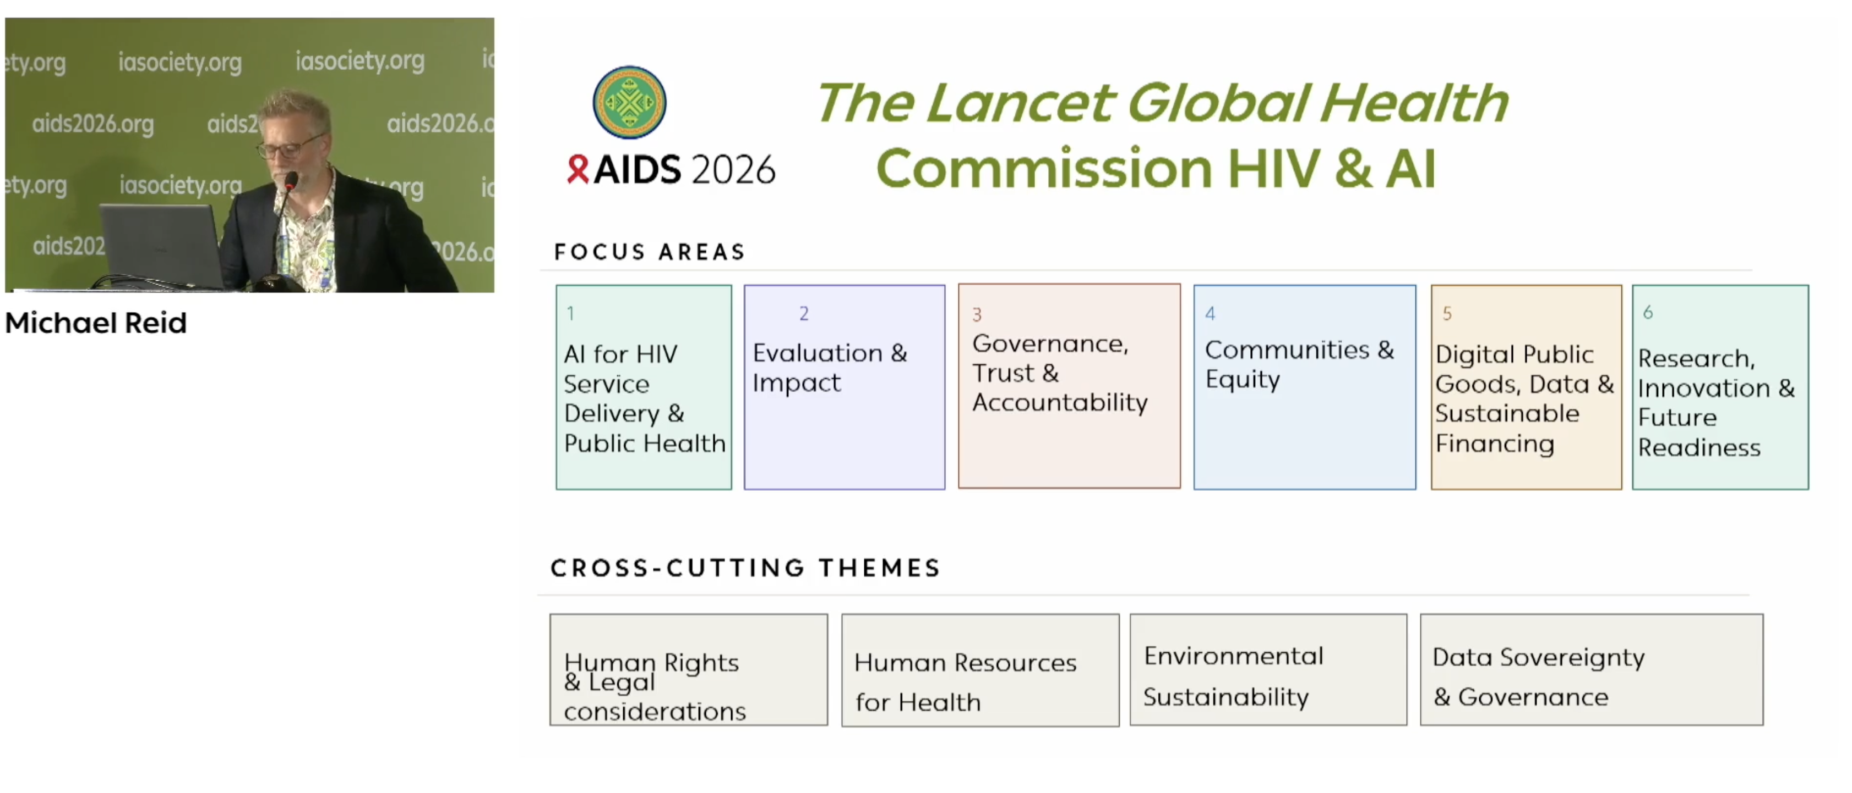
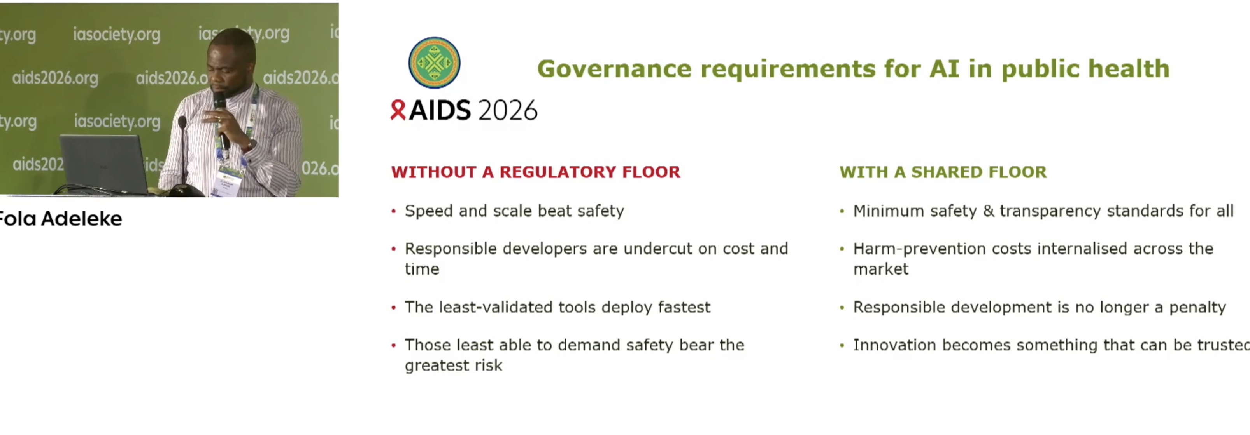

Watch this space!

Slide 35
Conclusion
AI is working but trust is what makes or breaks the product
Adoption depends on privacy, safety, community buy-in, and human oversight—not just technical performance.
Specialized beats generic
HIV/sexual health use cases are moving toward locally adapted, domain-specific AI tools rather than relying on general chatbots alone.
Human-in-the-loop is becoming standard
Clinician escalation, risk flagging, and safety monitoring are emerging as core design requirements in health AI.
The field needs to move from pilots to proof of outcomes
The key question is no longer whether people will use AI, but whether it improves linkage, retention, adherence, and health outcomes at scale.
Scale depends on systems, not just models
Governance, financing, interoperability, bias mitigation, and public-sector integration will determine whether AI delivers durable impact.

Slide 36
Thank you to all the presenters, collaborators
Jirair.Ratevosian@Duke.edu

