Slide 1
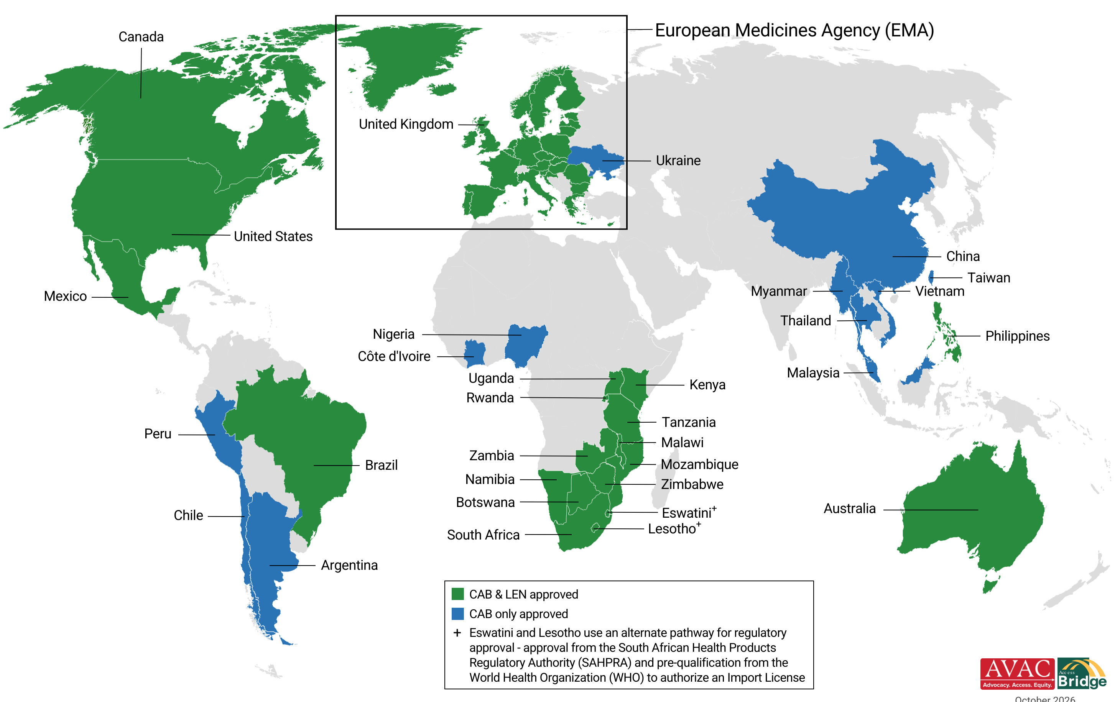
Injectable PrEP Regulatory Approvals
30 approvals for Cabotegravir; 20 approvals for Lenacapavir as of October 2026
Updated October 2026

