Slide 1
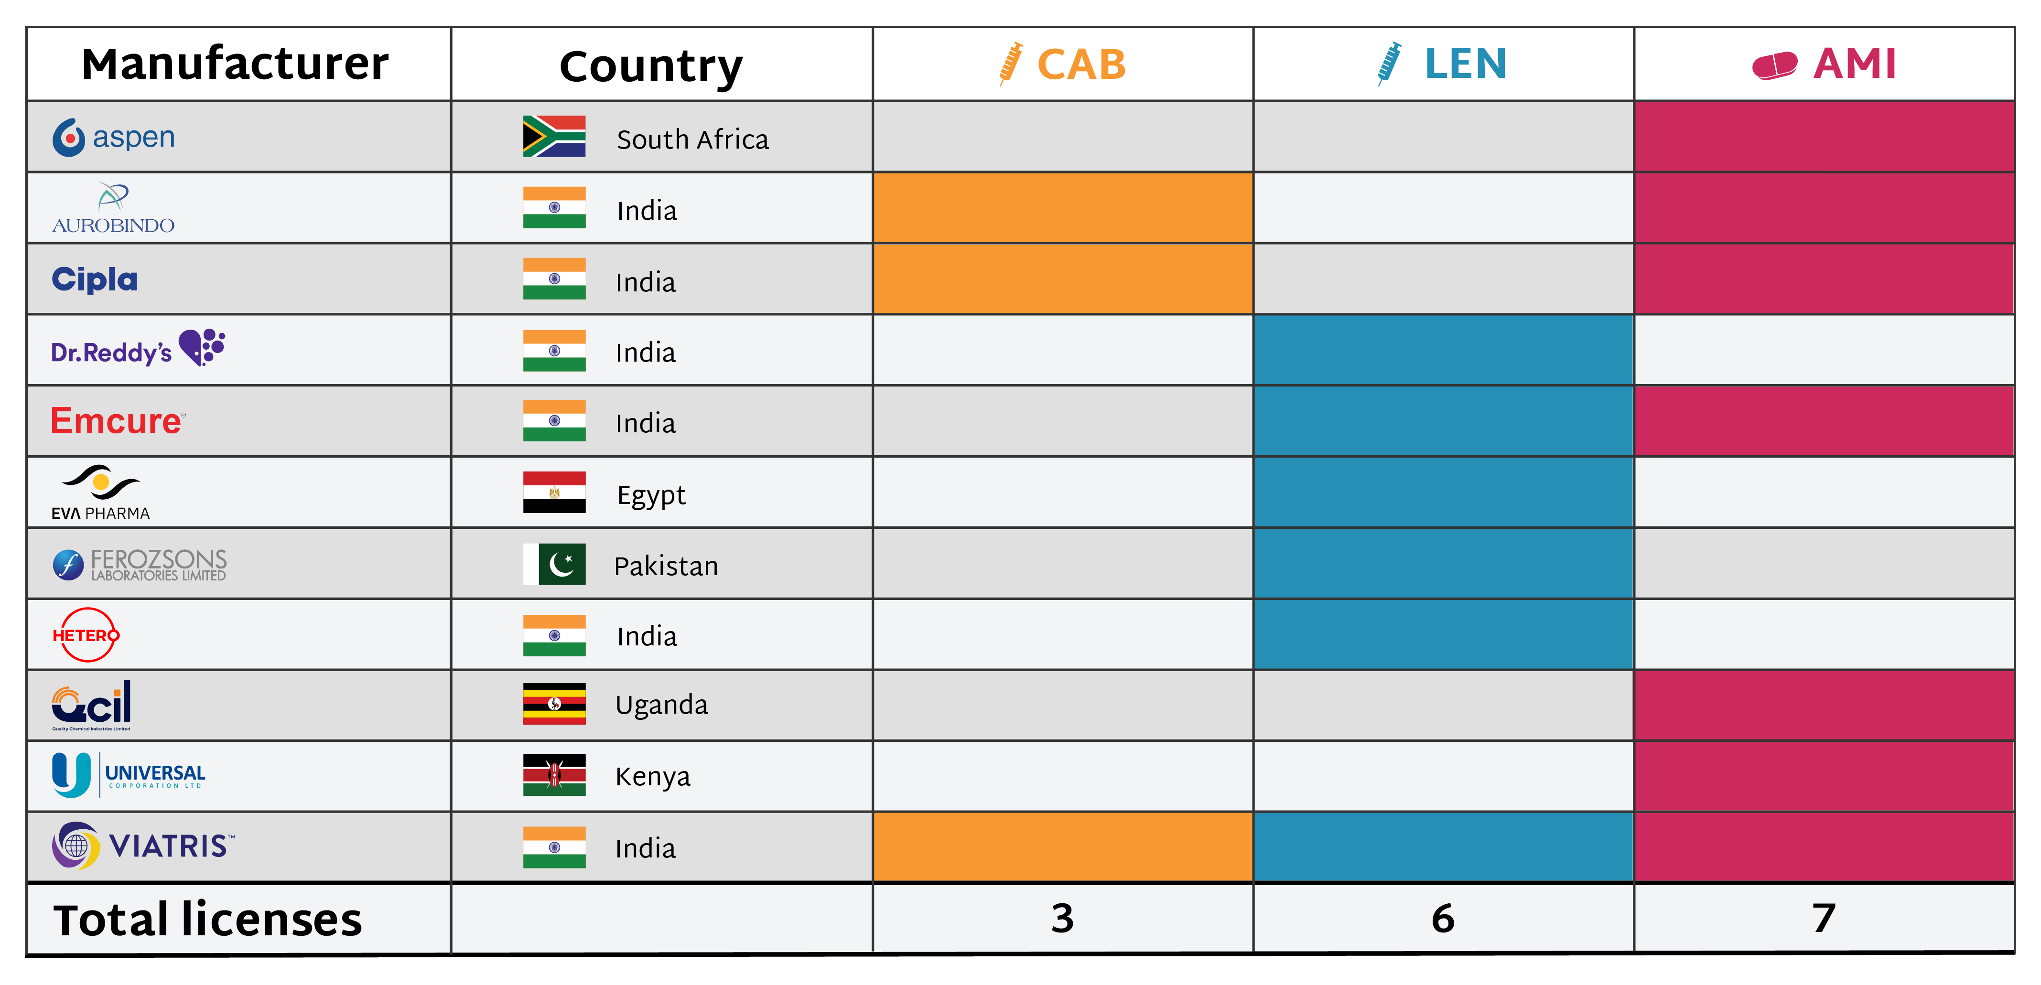
Long-Acting PrEP Generic Manufacturers
Licenses have been granted to manufacturers across multiple low- and middle-income countries to produce generic long-acting PrEP products. Cabotegravir (CAB) and Lenacapavir (LEN) are approved and rolling out, while alimatravir (AMI) is in Phase 3 efficacy trials. Generic manufacturing can play an important role in expanding access to PrEP, and licensing to three African manufacturers for AMI is a notable step toward strengthening regional supply and affordability.

