Slide 1
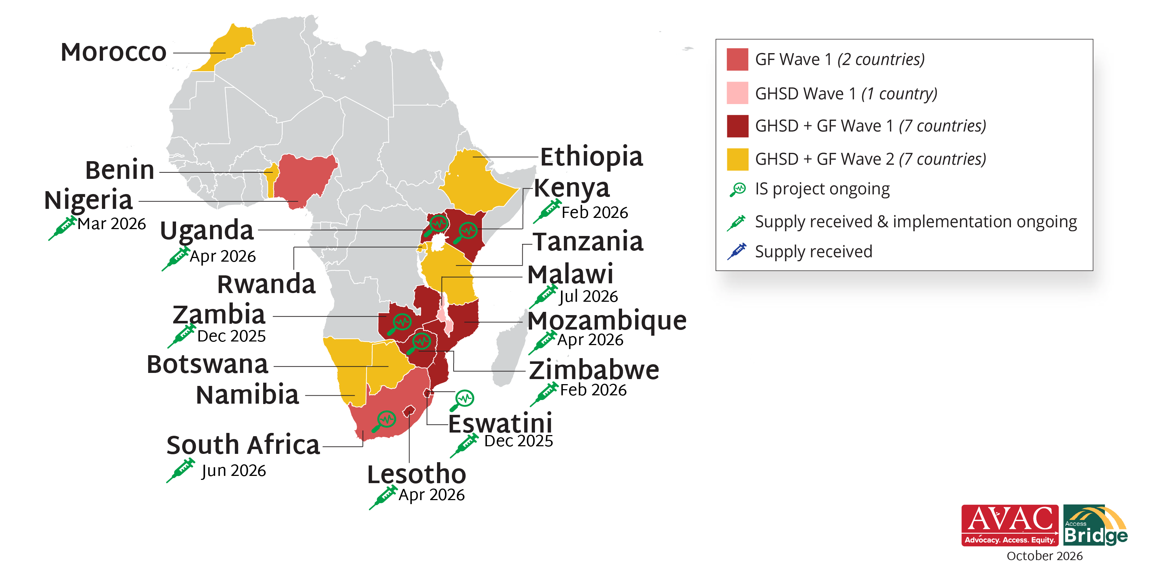
Lenacapavir for PrEP Rollout: Africa

